Slide 1



Fluoroquinolones and the associated risk of panic attacks: A systematic review and
active-comparator restricted disproportionality analysis
Keeirah Raguram, Mohammad Ali Omrani, Bala Swetha Baskaran, Niaz Chalabianloo, Flory Tsobo Muanda
Physiology and Pharmacology Department

Slide 2
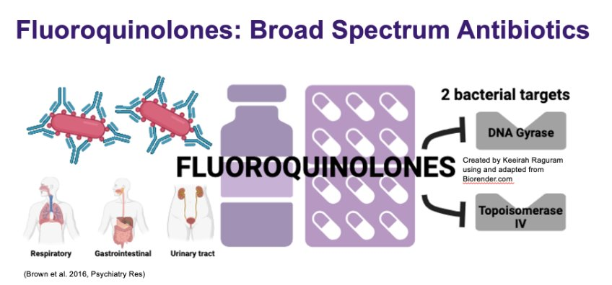

Background
Fluoroquinolones (FQs) are widely used broad‑spectrum antibiotics with high oral bioavailability.
FDA (2016) warned about mental health AEs (e.g., anxiety, delirium).
FQs cross the blood–brain barrier and may affect excitatory/inhibitory pathways.
Panic attacks are frequently reported yet underexplored in relation to FQs.

Slide 3
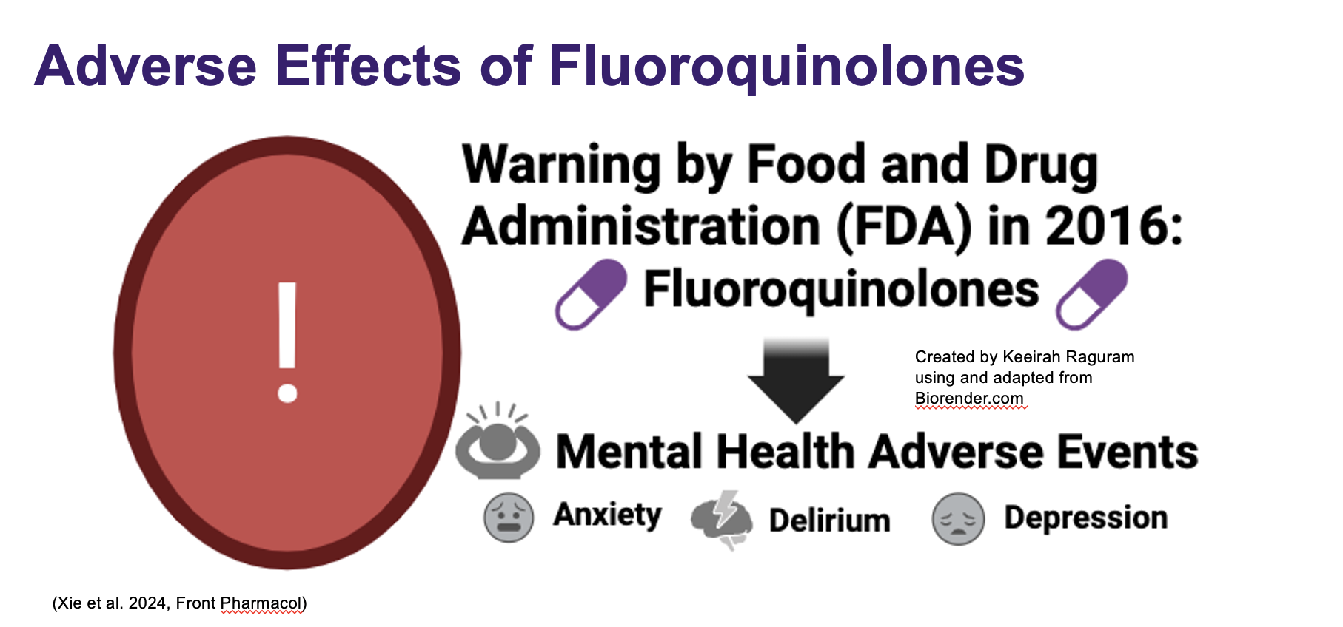

Slide 4
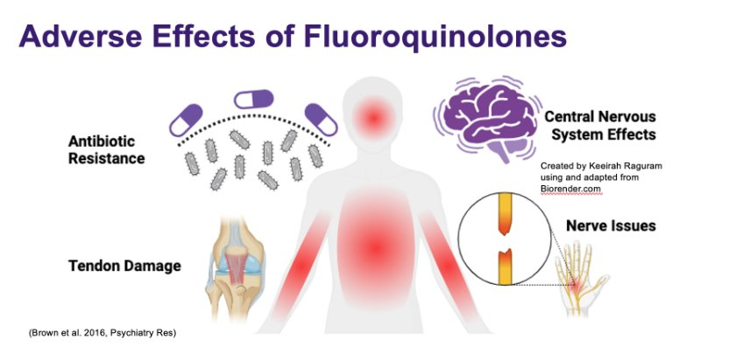
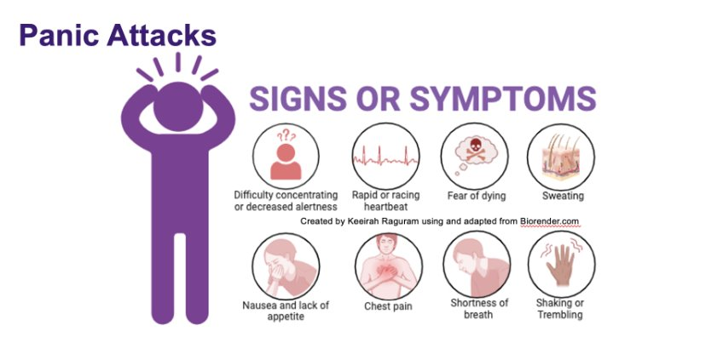

Slide 5


Aim & Methodological Approach
Aim
Fluoroquinolones (FQs) are associated with panic attacks.
Objectives
Systematically synthesize published evidence (trials, case reports) on panic attacks/acute anxiety with FQs.
Quantify disproportionate reporting of panic attacks for FQs vs active comparators (azithromycin, TMP-SMX).

Slide 6

Evidence gap
No prior systematic review focused on FQs→ panic attacks
Trials under-ascertain neuropsychiatric AEs
Real-world signal has not been quantified with an active-comparator approach.

Slide 7

Post-marketing Surveillance?
Post-marketing surveillance is the monitoring of drug safety after approval
It relies on spontaneous adverse event reports from patients, healthcare providers, and manufacturers
In the U.S., the FDA maintains the FAERS (FDA Adverse Event Reporting System) database
Contains millions of individual case safety reports (ICSRs).
Used to identify early safety signals for approved medications.
Disproportionality Analysis (DA) is used to detect potential drug–event associations as signal detection tools, not causal proof
Signal ≠ proof of harm, but a flag for further study
Drug use
Adverse event
Report to FDA
FAERS
Disproportionality Analysis
Signal detection

Slide 8
Study Overview
Literature Review
Summarize published evidence
Active Comparator-Restricted Disproportionality Analysis(ACR-DA) using FAERS
Explore real-world safety signals

Slide 9
RESULTS

Slide 10
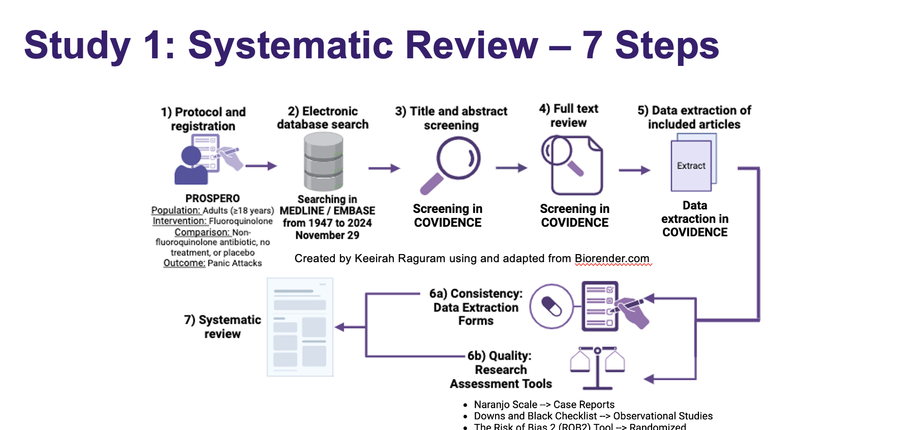

Slide 11


Literature Review – Methods
Databases searched: MEDLINE and EMBASE (to November 29, 2024)
Inclusion Criteria:
Population: Patients receiving Fluoroquinolone medications for bacterial infections.
Intervention: Fluoroquinolone antibiotic
Comparator: non-Fluoroquinolone, placebo or no treatment
Outcomes: Panic attack
Study Designs: Randomized controlled trials, cohort studies, case-control studies, and case reports

Slide 12

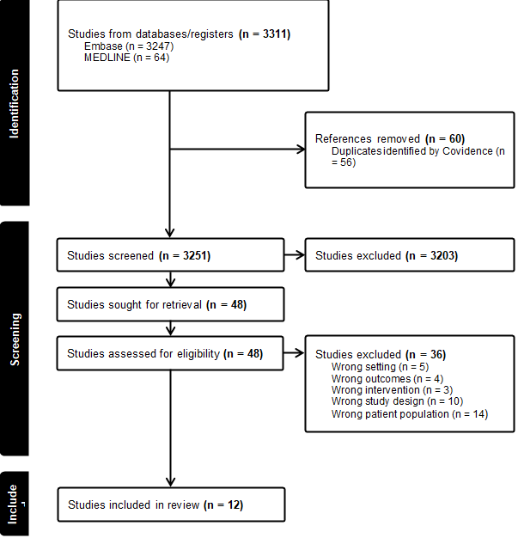
Literature Review – Findings
Trials (n=4): Panic/anxiety prevalence 0.5–1.8%. One head-to-head trial (levofloxacin vs cefuroxime): RR 3.08 (95% CI 0.63–15.15). Risk of bias: 3 high; 1 some concerns.
Case reports (n=8; 11 cases): Median age 32 (IQR 25–40); 45.5% male.
Indications: LRTI/acute bronchitis 36.4%, PID 18.2%, sinusitis 18.2%, others.
Agents: Levofloxacin 45.5%, moxifloxacin 36.4%, ofloxacin 18.2%.
Outcomes: Acute anxiety 81.8%, panic attacks 27.3% (some overlap possible).
Time to onset: median 48 h (IQR 5–72). Dechallenge: all but one stopped; time to relief median 1.5 days (IQR 1–5.5).

Slide 13
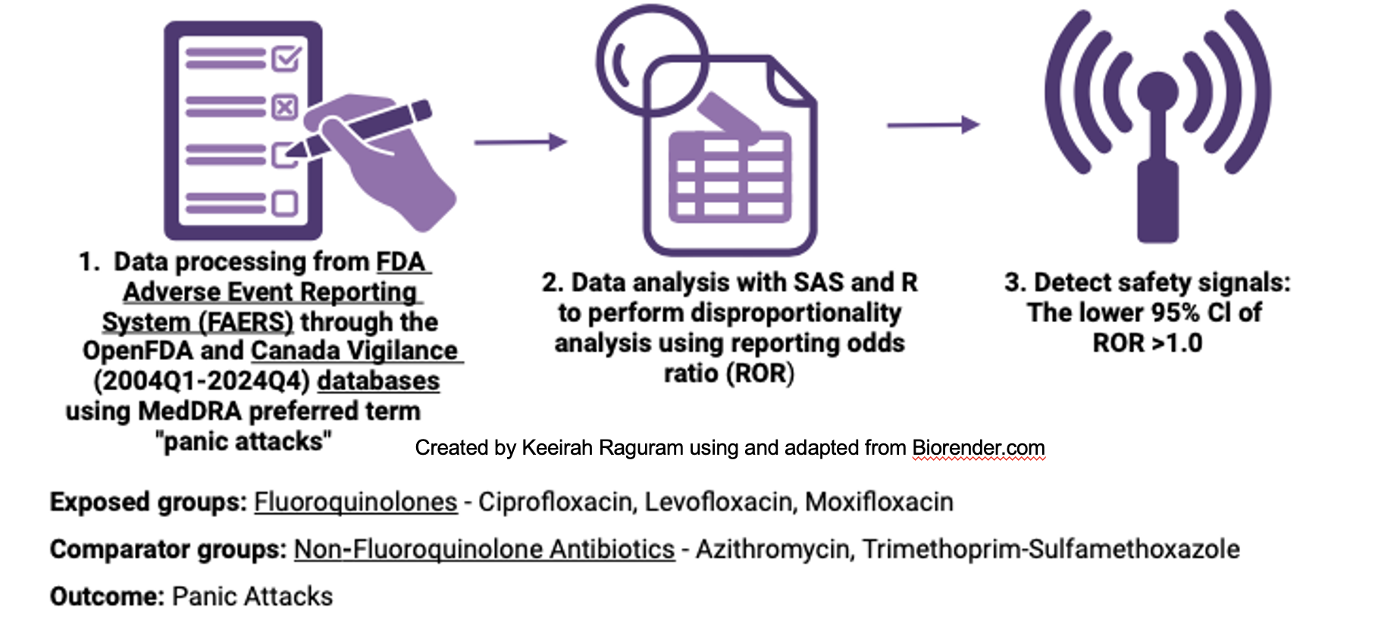
Study 2: Active-comparator disproportionality analysis

Slide 14



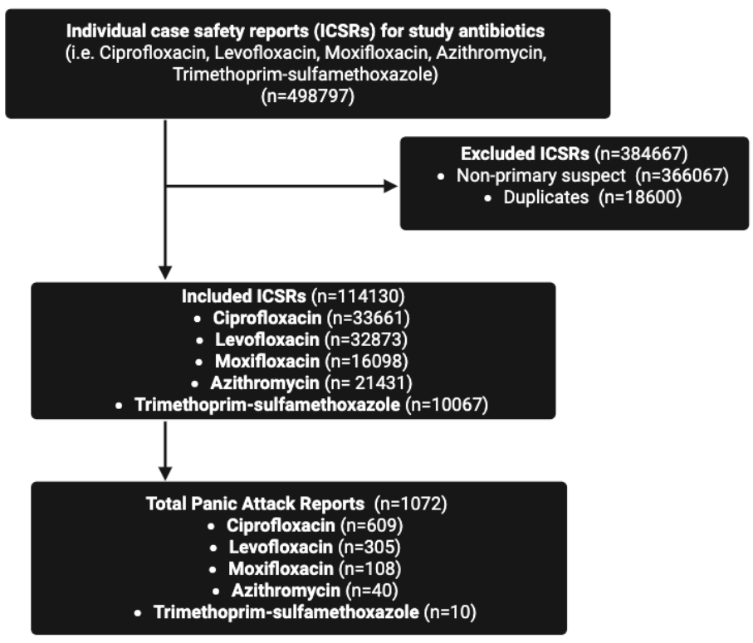
Who reports? ~45% aged 18–41 (FQs) female predominance across most FQs.
Onset: ~1.5–5 days after start (agent-dependent).
FQs vs azithromycin: ROR 6.69 (4.88–9.18); aROR 5.73 (4.16–7.88); IC025 > 0.
FQs vs TMP-SMX: ROR 12.59; aROR 12.20.
Ciprofloxacin vs azithromycin: ROR 9.85; aROR 8.68.
Ciprofloxacin vs TMP-SMX: ROR 18.51; aROR 16.58.
Within-class (cipro vs other FQs): ROR 2.17 (~2×).

Slide 15
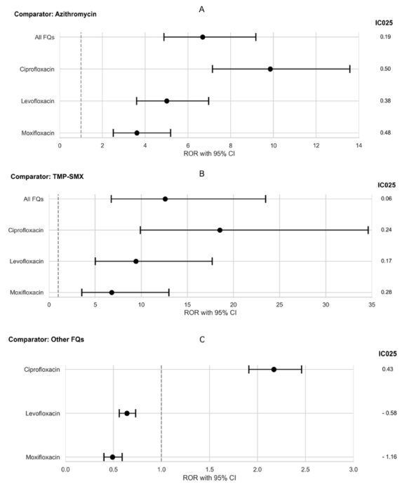
Forest plots for the ACR-DA of panic attacks for all fluoroquinolone compared to azithromycin or trimethoprim-sulfamethoxazole (TMP-SMX) or other FQs.

Slide 16

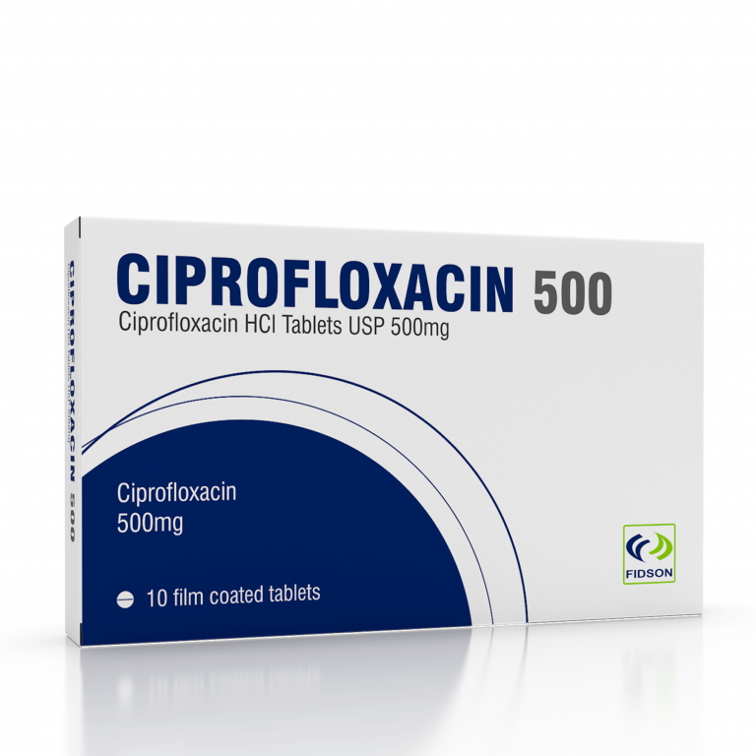

CONCLUSION
Signals converge: Literature + FAERS suggest an association between fluoroquinolones (FQs) and panic attacks, with early onset (≈1–5 days).
Magnitude: Disproportionate reporting vs comparators (azithromycin, TMP-SMX); ciprofloxacin shows the strongest signal (including within-class).
Evidence limits: Trials under-ascertain neuropsychiatric AEs; many case reports; meta-analysis not feasible; spontaneous reporting cannot prove causality.
Interpretation: Findings represent preliminary safety signals consistent across adjusted RORs and IC025 > 0, warranting caution and further study.

Slide 17


