Slide 1


Slide 2






PSP Real World Readiness Framework
Powered by
September 2025
www.cphin.ca
@CPHIN_CA
info@cphin.ca
1

Slide 3

What is CPHIN?
8

Slide 4








CPHIN Overview & Demonstration Projects
Vision: A health system continuously advancing through data and innovation
Mission:
CPHIN is a connector that enables collaboration between healthcare stakeholders (healthcare institutions, industry, government, academia) to accelerate innovation and improve health outcomes for Canadians
CPHIN’s demonstration project approach unites stakeholders to focus on the use and application of real-world data (RWD), a crucial step in moving toward a learning health system
Objectives:
Establish a collaboration model across healthcare ecosystem stakeholders including, CDA, Health Canada, Industry, Academics, Hospitals, Patients, and Payers
Design data sharing models and pathways for the collection and use of quality RWD for decision making
Cultivate widespread commitment to integrating RWE into strategic and clinical decision-making processes.
Why Demonstration Projects:
Conscious Collaboration: Show that public and private healthcare stakeholders can work together toward a common goal of a learning health system
Transparency and Trust: Engage key healthcare stakeholders from the outset, ensuring projects are transparent and designed to produce reliable, actionable data for regulatory, reimbursement, and clinical decision-making.
Focused Priorities: Enable stakeholders to concentrate on specific, high-impact topics, ensuring that individual demonstration projects drive targeted advancements.

Slide 5









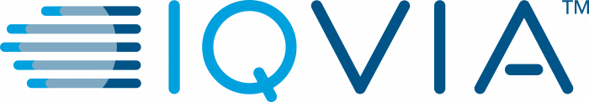
The PSP RWE framework was built in collaboration with partners across the healthcare landscape
Framework Development Team
Additional Project Partners
Feedback Committee
Core Team involved in developing the PSP Real World Readiness Framework and completing pilot analysis of PSPs against the framework
Additional Team involved in completing pilot analysis of PSPs against the established framework
Feedback committee established to review deliverables to enable cross organizational collaboration and additional industry feedback

Slide 6



The objective of this initiative is to advance the acceptance of PSP data in decision-making by key stakeholders
Project Objectives
Key Deliverables
Develop a Real-World Readiness Framework for PSP
Assess existing PSP datasets to evaluate the framework’s readiness
Improve trust across the ecosystem and drive better outcomes with the collaboration of many stakeholders
White Paper
Published Project Report
Collaboration with and feedback from key partners throughout the development of the framework and report
Notes:
To quickly recap on the parts of our PSP data project that we presented here last year, and spend a bit more time on some of the areas we’ve fleshed out since then.
This project now has 2 main deliverables:
1) A white paper describing a real-world readiness framework for secondary use of PSP data; and
2) A publication of an assessment of existing PSP datasets against this framework
And as always collaboration with and feedback from key partners is paramount to ensure the project deliverables are fit for purpose across the healthcare eco-system.

Slide 7
This project builds on Canadian and international initiatives to advance the utilization of PSP data as a trusted source of insights
Expected Project Impact:
Advance the acceptance of PSP data by decision-makers (CDA-AMC, INESSS, Payers) and other health ecosystem partners
Help bio-pharma and PSP vendors design their PSPs to collect data that can be used for decision-making
Demonstrate the positive impact of industry and broader ecosystem collaboration
Sources:
[1] CADTH: Guidance for Reporting Real-World Evidence - CADTH Methods and Guidelines | Guidance for Reporting Real-World Evidence
[2] ISPOR: UReQA Framework - ISPOR - Fit-for-Purpose Real-World Data Assessments in Oncology: A Call for Cross-Stakeholder Collaboration
[3] FDA: Real-World Evidence Program - download (fda.gov)
[4] Health Canada: Elements of Real-World Data / Evidence Quality throughout the Drug Product Life Cycle - Elements of real world data/evidence quality throughout the prescription drug product life cycle - Canada.ca
[5] BMC: Real-world data: A Brief Review of the Methods, Applications, Challenges and Opportunities - Real-world data: a brief review of the methods, applications, challenges and opportunities | BMC Medical Research Methodology | Full Text (biomedcentral.com)
[6] Duke Margolis Center for Health Policy: Determining Real-World Data’s Fitness for Use and the Role of Reliability - rwd_reliability.pdf (duke.edu)
[7] NIH: A Harmonized Data Quality Assessment Terminology and Framework for the Secondary Use of Electronic Health Record Data - A Harmonized Data Quality Assessment Terminology and Framework for the Secondary Use of Electronic Health Record Data - PMC (nih.gov)
Notes:
And to remind us all on the why of this project
We know PSPs are here to stay and there is significant investment in them, that and the recent policy changes from Health Canada, CDA-AMC, INESS and others comes an opportunity to unlock the data collected, identify any gaps and ensure data variables are consistent and usable for decision-making across the various interested partners.
Of course this will also enable better design of PSPs going forward, and it’s always beneficial to be able to demonstrate that this kind of partnership is both very feasible and fruitful, all while keeping the patient and their experience front of mind.
PAUSE

Slide 8
PSP Real-World Readiness Framework
1
2
3
Real-World Readiness Framework
Establishing Fit for Purpose Data
Identifying Use Cases
Data Variable Identification
Data Gaps
Consent
Notes:
Our framework is built with 3 main inputs:
First – we identified the right use cases for possible RWE use of PSP data
Next – we defined a common set of PSP data elements for RWE that would be acceptable for decision-making, specifically establishing data points and associated metrics, outcomes collected through PSPs
Finally – we established what minimum quality standards we would accept to assess the reliability and relevance of the data for across the chosen use cases
Across all 3 of these we wanted to ensure we were able to identify gaps in PSP data collection practices that hinder decision-making, and also consider constant requirements and associated challenges, albeit at a high level

Slide 9





Overall Program and Product Information
Disease Area
Source
Consent
Data Dictionary
Data Quality
Notes:
The PSP program-level overview covers:
Disease Area including Product, Method of Admin
Source (EMR systems) such as In-person presence (e.g. Infusion clinics) vs phone call
Consent, for example does the consent allow for public reporting of aggregated data
Does a program-level data dictionary exist? Is it kept updated?
Do data quality measures such as change/audit logs exist for the data on the system it’s collected within?

Slide 10




Specific Variable Information
Mandatory Collection
Any Compuatation
Field Name & Specifications
Source & Audit Trail
Assessed across Key Variables such as Age, Diagnoses, Past Medical History
Notes:
The Data Assessment:
Does the variable exist? If so - is it mandatory. In the example of age you’d expect these to both be yes
Is the variable computed or raw value? In most instances we’d expect that age is computed from date of birth and date of enrollment
Is the variable included in a data dictionary? If so – what’s it’s Field name and are there any Standard specifications. Again, using age as an example: how many decimal places (if any!) is it recorded to, perhaps values over 85 have to be confirmed
Does consent allow use of this variable (e.g. using OHIP number for linkage to other datasets)? Is there one source of truth if something is collected from both patients and HCPs for example? Are previous versions saved? Are there date/timestamps associated with updates?

Slide 11
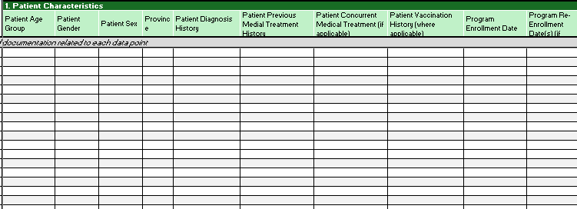
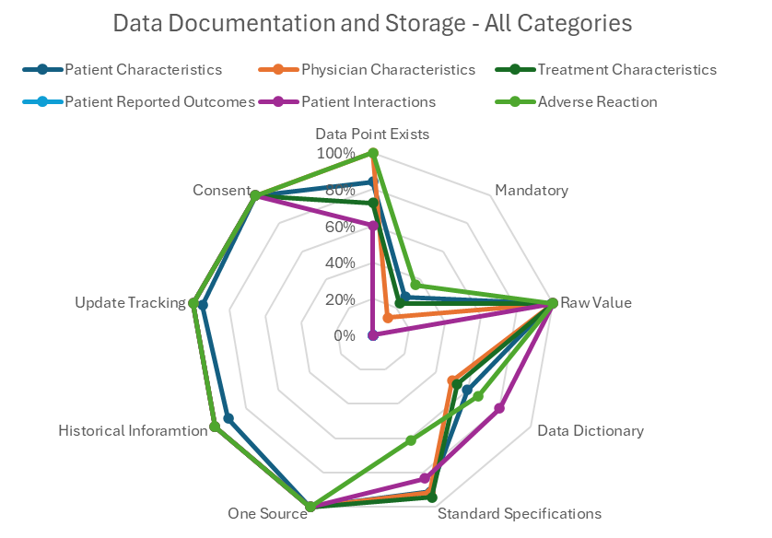
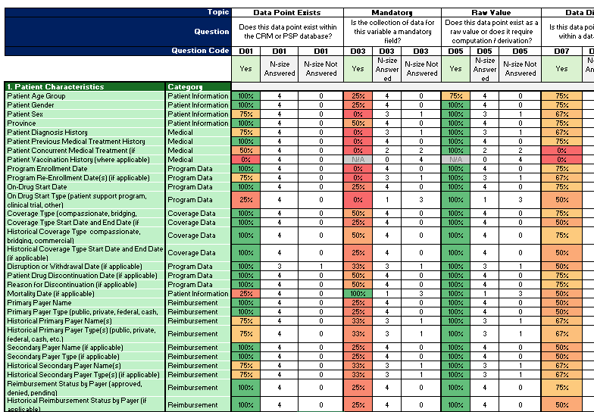
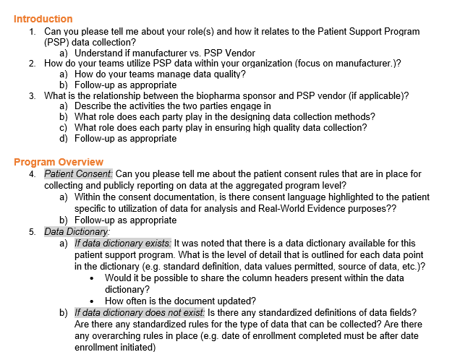
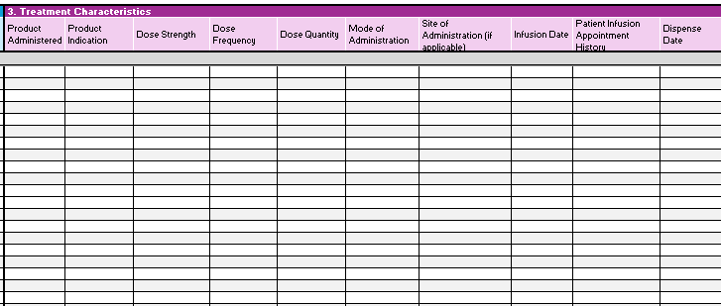
We have aggregated all the PSP analysis submissions at the data point level and rolled up analysis to overall categories
Aggregating PSP Assessment
Analysis at Data Point Level
Aggregated Analysis
Importing all raw data from each PSP assessment completed
Aggregating all raw data for each of the framework components: documentation and storage, data collection and data quality
Completing analysis at the data point level (~58 total data points) against each of the ~36 different analysis questions
Report aggregated metrics for all analysis questions at the data point level (excluding open answer questions)
Data Categories
Report aggregated metrics rolled up to the data category level¹ (e.g., patient characteristics)
Allows for an understanding of differences in trends across different data types
1: All Categories - Patient Characteristics, Physician Characteristics, Treatment Characteristics, Patient Reported Outcomes, Patient Interactions and Adverse Reactions

Slide 12
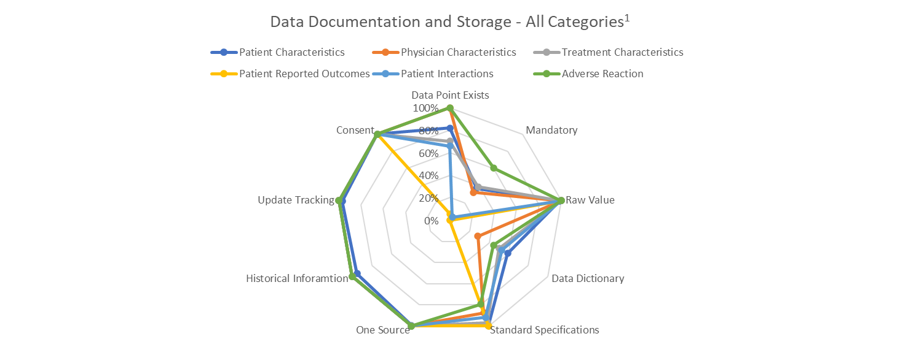
Within the analyzed PSPs, patient reported outcomes are rarely collected and there is a low level of data documentaiton
Preliminary Analysis for Data Representation Purposes
Data Point Existing
Patient Reported Outcomes are rarely collected across assessed PSPs
Within all other categories ~65-100% of listed data points are collected
Mandatory Data Point Collection
Majority of data points are not mandatory for PSP data collection (highest below)
AE: ~60%,Treatment Characteristics ~40%, Treatment Characteristics ~35%
Data Dictionary
Across all categories, an average of ~40% of data points are documented within data dictionaries
Percent of Data Points with Standard Specifications
~90-100% of patient interactions, treatment and patient characteristics
~80-89% of physician characteristics and adversereactions
Other Categories
All other categories had ~90-100% of aggregated data points conforming to the following: one source of truth for the data point, ability to track historical information, ability to track updates and consent to report on the data point
1: All Categories - Patient Characteristics, Physician Characteristics, Treatment Characteristics, Patient Reported Outcomes, Patient Interactions and Adverse Reactions
2: See Appendix for full list of data points within each category

Slide 13
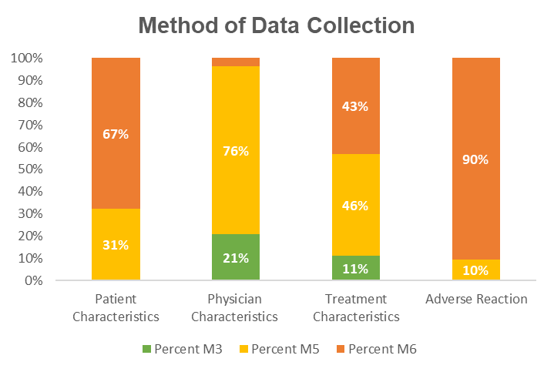
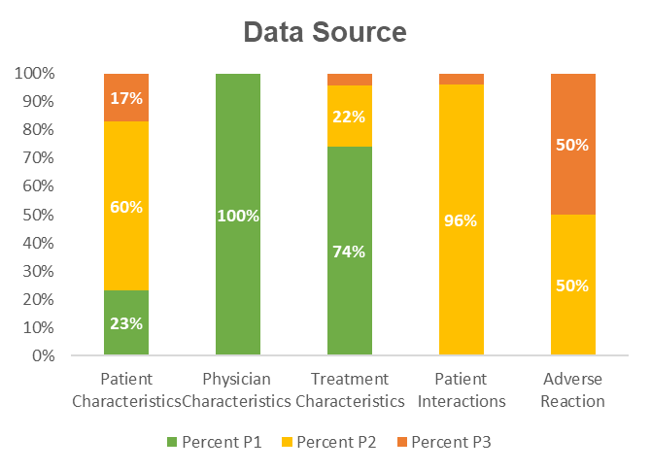

Although majority of data is manually collected and entered into a digital system, the source is from trained professionals
Preliminary Analysis for Data Representation Purposes
Data Collection:
Data Source:
Method by which information is inputted into the digital system
Source of information which is inputted into the digital system
M3: Data collected and integrated through automated databases
M5: Manually collected paper-based forms completed by patient or HCP and scanned and stored within digital system
M6: Physician notes or other manually collected data entered into a digital system
P1: Medical Records – Data originating from the supervision of healthcare professionals
P2: Standard Health Adjacent Records – Sources with data originating from the supervision of a trained professional
P3: Other Sources – Wide range of sources without the supervision of any trained professional
Majority of data is manually collected
Implications
Majority of data is manually collected – high potential for manual error of entry
Forms may be scanned and stored without entry of datapoint as a field in the database
High variability in information across different paper-based forms
Implications
High level of data reliability since majority of the data source is under the supervision of a healthcare professional or trained professional
1: All Categories - Patient Characteristics, Physician Characteristics, Treatment Characteristics, Patient Reported Outcomes, Patient Interactions and Adverse Reactions
2: See Appendix for full list of data points within each category

Slide 14



There are three levels from which we can view the plan to realize impact through the use of PSP data
Framework Learnings
Implement learnings from the framework analysis, leveraging the document as a source for setting up PSP programs with RWE data analysis as a consideration
PSP Program Owners
Usage of the developed guidelines as a foundation to better proceed in evidentiary objectives
Evidence Consumers
Understand how to make use of the framework to empower program owners to generate higher quality data inputs for decision making processes
1
2
3

Slide 15



Want to Learn More?
PSP Real World Readiness Framework White Paper
We want to hear your feedback
(answer via QR Code):
Would you want to be included in future project updates?
What feedback or additional questions do you have regarding the framework / analysis?
What roadblocks have you faced in utilizing PSP data?
8

Slide 16

Questions?

Slide 17
Thank you!
Website: https://www.cphin.ca/
Contact: Info@CPHIN.ca
8

Slide 18



Appendix
8

Slide 19
Fit For Use Data
PSP Protocol
Use Case Definition
Consent
Data Variable Identification
Establishing a Data Dictionary
Data Source Prioritization
Data Quality
Data Analysis
Establishing Fit For Purpose Data
Data Relevancy
Data Representativeness
Notes:
To establish what a fit for purpose dataset looked like we landed on this flow, which can be applied to an already existing PSP dataset or be used when setting up a new PSP.
PSP Protocol: What are the primary PSP objectives
Consent: What data is being / can be collected and what can it be used for?
Data Dictionary: What are the data points collected
Data Source Proritisation: What is the source of the data and collection method used?
Data Quality: How reliable and trusted is this data?
Data Analysis (including planning): How are the metrics necessary for use case evaluation planned on being calculated?
Data Relevancy: Are the calculated metrics in line with existing literature?
Data Represnetaivness: Is the dataset a representative of the broader PSP patient pool, Canadian patient pool, and under-served/at-risk population groups

Slide 20
Use Cases to Anchor the Framework and Variable Domains
Use Cases
1. Reimbursement
2. Patient Experience & Outcomes
3. Regulatory
Regulatory
Product Effectiveness
Process
Improvement
Variable Domains
Treatment Characteristics
Patient Reported Outcomes
Patient Characteristics
Physician Characteristics
Equity
Considerations
Adverse Reaction Documentation
Notes:
Canvassing our respective organisations landed us on 3 external use cases to base our framework on:
The 3 external are: Reimbursement; Patient Experience and Outcomes: and Regulatory.
By looking at the variables required for each use case we identified domains that resonated across various therapeutic areas, even if the specifics differed.
We did have some discussion on if Health Equity should be it’s own use case but consensus was that really all of these use cases would have Health Equity input and so we should rather ensure this was kept front of mind, by for example considering race, ethnicity, geographical area and other possible determinants of health in-equity

Slide 21


Envision Framework being Leveraged by PSP Vendors, Biopharma, Patients and HTA/Payers
PSP Vendors
Inform the design of PSPs that collect fit-for-purpose data
Biopharma
Coordinate with vendors to design programs
Patients
Enable patients to better understand how their data is being used
HTA / Payers
Increase the impact of PSP data for decision-making in the right situations
Notes:
Circling back to the why we’re doing this project,
Our hopes and dreams are that this can be of service to many aspects of those involved in healthcare from Health Technology Assessors through to the patients who are using these PSP services for a variety of reasons.
Mention we have some public and private payers in the works

Slide 22
Variable Domains Within the Use Cases
Patient Characteristics
Age
Gender
Physician Characteristics
Specialty
Province
Treatment Characteristics
Mode of Administration
Dosing
Patient Reported Outcomes
Biometric Data from Wearable
Quality of Life
Adverse Reaction Documentation
Type
Seriousness
Notes:
We found that the specific variables required for each use case differed between therapeutic areas but could be broadly bucketed into domains such as:
Patient characteristics (e.g. age ),
Physician characteristic (e.g. speciality),
Treatment Characteristics (e.g mode of administration)
Patient Interactions (e.g patient call )
Patient Reported Outcomes (e.g. WAPI)
Adverse Reaction Documentation (e.g. Seriousness)

Slide 23








0
Establishing a Data Dictionary
Data Source Prioritization
Data Quality
Data Analysis Plan
Data Relevancy
Data Representativeness
A robust consent documentation that takes various nuances into consideration can be instrumental in elevating any organization’s RWE capability
Challenges to Consider for Expanding Consent Documentation:
Key elements that should be captured in consent documentation
Are the potential outcomes and nuances of Bill C-27 being addressed in consent documentation?
Expanded restrictions around implied data analysis consent may result in the need for amendments to existing consents in place
Consent to collect the data point itself
RWE specific consent (if possible)
Procedure to withdraw consent
No punitive action for patients not providing consent
Purposes for which the data will be used
Bill C-27
Which stakeholders will be responsible as the data custodian of the consent documentation and the resulting database?
Who is going to absorb the cost of setting / maintaining the database?
Data Users
Data Controllers
(PSP Vendor)
Data Processor
(Pharma Manufacturers, non-pharma entities, etc. )
Data Ownership
Types of Data Usage
Expanded consent will enable rich data collection. However, it would also result in more comprehensive capture of data points that are directly/tangentially related to adverse reactions.
Internal Use
(Internal company stakeholders)
Quasi External Use
(e.g., Health Canada, CADTH)
External Use
(PSP Vendors, Private Payers, etc.)
Adverse Reaction Reporting
Note: When collecting datasets that may impact AE reporting, connect with your pharma co-vigilance team in advance

Slide 24

1
Establishing a Data Dictionary
Data Source Prioritization
Data Quality
Data Analysis Plan
Data Relevancy
Data Representativeness
The program data dictionary will inform the project specific data dictionary to be used for use case analysis
The use case will inform which subset of data from the program data dictionary is needed for project analysis
Decision of use case to be evaluated
Creating a New Program
Evaluating a Program
Program Data Dictionary
Project Specific Data Dictionary
Program data dictionary, encompassing all data collected within PSP
Subset of program data dictionary, consisting of data to be used for project
Use Case Definition

Slide 25




2
Establishing a Data Dictionary
Data Source Prioritization
Data Quality
Data Analysis Plan
Data Relevancy
Data Representativeness
Prioritization order of various PSP data input/capture methods has been defined based on the level of trust in the data source
Data Provider
Prioritization of Data Input Method
P1: Medical Records
Sources with data originating from routine medical care under the supervision of healthcare professionals⁴
Healthcare Providers Collecting Patient History and Medical Care Data for PSP Administration¹
Healthcare Providers
Pharmacies
P2: Standardized Health Adjacent Records
Patients /
Caregivers
Pharmacy Dispense Data^{2,3}
PSP Administration Data
(e.g., Treatment Discontinuaiton Date, Insurance Type, etc.)
Healthcare
Technology
Sources with data originating from the supervision of a trained professional⁴
PSP Case Manager
P3: Other Sources
Wide range of sources containing data collected without the supervision of any trained professional⁴
Self / Caregiver Reported Patient Health Data
(e.g., Apps)
Biometric Patient Health Data
(Personal devices e.g., wearables)
CRM System
1: Note: Third party vendors can be contracted vendor by the physician’s office to be responsible for collecting and managing data on behalf of the physician’s office
2: Data sources may not be available to inform PSP data sets
3: Sources may have limited completeness due to patient consent and capture of non-PSP specialty pharmacy data
4: Integration of real-world evidence from different data sources in health technology assessment: here

Slide 26
2
Establishing a Data Dictionary
Data Source Prioritization
Data Quality
Data Analysis Plan
Data Relevancy
Data Representativeness
Prioritization of data collection methods (applicable for all data sources) has been defined as follows:
Methods of Data Collection
Information Collected Directly into Digital System
Manually Collected Information Entered into Digital System
M1: Data automatically collected via cloud-based connection and integration (e.g., a wearable or device)
M2: Data collected digitally by HCP via structured database or validated assessment tool (e.g., EMR, digital EQ-5D survey)
M3: Data collected and integrated through automated databases (e.g., pharmacy ordering systems)
M4: Raw data manually collected by HCP with a validated assessment tool and saved within digital system (e.g., paper-based EQ-5D)
M5: Paper-based forms completd by patient or HCP scanned and stored within digital system (e.g., manual enrollement forms, infusion reports entered into PSP database)
M6: Physician notes or other manually collected data saved within digital system (e.g., manual records entered into EMR or CRM system)
Validated assessment tools are questionnaires with established guidelines which have been leveraged for capturing patient reported outcomes in clinical studies

Slide 27


3
Establishing a Data Dictionary
Data Source Prioritization
Data Quality
Data Analysis Plan
Data Relevancy
Data Representativeness
Data quality assessment for any PSP data points will entail comprehensive validations for completeness, accuracy and transparency
Data Quality
Data Completeness
Data Accuracy
Data Transparency
Level of data completeness for each PSP record
Amount of data captured based on patient and HCP consent
Dataset representativeness of program patient population
Data collection method / source used to capture data points
Data quality measures in place to validate data points
Data persistance to ensure that there is complete capture of records between data refreshes
Data provenance: documented trail that accounts for the origin of a piece of data, where it has moved from to where it is presently¹, data refreshes and efforts to address / mitigate sources of bias²
Extent to which the data is representative of the broader patient pool
Exent to which data covers under-served populations / at-risk patient groups – will dictate the ability of addressing any inequites
Control
Assurance
1: National Library of Medicine: Data Provenance: here
2: CADTH Guidance for Reporting Real-World Evidence - CADTH Methods and Guidelines: here

Slide 28
The following illustrative example demonstrates how the framework will be used to evaluate PSP data quality
3
Establishing a Data Dictionary
Data Source Prioritization
Data Quality
Data Analysis Plan
Data Relevancy
Data Representativeness
Index Date
Illustrative Example – Non-Exhaustive
Data Completeness^{1,2}
Data Accuracy
Data Transparency
Quality Control^{1,2}
Quality Assurance^{1,2}
Data Persistance^{1,2}
X% of index date have missing, or unknown variables
X% of patients have associated post-infusion/injection reports or pharmacy dispense data
…
X% of fields conform to index date specifications for data type and length
X% of fields contain values outside of index date specification
X% of fields have non-permissible missing values
…
X% of fields have future dates (dates beyond the day of refresh)
X% of patients have illogical dates (e.g., index date before birth date)
X% of the records have extreme values (values that fall in the lowest or highest of categories)
…
X% decrease in index dates associated with patient population between refreshed data
…
NOTE: The value of X in each of the checks will vary depending on the use case that we are trying to solve for (e.g., Regulatory/Reimbursement will have a higher threshold than others)
Notes:
[1] Duke Margolis Center for Health Policy: Determining Real-World Data’s Fitness for Use and the Role of Reliability rwd_reliability.pdf (duke.edu)
[2] PCORnet Data Checks Version 14: PCORnet Data Checks, Version 14

Slide 29

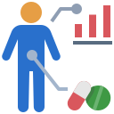

5
Establishing a Data Dictionary
Data Source Prioritization
Data Quality
Data Analysis Plan
Data Relevancy
Data Representativeness
Data relevancy will be evaluated by validating if the calculated metric value is inline with benchmarks cited in pre-existing literature
Existing literature from which data relevancy can be measured against:
Observational RWE Studies
Clinical Trial Results
Published Medical Journals
Data relevancy checks will determine the level of confidence in the calculated metric (output of our analyses)

Slide 30



When analyzing PSP data, there are a few considerations of how to mitigate bias
6
Establishing a Data Dictionary
Data Source Prioritization
Data Quality
Data Analysis Plan
Data Relevancy
Data Representativeness
Efforts to mitigate bias include¹:
The analysis is transparent in documenting limitations associated with the population subset of patients the data covers
Standardized PSP Enrollment / Onboarding information is available publicly
Data analysis plan is comprehensive – results can be replicated by a third person following the outlined analysis plan
1: Adherence to external guidelines to strengthen reporting (e.g. STROBE)

Slide 31




6
Establishing a Data Dictionary
Data Source Prioritization
Data Quality
Data Analysis Plan
Data Relevancy
Data Representativeness
Representativeness of the dataset used for analyses will be measured by comparing its patient mix to that of the broader PSP population as well as the Canadian patient population
Data representativeness is measured at two levels:
Parameters to consider to determine data representativeness:
Patient age group
Gender
Patient geographical location
Ethnicity
…
Insurance status
Income bracket
Disease severity
…
1. PSP program population
Are the calculated metrics in line with expectations based on existing literature?
Sources to obtain baseline data for representativeness comparison:
2. Overall patient population
Note: PSP program enrollment information is public information
Epidemiology Reports
Market Research
Clinical Studies (Canadian and Global)
Administrative Data (e.g., IC/ES, CIHI)
Understanding the limitations and subset of data captured by the PSP will allow for mitigation of
any biases during evaluation of use cases

Slide 32


Two-Phased Approach to Assess PSP Programs
PSP Data Assessment
Understand the structure of the program and assessment of data variables collected
Qualitative Interviews
Qualitative context surrounding the PSP Data Assessment
System-Wide Improvement Recommendations for Elevation of PSP Data Utility
Notes:
Once we’d established the framework we wanted to see how some of our current PSPs stood up to it. So the PSP Assessment is being done in 2 parts:
A quantitative assessment on the specific data points and qualitative interviews to understand areas such as outliers that have been identified or context for why identified issues may be difficult to change for established PSPs
Overall, common issues will be identified to provide recommendations for improvements across the system that will elevate the utility of PSP data to be included in decision making
PAUSE

Slide 33

CPHIN PSP Real World Readiness Framework Project Status
Completed
Developed and published framework whitepaper
Socialized Real World Readiness Framework across several conferences / symposiums
Developed PSP Real World Assessment Excel workbook to be leveraged in understanding the structure of the program and assessment of data variables collected
Evaluated 7-8 PSP datasets against the developed framework utilizing the PSP assessment workbook (~60 data points across ~35 different metrics)
In Progress
Complete qualitative interviews with stakeholders familiar with the documentation, storage, data collection methodology and data quality standards to broaden understanding of nuances in the dataset
Academic publication of the analysis insights

Slide 34


External RWE Framework Research
8

Slide 35
The team is researching external RWE frameworks to incorporate in our project approach (1/2)
Reference Source | Description | Key Information to Incorporate Into Project Approach
CADTH: Guidance for Reporting Real-World Evidence¹ | Fit-for purpose reporting guidance that aims to harmonize current RWE principles for Canadian HTA agencies and regulators while maintaining alignment with international standards | Leverage guidance that is relevant to PSP data: Setting and Context Data Specification, Access, Cleaning Methods, and Linkage Data Sources, Data Dictionary, and Variables
ISPOR: Fit-for-Purpose Real-World Data Assessments in Oncology: A Call for Cross-Stakeholder Collaboration² | Framework combines relevance and quality dimensions of RWD assessment into a single framework to inform the choice of fit-for-purpose RWD to address specific scientific questions | Data element standardization Verification and validation of patient-level data against the list of prespecified quality checks Benchmarking real-world datasets for fit-for purpose use in context of specific use cases
FDA: Real-World Evidence Program³ | Framework that the FDA has used to implement its RWE program to generate RWE of product effectiveness to help support approval of new indications for drugs or help support post approval study requirements | Characteristics of the data (e.g., contain data on a relevant endpoint, consistency in documentation, lack of missing data) that improve the chance of a valid result Characteristics of analysis that improve the chance of a valid result
Health Canada: Elements of Real-World Data / Evidence Quality throughout the Drug Product Life Cycle⁴ | Overview of protocol elements and data quality that could be considered when collecting data and evaluating the quality of RWE | Data Sources and Collection protocol development Data Management and Quality Control protocol development Feasibility and Data Limitation analyses
HL7 FHIR: Vulcan⁵ | Program designed to bridge existing gaps between clinical care and clinical research, strategically connect industry collaboratives, maximize collective resources, and deliver integrated tools and resources | Minimal set of clinical resources and elements needed to be present in a health record Development, refinement and use of standards toward optimizing the design, conduct and reporting of data
Are there other frameworks that you have been exposed to that we should investigate?
Notes:
[1] CADTH: Guidance for Reporting Real-World Evidence - CADTH Methods and Guidelines | Guidance for Reporting Real-World Evidence
[2] ISPOR: UReQA Framework - ISPOR - Fit-for-Purpose Real-World Data Assessments in Oncology: A Call for Cross-Stakeholder Collaboration
[3] FDA: Real-World Evidence Program - download (fda.gov)
[4] Health Canada: Elements of Real-World Data / Evidence Quality throughout the Drug Product Life Cycle - Elements of real world data/evidence quality throughout the prescription drug product life cycle - Canada.ca
[5] HL7 FHIR: Vulcan - Vulcan | HL7 International

Slide 36
The team is researching external RWE frameworks to incorporate in our project approach (2/2)
Reference Source | Description | Key Information to Incorporate Into Project Approach
Flatiron Health: Data Quality 2.0: The Future of Real-World Evidence in Oncology¹ | Description of multiple data quality dimensions that are needed to determine fitness-for-purpose of RWE / RWD data | Data Quality Dimensions: Relevance: Availability, Sufficiency, and Representativeness Reliability: Accuracy (validation and verification), Completeness, Provenance, and Timeliness
EUnetHTA: REQueST Tool and Vision Paper² | Tool that aims to support HTA organizations and other actors in guiding and evaluating registries for effective usage in HA | Leverage tool to identify of data gaps in order to highlight areas that need improvement and to maximize the quality of data
BMC: Real-world data: A Brief Review of the Methods, Applications, Challenges and Opportunities³ | Overview of the most common models and approaches to utilize and analyze real-world data | Data quality assessment methods and challenges Reproducibility and replicability of results with multiple dimensions of the data set
Duke Margolis Center for Health Policy: Determining Real-World Data’s Fitness for Use and the Role of Reliability⁴ | Framework for how reviewers can systemically evaluate whether RWD are fit for use by using verification checks to assess reliability | Considerations for verification checks to assess Electronic Health Record Data reliability Considerations for verification checks to assess Person-Generated Health Data reliability
NIH: A Harmonized Data Quality Assessment Terminology and Framework for the Secondary Use of Electronic Health Record Data⁵ | Data quality assessment terms, methods and reporting practices organized into a conceptual framework to support a common approach to defining whether HER data is ‘fit’ for specific uses | Data quality comprises of data conformance, completeness and plausibility Data quality assessment methods for verification and validation
Are there other frameworks that you have been exposed to that we should investigate?
Notes:
[1] Flatiron Health: Data Quality 2.0: The Future of Real-World Evidence in Oncology - ISPOR_Data_Quality (90%)
[2] EUnetHTA: REQueST Tool and Vision Paper - REQueST Tool and its vision paper - EUnetHTA
[3] BMC: Real-world data: A Brief Review of the Methods, Applications, Challenges and Opportunities - Real-world data: a brief review of the methods, applications, challenges and opportunities | BMC Medical Research Methodology | Full Text (biomedcentral.com)
[4] Duke Margolis Center for Health Policy: Determining Real-World Data’s Fitness for Use and the Role of Reliability - rwd_reliability.pdf (duke.edu)
[5] NIH: A Harmonized Data Quality Assessment Terminology and Framework for the Secondary Use of Electronic Health Record Data - A Harmonized Data Quality Assessment Terminology and Framework for the Secondary Use of Electronic Health Record Data - PMC (nih.gov)

Slide 37




3
To understand the landscape of checks used to assess reliability, multiple frameworks by data aggregators were reviewed and compared
Data Quality Check Principles¹⁻⁷
Validity
Level 1:
Completeness, Validity
Model Conformance
Completeness
Plausibility
Level 2:
Accuracy, Integrity
Plausibility
Consistency
Consistency
Level 3:
Consistency of Trends
Completeness
Conformance
Accuracy
Completeness
Level 4:
Plausibility
Persistence
Notes:
[1] Kahn MG, Callahan TJ, Barnard J, et al. A Harmonized Data Quality Assessment Terminology and Framework for the Secondary Use of Electronic Health Record Data. EGEMS (Wash DC). 2016;4(1):1244.
[2] Daniel G, McClellan M, Silcox C, Romine M, Bryan J, Frank K. Characterizing RWD Quality and Relevancy for Regulatory Purposes. Duke-Margolis Center for Health Policy; October 1, 2018.
[3] US Food and Drug Administration. Use of Real-World Evidence to Support Regulatory Decision-Making for Medical Devices: Guidance for Industry and Food and Drug Administration Staff. US Department of Health & Human Services; August 2017.
[4] US Food and Drug Administration. Standards for Data Management and Analytic Processes in the Office of Surveillance and Epidemiology (OSE). Manual of Policies and Procedures (MAPP 6700.2). US Department of Health & Human Services; 2008.
[5] US Food and Drug Administration. Best Practices for Conducting and Reporting Pharmacoepidemiologic Safety Studies Using Electronic Healthcare Data: Guidance for Industry and FDA Staff. US Department of Health & Human Services; May 2013.
[6] National Patient-Centered Clinical Research Network. PCORnet Data Checks v6. https://pcornet.org/wp-content/uploads/2019/09/PCORnet-Data-Checks-v61.pdf; May 22, 2019.
[7] Sentinel. Data Quality Review and Characterization. https://www.sentinelinitiative.org/sentinel/data-quality-review-and-characterization. Accessed September 2023.

