Slide 1
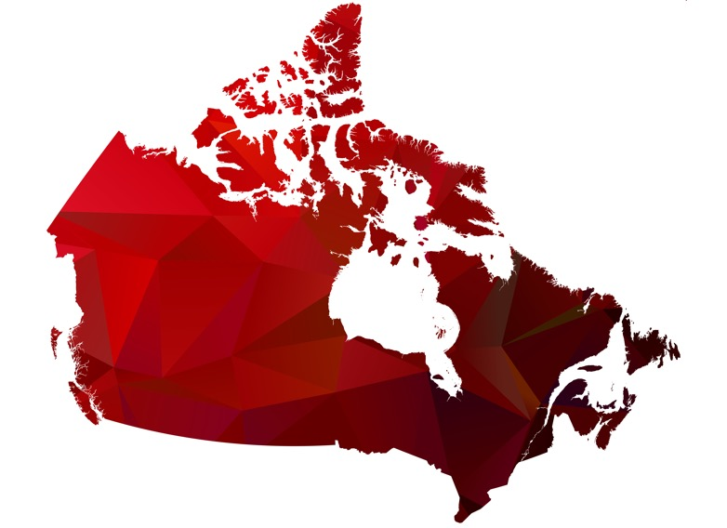
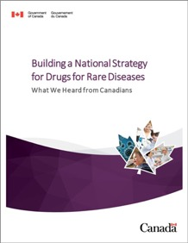
Building Canada’s rare disease strategy: Strengthening Canada with a truly national approach to rare disease research, diagnosis and treatment across jurisdictions
September 23, 2025

Slide 2

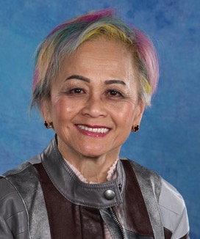



Speakers
MODERATOR:
PANELLISTS:
Gerry Jeffcott
3Sixty Public Affairs
Durhane Wong-Rieger
CORD
Ian Stedman
York University professor & Canadian Rare Disease Network
Jo Kennelly
Global Health Systems
Rob Woolstencroft
Alexion

Slide 3

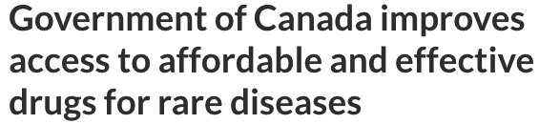
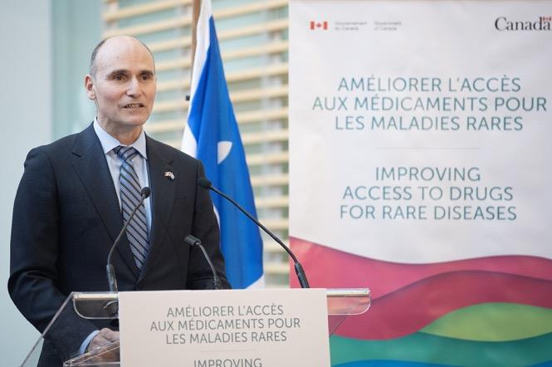
National Drugs for Rare Diseases Strategy overview
National Strategy for Drugs for Rare Diseases
The goal of the first three-year phase is to increase access to, and affordability of, effective drugs for rare diseases, which will contribute to improving the health of patients across Canada
Lessons learned will be incorporated into future phases, staying aligned with the government’s broader pharmaceutical agenda
Objectives:
Support patient outcomes & sustainability
Invest in innovation
Seek national consistency
March 22, 2023
Collect and use evidence
Three-year, $1.5-billion national rare disease treatment strategy announced in March 2023

Slide 4
Elements of the Strategy
Bilateral Negotiations | Governance | Data Collection and Use | Research
Pursuing bilateral agreements between Health Canada and provinces and territories Funding to Indigenous Services Canada's Non-Insured Health Benefits program | FPT Pharmaceutical Executive Group (PEG) Health Canada’s DRD Secretariat Implementation Advisory Group (IAG) | CDA Disease-based registries and real-world evidence (RWE) Newborn screening panel DRD pipeline repository Customized pharmaceutical work on request CIHI Linked analyses for rare disease (with CDA) DRD data landscape Pharmaceutical data web tool | CIHR Improving health and administrative data and monitoring for rare diseases Pediatric rare disease clinical network Improving diagnosis for rare disease patients Bringing rare disease gene therapies to clinical trial readiness

Slide 5













National DRD strategy
Signed deals & elected drugs on the common list, by province (and territory)
BC $194M over 3 yrs
(1-2-3-4-5-6-7-8)
AB $162M over 3 yrs
(1-2-3-4-5-6-7)
ON $535M over 3 yrs
(1-2-3-4-5-6-7)
NB $32M over 3 yrs
(1-2-3-4-6)
NS $39M over 3 yrs
(1-2-3-4-5-6-8)
YUKON $8.5M over 3 yrs
(5)
SK $40M over 3 yrs
(1-2-3-4-5-6-7)
MB $42M over 3 yrs
(1-2-3-4-5)
QC
$305M over 3 yrs
(n/a)
PEI $10M over 3 yrs
(1-3-6)
NL $22M over 3 yrs
(1-2-3-4-5)
NWT $7.8M over 3 yrs
(1)
NUNAVUT $7.3M over 3 yrs
(1-3-4-5)
2023 – 3-year, $1.5-billion national strategy for drugs for rare diseases
$1.4 billion for provinces and territories to help invest in new RD meds (the “common list”), existing medicines as well as screening and diagnostics
Additional money for Canada’s Drug Agency (e.g., patient registries)
The Common List
Poteligeo (mogamulizumab) - mycosis fungoides or Sézary syndrome
Oxlumo (lumasiran) - primary hyperoxaluria type 1
Epkinly (epcoritamab) - R/R diffuse large B-cell lymphoma
Welireg (belzutifan) - von Hippel-Lindau (VHL) disease
Yescarta (axicabtagene ciloleucel) - for the treatment of several lymphomas
Koselugo (selumetinib) - neurofibromatosis type 1
Sohonos (palovarotene) - fibrodysplasia ossificans progressiva (FOP)
Imcivree (setmelanotide) - Bardet-Biedl syndrome
9-10-11-12 TBD

Slide 6

Anatomy of a bilateral deal
Calculation of the funding
Common list
Distribution of funds
Jurisdictional reporting

Slide 7

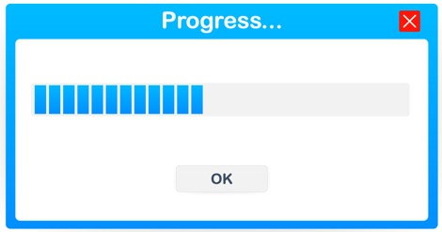
Phase II of National DRD Strategy
The Trudeau government pledged to contribute $500 million per year after 2026-27 to maintain the strategy
Health Canada’s DRD Secretariat is developing plans for Phase II and trying to determine how it will be organized / managed in consultation with the Implementation Advisory Group
Future of the strategy is likely dependent on the upcoming federal budget (Nov. 4)

Slide 8



