Slide 1
Caring for an Aging Population: Policy and Advocacy in Brain Health
CAPT Conference Panel
September 22, 2025

Slide 2
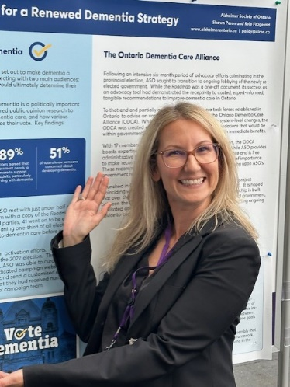


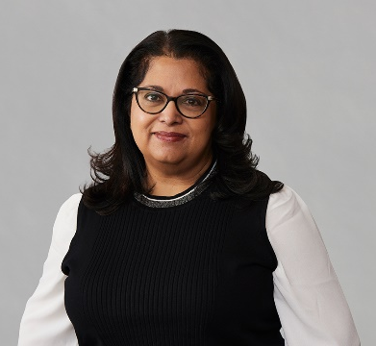

Panelists
Shawn Paron
Chief Operating Officer
Alzheimer Society of Ontario
Jennie Z. Young
Executive Director
Canadian Brain Research Strategy
Hon. Natalia Kusendova-Bashta
MPP - Mississauga Centre
Ontario’s Minister of Long-Term Care
Sudha Kutty
Executive Vice-President, Evidence, Products, and Services
CDA-AMC
Zayna Khayat
Health Futurist
Deloitte Canada, Life Sciences & Healthcare Practice

Slide 3

Why Brain Health Matters
Our brains define who we are, how we behave, what we strive for, and how we interact with each other and our environments
A healthy brain allows for overall well-being, personal fulfillment and a productive workforce
Brain conditions impact every Canadian demographic and region, particularly affecting indigenous peoples, women, and those in socio-economically disadvantaged communities
For aging Canadians, brain conditions affect independence, quality of life, and emotional stability
Canadian Brain Research Strategy

Slide 4

Alzheimer’s Disease
Unique Opportunity for Change​
New therapies and increased awareness create a chance to shift the Alzheimer’s disease care landscape.
Barriers to Overcome​
System readiness, equitable access, and under funding remain key challenges in transforming Alzheimer’s care.​
Collaborative Action Needed​
Government, industry, research, and advocacy sectors must unite to build sustainable care systems.​
Urgency and Impact​
Rising cognitive decline and available interventions demand immediate and sustainable policy and advocacy action.

Slide 5
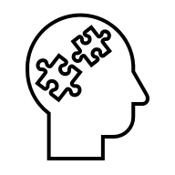


Our Goal Today
Understand what people impacted by Alzheimer’s disease (AD) experience when faced with an early diagnosis in the absence of a coordinated care pathway
Surface the barriers of systemic neglect for AD that stand in the way of equitable access to new therapeutics - stigma, under recognition, lack of prioritization and underfunding
Explore the policy levers and partnerships that can help us build a more proactive, collaborative, and sustainable model of care

