Slide 1


2025 Annual General Meeting
Canadian Association for Population Therapeutics / Association Canadienne pour la Thérapeutiques des Populations
www.capt-actp.ca
MaRS Discovery District | September 23, 2025 | Toronto, Ontario

Slide 2
2025 AGM Agenda Outline
Approval of the 2025 Agenda and the Finance Webinar Minutes
Opening Acknowledgements
Annual Conference Highlights
Committee Reports
Election Results
Business Arising: Bylaws Update
Closing Remarks
Adjournment
2025 ANNUAL GENERAL MEETING |

Slide 3
Approvals
Approval of the 2025 AGM Agenda as presented
Approval of Minutes from the March 13, 2025 Finance Webinar Regarding the 2023 Financial Report
2025 ANNUAL GENERAL MEETING |

Slide 4

CAPT-ACTP 2025 Board of Directors
Adam Haynes | President​ | Alex Chambers | Member-at-Large​
Jason Robert Guertin | President Elect​ | Raina Rogoza | Member-at-Large​
Julia Shen | Past President​ | Eon Ting | Member-at-Large​
Belinda Yap | Treasurer​ | Joan Paulin | Member-at-Large​, Patient Rep
​Jorgie Jeresano | Secretary | Danielle Nagy | Member-at-Large​, Student Rep
 | Dan Moldaver | Member-at-Large​
​ | Linda Lu Wittenberg | Member-at-Large​
​ | Gillian Bromfield | Member-at-Large​
​ | Sherif Eltonsy | Member-at-Large​
 | Jordan Roumieu | Member-at-Large
​ | ​
2025 ANNUAL GENERAL MEETING |

Slide 5
Thank You to Our Departing Board Members
Danielle Nagy
Dan Moldaver
2025 ANNUAL GENERAL MEETING |

Slide 6
From Challenge to Change: Driving Progress in Canada’s Healthcare Landscape
Event Highlights:
Over 230 attendees registered
$17,300 student travel bursaries awarded
68 poster presentations showcased
Wide-ranging topics represented in the abstract sessions
Abstracts to be published 72
2025 ANNUAL GENERAL MEETING |

Slide 7
Committee Reports

Slide 8
Committee Reports
Partnership Committee
Scientific Program Committee
MMAS Committee
Finance Committee
2025 ANNUAL GENERAL MEETING |

Slide 9
Partnership Committee Report
Chaired by Julia Shen (Past President)
Sponsorship Overview: Our sponsorship goal for the year was $150,000.
Thanks to the generous support of our sponsors, we secured a total of $182,000 in funding.
Confirmed Sponsors:
Platinum: 8
Gold: 2
Silver: 6
Bronze: 3
Ruby: 3
2025 ANNUAL GENERAL MEETING |

Slide 10
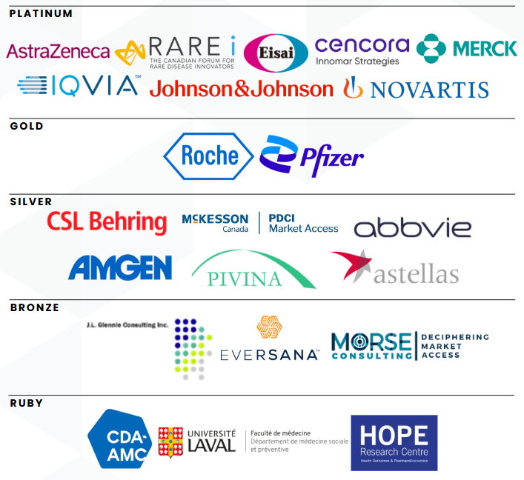
We gratefully acknowledge the generous support of our 2025 CAPT-ACTP Conference sponsors:

Slide 11
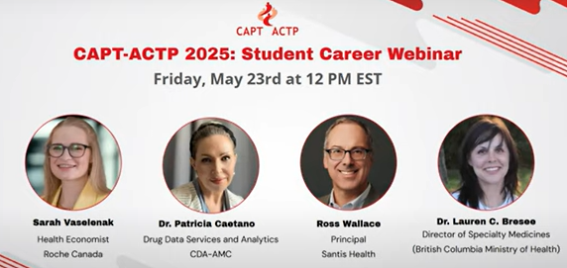
MMAS Committee Report
Chaired by Adam Haynes (President) & Danielle Nagy (Student Rep)
Student career webinar
4 speakers across industry, HTA, consultancy & government
35 attendees
46 students attending the conference
Travel bursaries awarded to 16 students
Career fair
2025 ANNUAL GENERAL MEETING |

Slide 12
Scientific Program Committee Report
Chaired by Jason Guertin (President-Elect) & Adam Haynes (President)
2 full days of conference
Keynote presentation by Dr. Dean Regier
8 sponsored panel sessions and over 25 different panelists
Wide range of topics including Cancer care, Rare Diseases, Real-World Evidence
Over 70 abstracts – 4 student oral presentations / 4 evaluated poster presentations
Special thanks to all SPC members for their great help!
2025 ANNUAL GENERAL MEETING |

Slide 13
Finance Committee: Treasurer’s Report (2024 Financials) Belinda Yap

Slide 14
Financial Performance Review
Assets vs Liabilities
Net Assets
Revenues vs Expenses
Financial Status - Excess of Revenues vs Expenses
Cash and Cash Equivalents

Slide 15
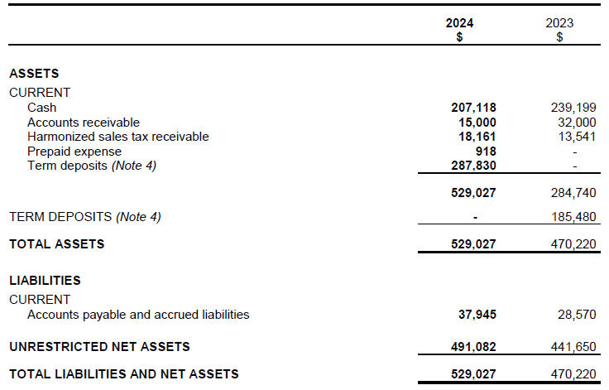
2024 Financials – Assets vs Liabilities

Slide 16
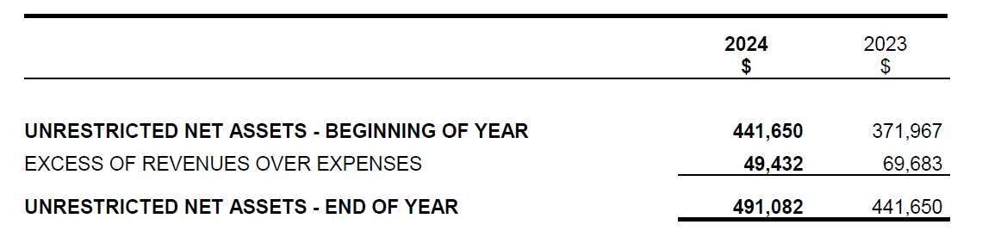
2024 Financials – Net Assets

Slide 17
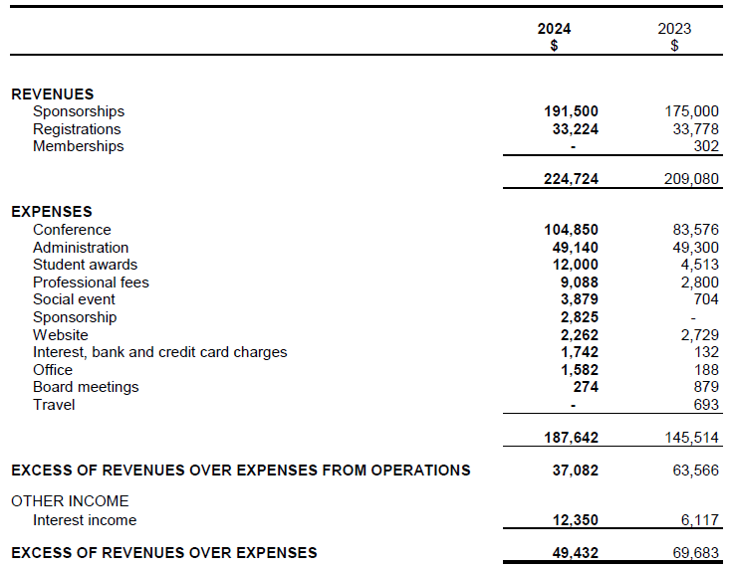
2024 Financials – Revenues vs Expenses

Slide 18
2024 Financial Status – Excess of Revenues vs Expenses
 | 2024 |  | 2023
 | $(000’s) | Share | $(000’s) | Share | Growth
Revenue (Total) | $237.1 |  | $215.2 |  | (10%)
Sponsorship | $191.5 | 80.8% | $175.0 | 81.3% | (9%)
Registrations | $33.2 | 14.0% | $33.8 | 15.7% | (2%)
Memberships | $0.0 |  | $0.3 | 0.1%
Interest | $12.4 | 5.2% | $6.1 | 2.8%
Expenses | $187.6 |  | $145.5 |  | (29%)
Excess/Surplus | $49.4 |  | $69.7 |  | (29%)
Notes:
Increase in expenses attributed mostly to:
Conference expenses (venue – preconference workshop, speaker expenses)
Increase in student bursaries/awards

Slide 19
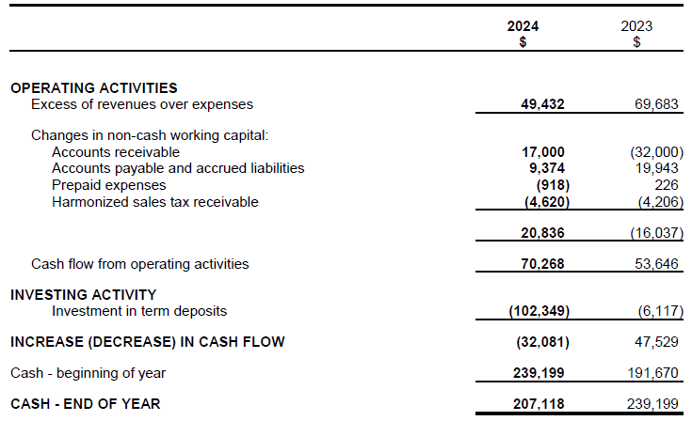
2024 Financials – Cash and Cash Equivalents

Slide 20
Financial Takeaways
Healthy financial status
Revenue exceed expenses year over year since returning to in-person meeting format in 2022
Solid financial footing from accumulated unrestricted net assets
Notes:
Healthy financial status and solid financial footing
Revenues exceed expenses year over year since we came back to in-person meeting format in 2022.
Built up a comfortable ‘piggy bank’ – allow us to weather not only any unanticipated events/emergencies, but importantly also opportunity for the board to develop additional initiatives in the coming year(s) for the association/membership (stay tuned and welcome any suggestions from membership)

Slide 21
Motion to Accept Finance Report
I, Belinda Yap, Treasurer of CAPT, hereby move that the Audited Financial Statements for 2024 be approved and adopted by the Members of the Association

Slide 22
Nominations and Board Elections Adam Haynes / Julia Shen

Slide 23
Timelines
Call for Board nominations
Nomination process open July - September 5, 2025
Elections opened September 8 - 12, 2025
Candidates notified/accepted
2025 ANNUAL GENERAL MEETING |

Slide 24
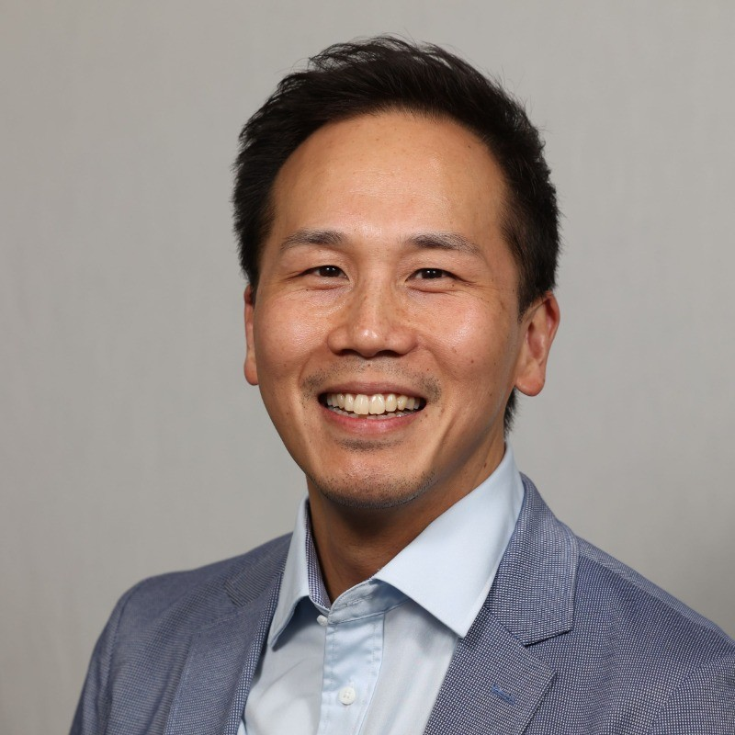
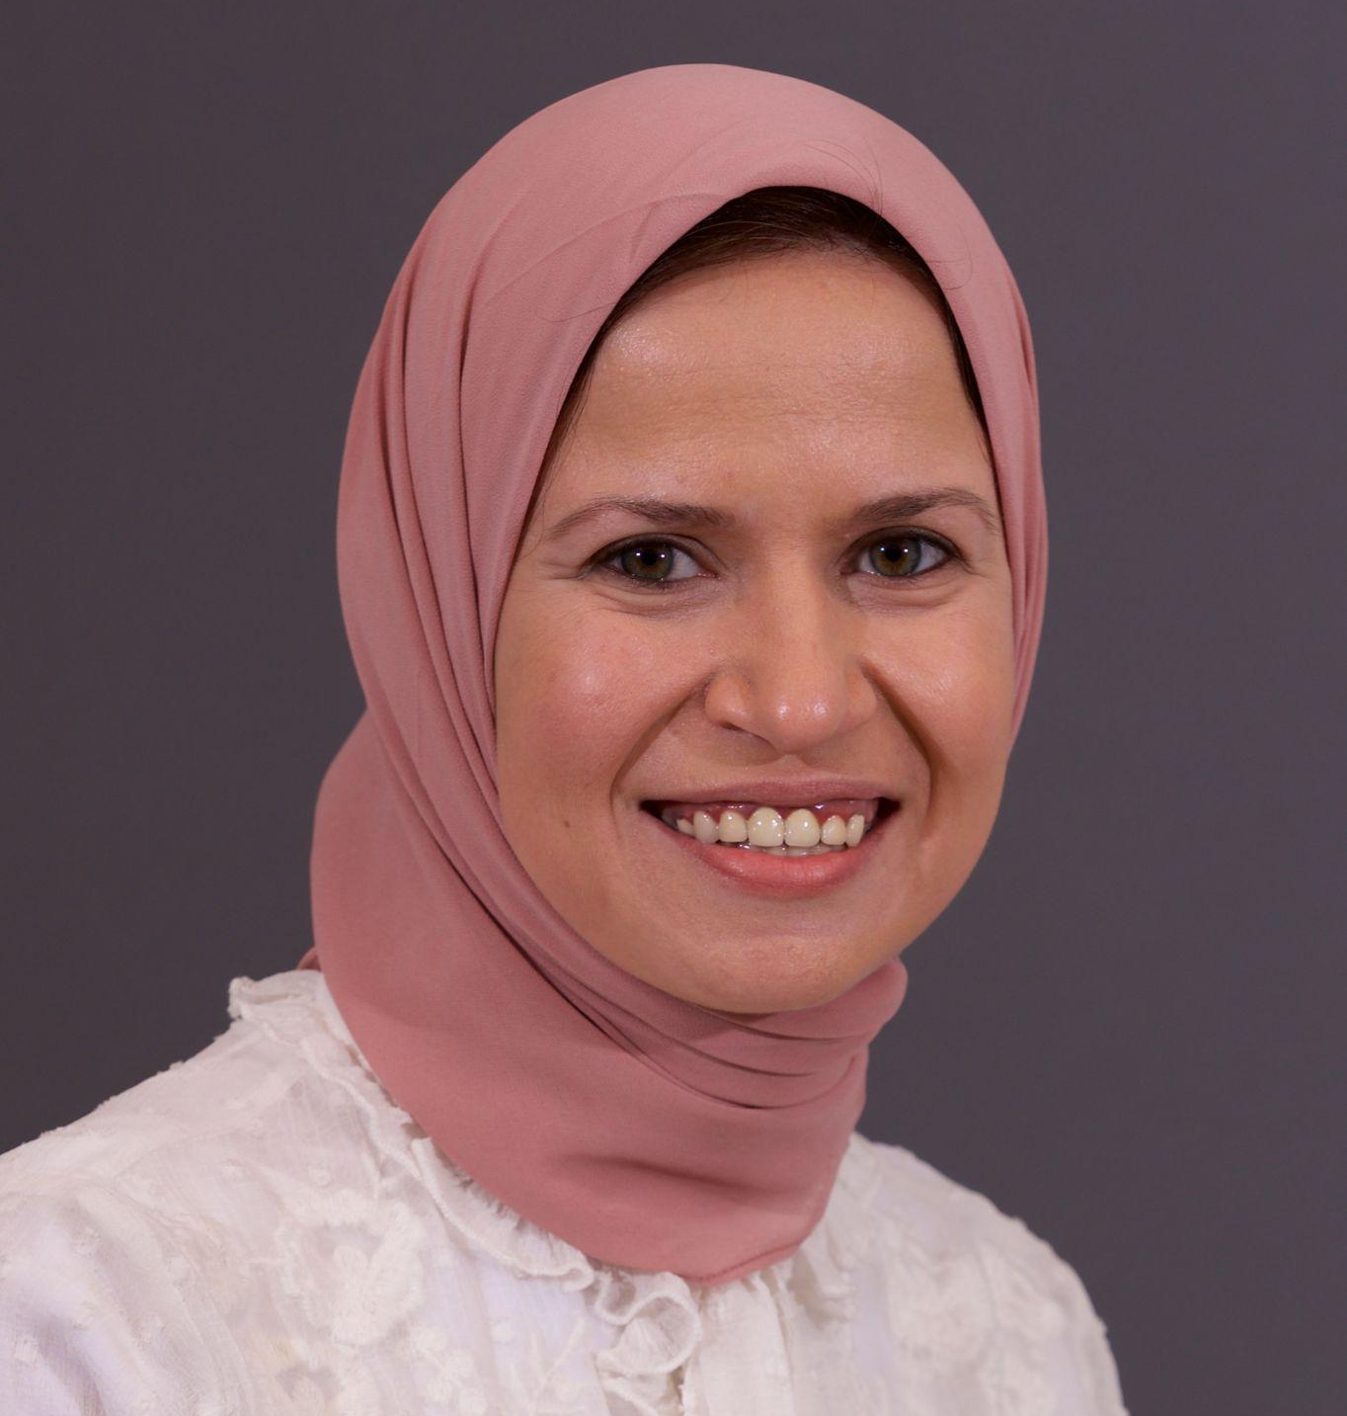
Board Nominees: President Elect & Student Representative
EON TING
2026 CAPT President Elect
LAILA ABOULATTA
2026 CAPT Student Representative
2025 ANNUAL GENERAL MEETING |

Slide 25
Business Arising

Slide 26
Bylaws Review
The CAPT-ACTP Board will be undertaking a review and assessment of the bylaws over the next year. The Board will report back to the membership with the results of this assessment and proposed changes at the 2026 Annual General Meeting.

Slide 27

AWARDS
2025 ANNUAL GENERAL MEETING |

Slide 28
CAP-ACTP 2025 Kris Schindel Award
2025 Recipient
Peggy Kee Award
Soo Jin Seung

Slide 29
2025 Recipient
Student Poster Award
Atafeh Jafari

Slide 30
CAP-ACTP 2025 Kris Schindel Award
2025 Recipient
Student Oral Presentation Award
Martin Ho

Slide 31
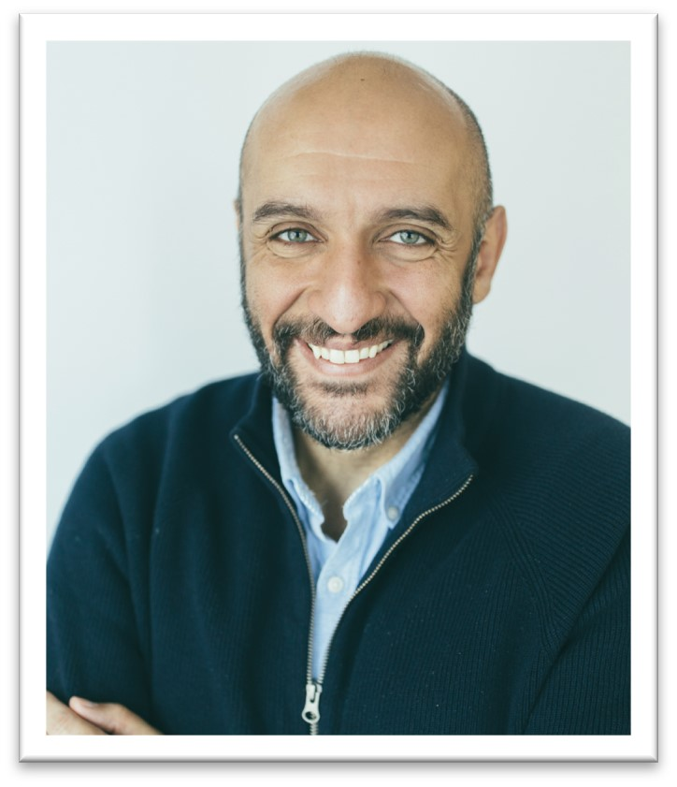
CAP-ACTP 2025 Kris Schindel Award
2025 Recipient
Kris Schindel Award
MINA TADROUS

Slide 32
Closing Remarks
2025 ANNUAL GENERAL MEETING |

Slide 33
Motion to adjourn
2025 ANNUAL GENERAL MEETING |

Slide 34
Questions or requests for handouts may be directed electronically to:
Jorgie Jeresano
CAPT-ACTP Secretary
admin@capt-actp.ca
2025 ANNUAL GENERAL MEETING |

