Slide 1


Early Detection and Better Access:
Advancing the Continuum of Breast Cancer Care in Canada
Sponsored by: Novartis Canada Inc

Slide 2
Agenda
Time | Session / Speaker
10:45–10:50 | Opening Remarks Moderator: Jefferson Tea
10:50–11:00 | Clinical Insights – Early Screening Dr. Anna Wilkinson
11:00–11:10 | Clinical Insights – Access to Treatments Dr. Sandeep Sehdev
11:10–11:20 | Patient Advocacy Kimberly Carson
11:20–11:40 | Panel Discussion & Audience Q&A Moderator-led with all speakers
11:40–11:45 | Closing Remarks Moderator: Jefferson Tea

Slide 3


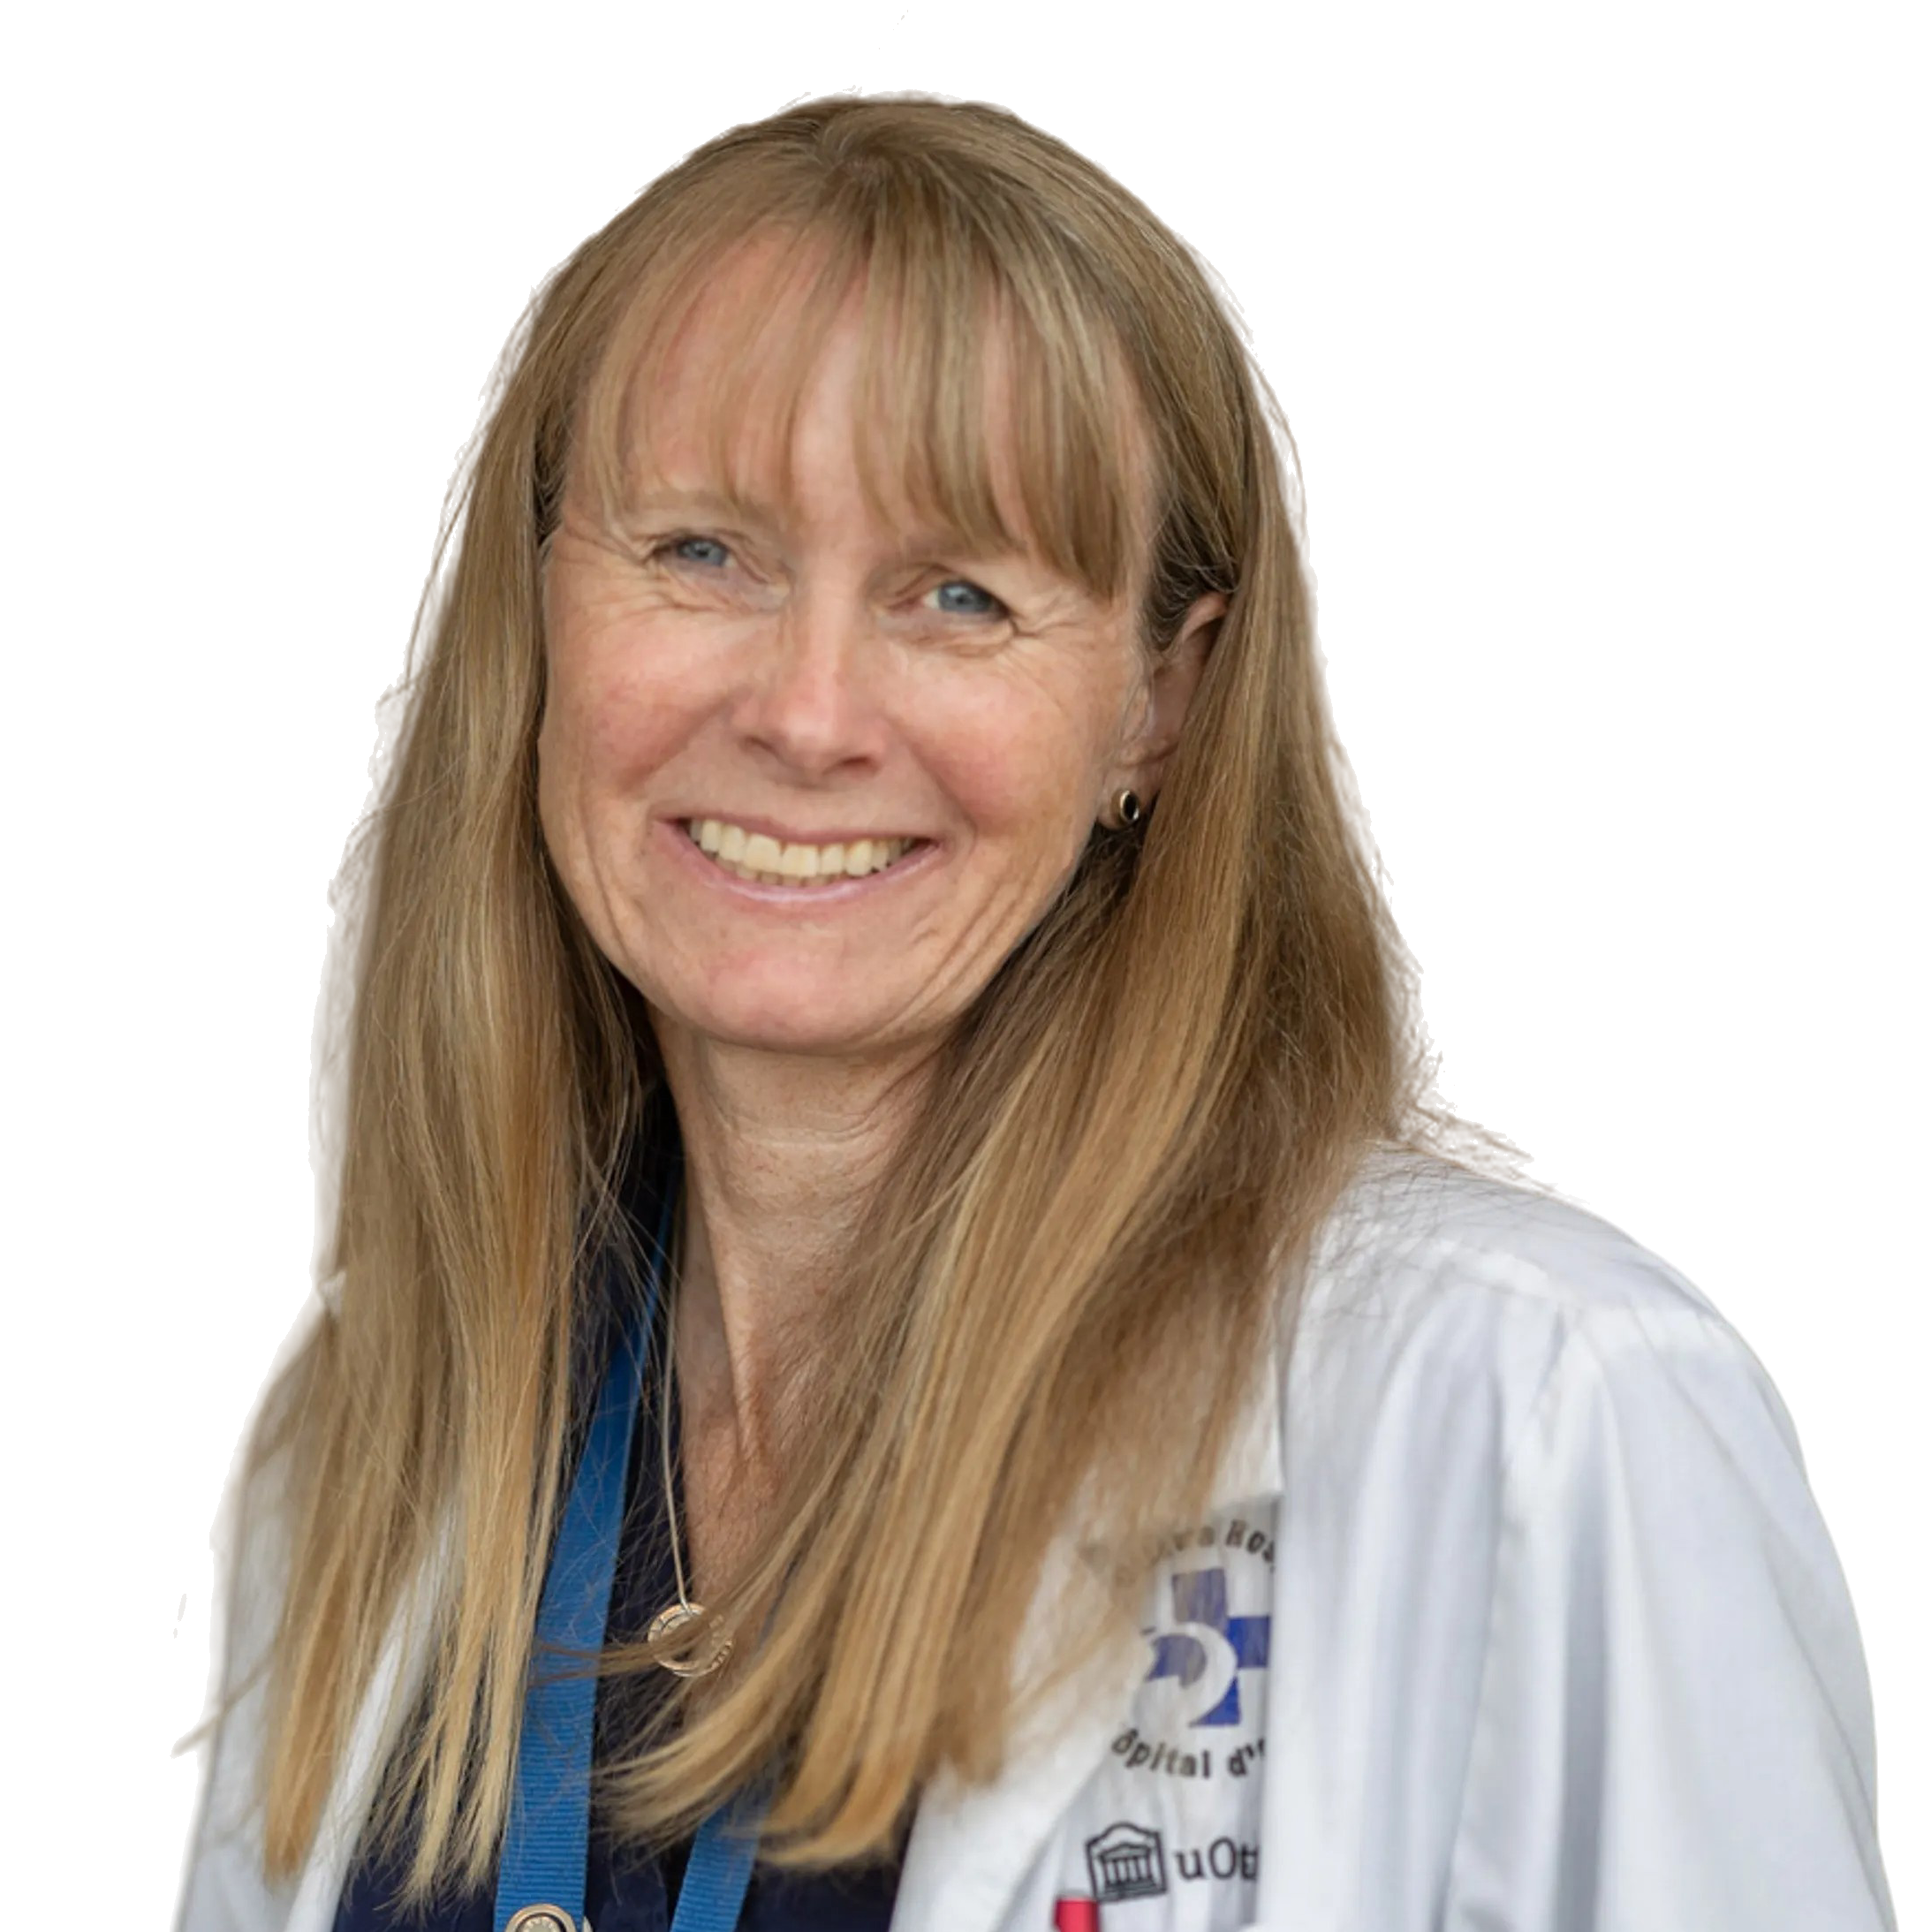
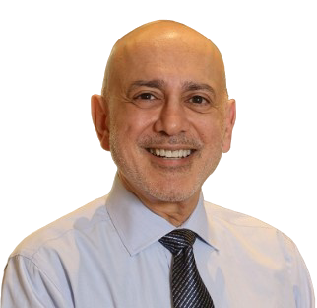
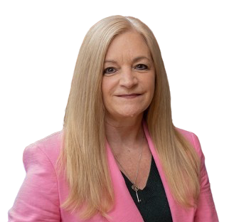
Guest Speakers
Moderator:
Speakers:
Jefferson Tea
CEO,
Agilis Health
Dr. Anna Wilkinson
MSc., MD, CCFP, FCFP
GP Oncologist,
The Ottawa Hospital (University of Ottawa)
Dr. Sandy Sehdev MD FRCPC
Medical Oncologist, Ottawa Hospital Cancer Centre (University of Ottawa)
Kimberly Carson
CEO
Breast Cancer Canada

Slide 4
Dr. Anna Wilkinson
Dr. Anna Wilkinson is a family physician with a special interest in oncology. She completed a Masters in Science at Queen’s University, and her MD and family medicine residency at the University of Ottawa, where she is an Associate Professor. She divides her clinical time between caring for medical oncology inpatients and academic family practice, where she teaches and trains family doctors. Anna is Program Director for the PGY-3 FP Oncology program, allowing family doctors to gain additional expertise in caring for cancer patients. Anna’s passion is bridging the gap between oncology and family medicine with knowledge translation, and investigating impacts of cancer screening to optimize cancer outcomes.
Dr. Anna Wilkinson
MSc., MD, CCFP, FCFP
GP Oncologist,
The Ottawa Hospital (University of Ottawa)

Slide 5

Early Detection, Lifesaving Action: Advancing Breast Cancer Screening in Canada
Anna N. Wilkinson, MSc, MD, CCFP, FCFP
Associate Professor, University of Ottawa
Family Physician, The Ottawa Academic Family Health Team
GP Oncologist, The Ottawa Hospital Cancer Centre
Program Director, PGY-3 FP-Oncology
@anwilkinson
Notes:
- Overview of breast cancer burden in Canada. - Evidence: how early detection shifts survival outcomes, referencing clinical data. - Real-world examples/case studies showing improved outcomes through early detection. - Barriers: fear, misinformation, logistical challenges, and unequal access. - Call to action: strengthening national screening uptake.

Slide 6
Disclosures
Relationships with financial sponsors/grants:
CFPC Grant for Breast Cancer Survivorship Tool/Oncology Briefs
Regional Cancer Primary Care Lead- Stipend
Health Care Unburdened Grant
Prostate Cancer Canada Foundation Grant
Sullivan Urological Society Grant
Breast Cancer Canada Grant
Consultant-Thrive Health

Slide 7
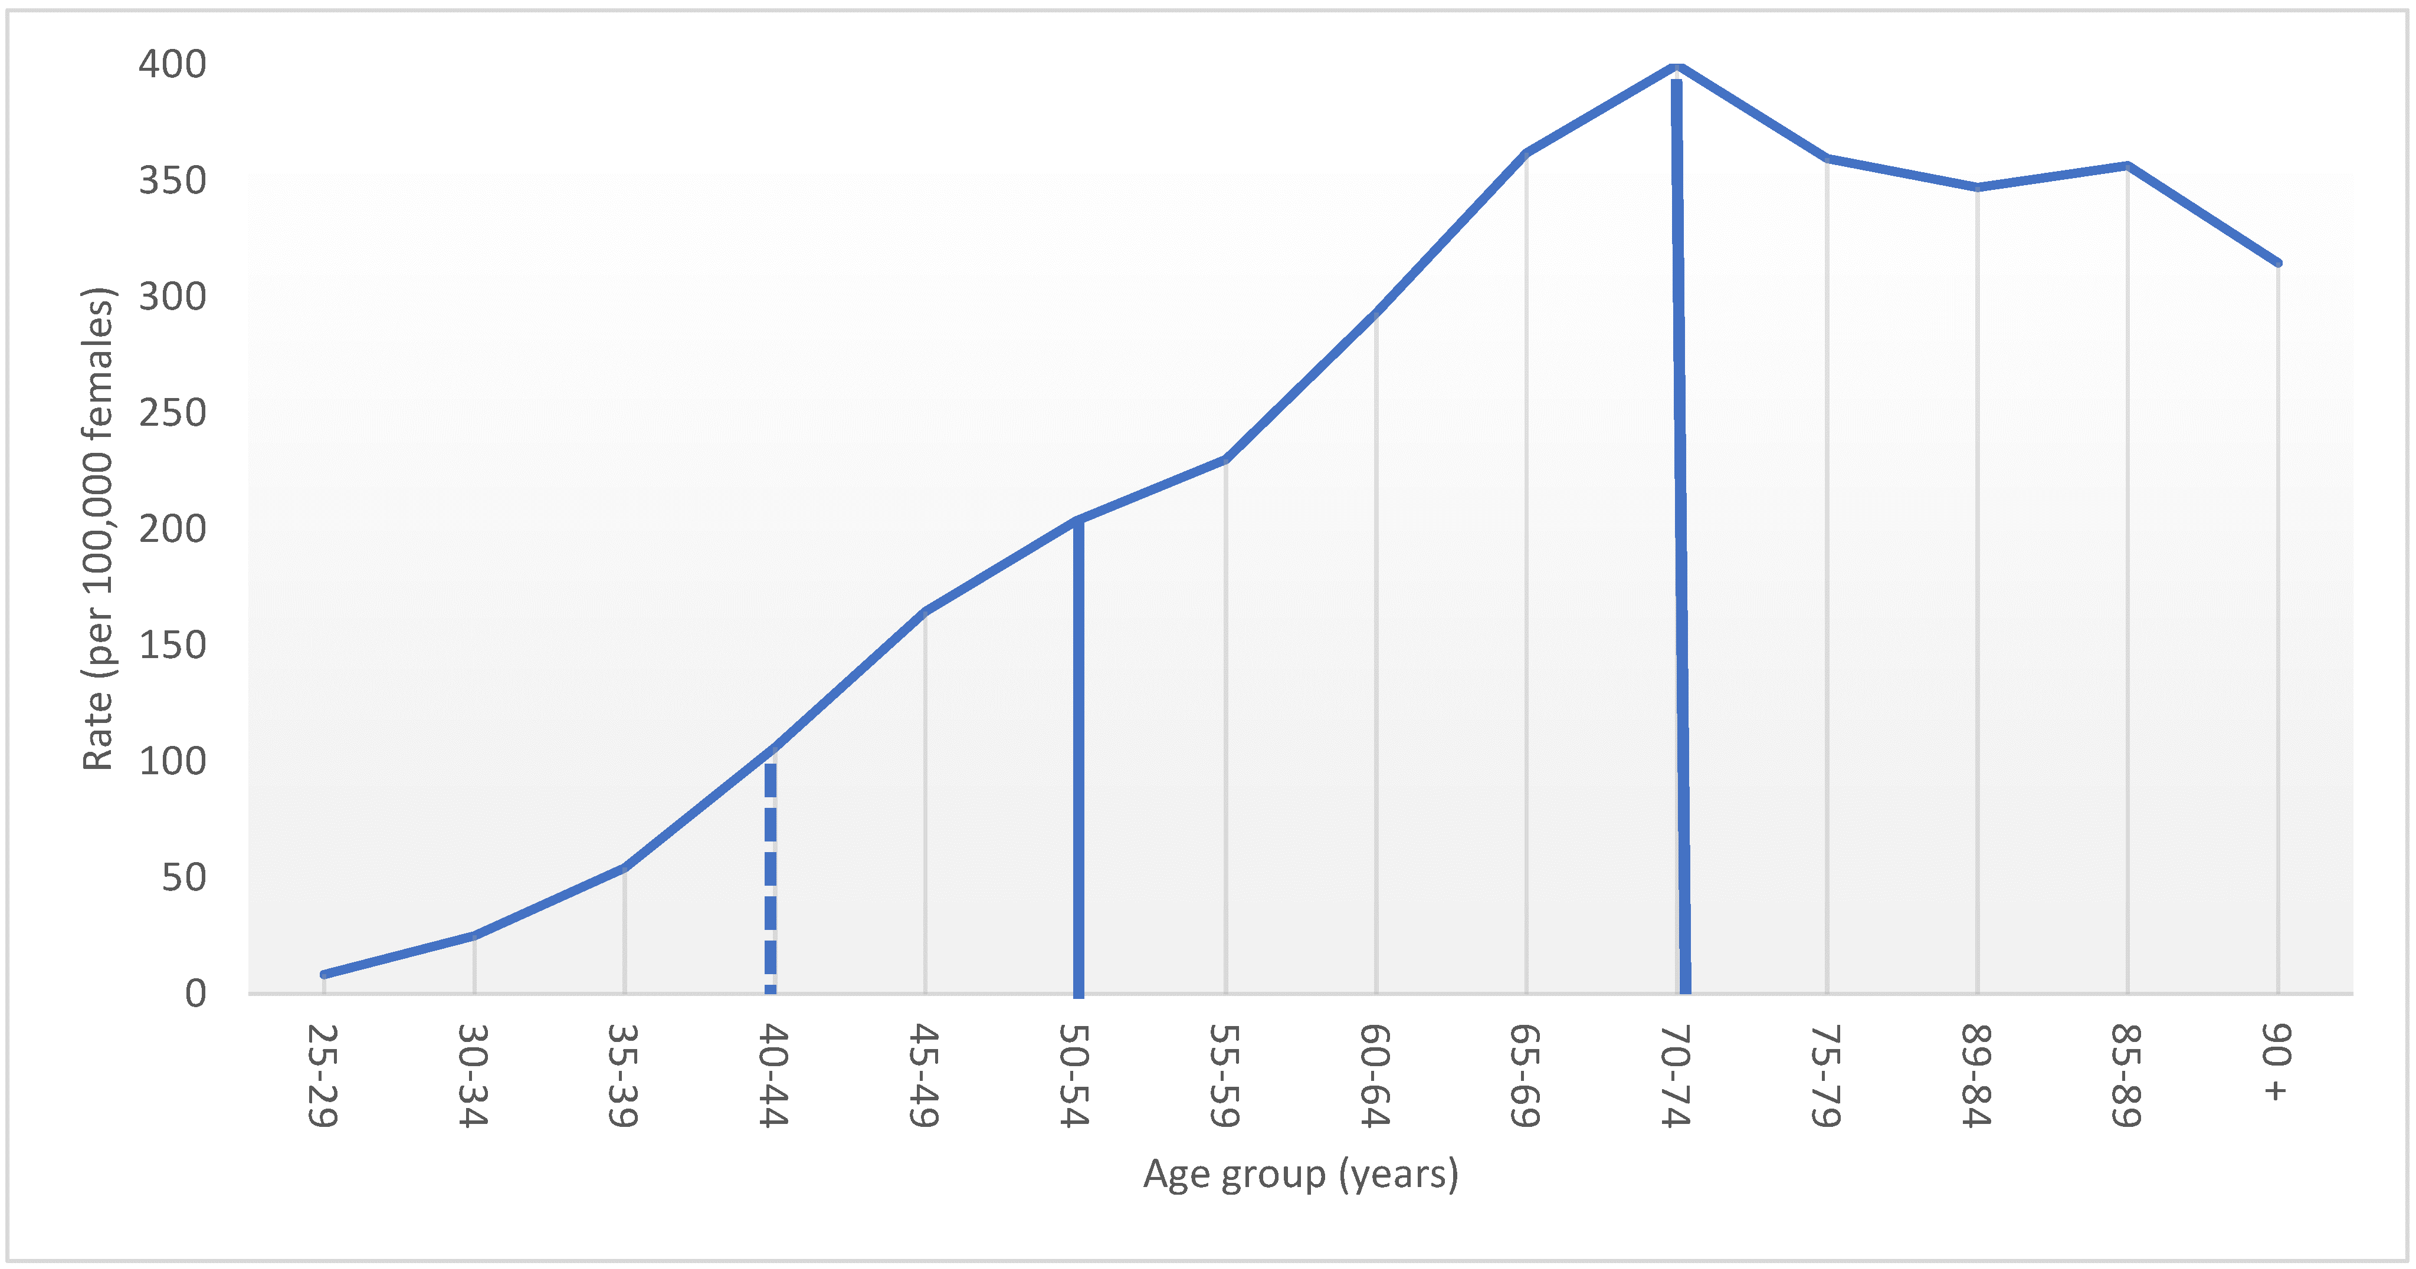

Breast Cancer Incidence in Canada
Wilkinson, A. N., Billette, J. M., Ellison, L. F., Killip, M. A., Islam, N., & Seely, J. M. (2022). The impact of organised screening programs on breast cancer stage at diagnosis for Canadian women aged 40–49 and 50–59. Current Oncology, 29(8), 5627-5643.
Notes:
-30,000 case per year
-5400 deaths
-80 women dx each day, 15 die each day

Slide 8
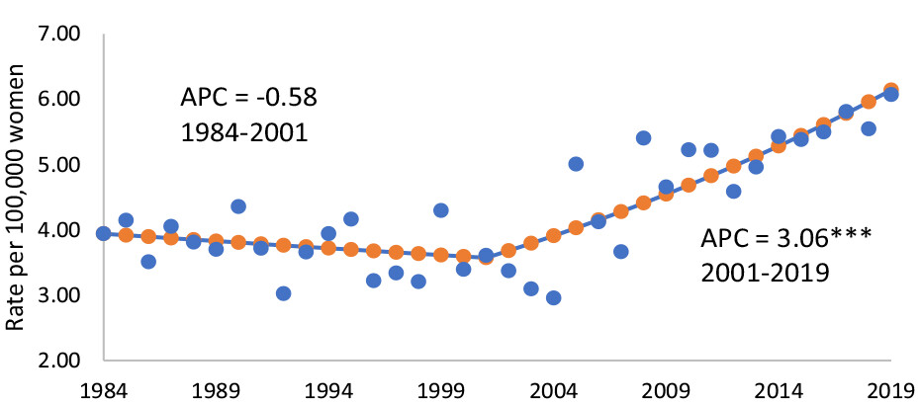
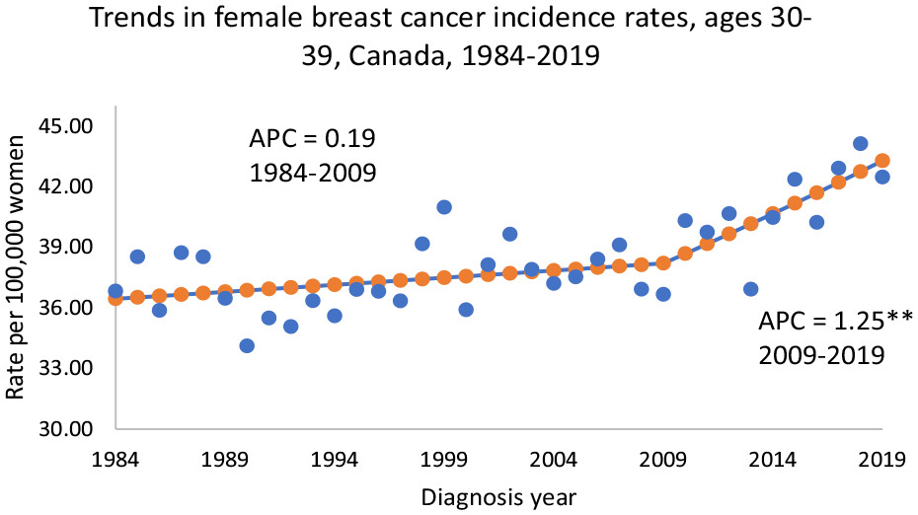
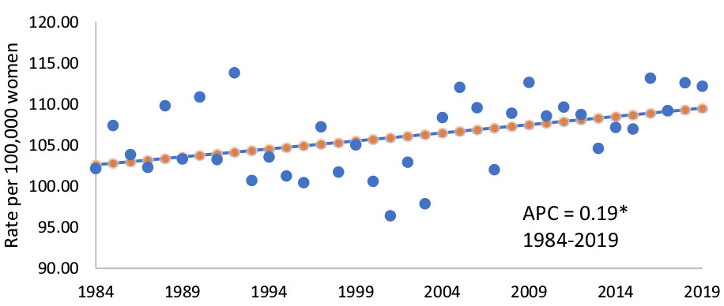
Increasing Incidence in Young Women
20’s
56.4% increase
30’s
12.5% increase
40’s
9.1% increase
Seely JM, Ellison LF, Billette J-M, Zhang SX, Wilkinson AN. Incidence of Breast Cancer in Younger Women: A Canadian Trend Analysis. Canadian Association of Radiologists Journal. 2024;75(4):847-854. doi:10.1177/08465371241246422

Slide 9
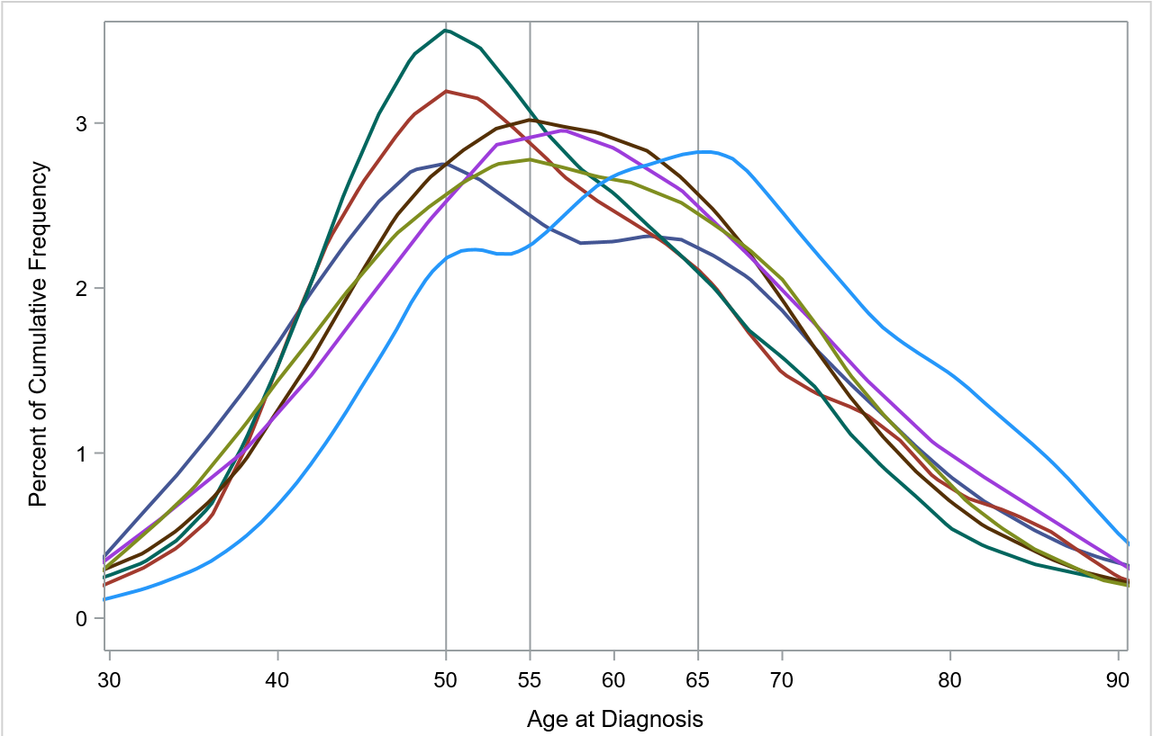

Race and Ethnicity and Breast Cancer
~50
65
Mortality
40-49
40% higher in Black
60-69
20% higher in First Nations
50% higher in Métis
Wilkinson, A. N., Ng, C., Ellison, L. F., & Seely, J. M. (2024). Breast cancer incidence and mortality, by age, stage and molecular subtypes, by race/ethnicity in Canada. The Oncologist, oyae283.
Notes:
2021 1 in 4 can identified as group other than white.

Slide 10
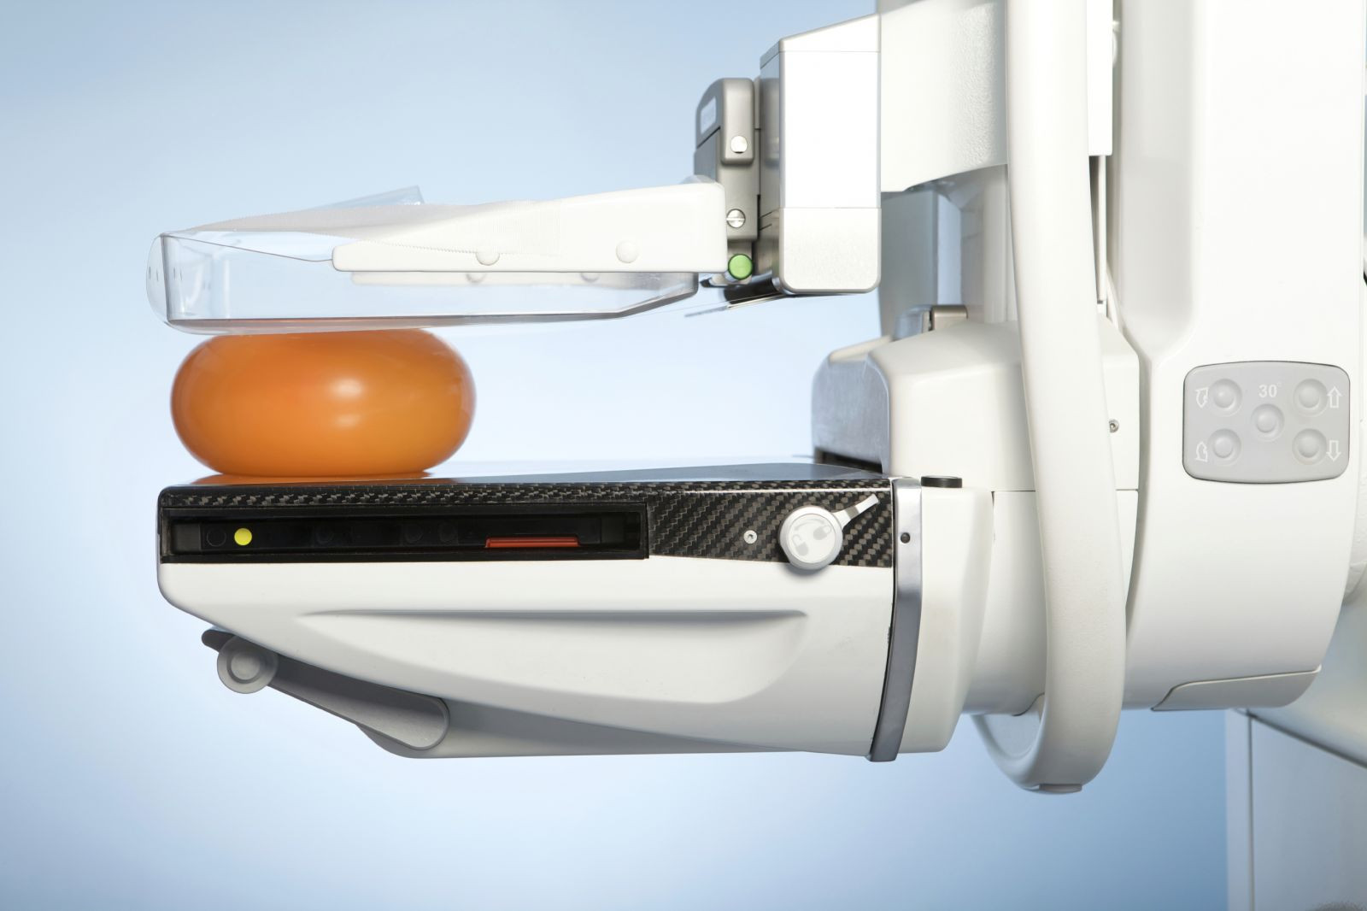
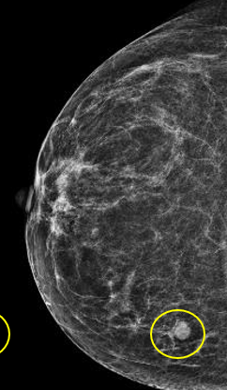
Cancer Screening
Screening
Healthy Cells
Abnormal Cells
Pre-invasive Cancer
Invasive Cancer
Cancer Spread
Simple tests for a healthy population to find a precancer or early-stage cancer before there are symptoms
Notes:
Mort in 40’s- ? No screening
Screening allows for early detection-> beterr outcoms
Mammogram Organized programs
Screen- 2mm pea/peanut,

Slide 11
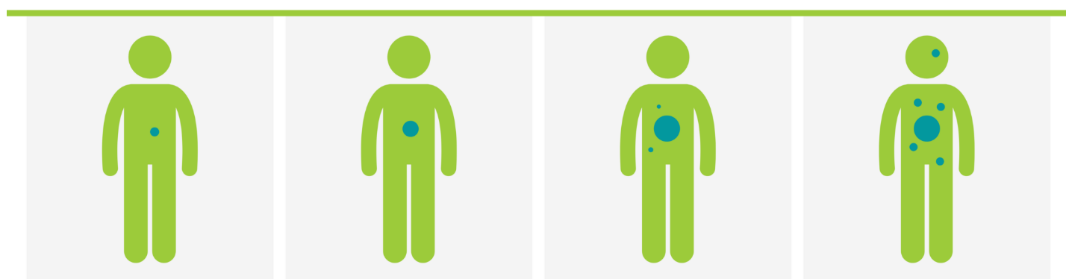
Benefits of Screening- Earlier Stage
Earlier diagnosis= earlier stage
Stage I
Small
Localised
Stage II
Larger
Localised
Stage III
Larger
Regional
Lymph nodes
Stage IV
Spread to other organs or area of body
Not curable
Notes:
2mm, pean/peanut-> symptomatic grape, walnut
65 % of cancers in OBSP are stage 1

Slide 12
Benefits of Screening- Survival
5-year Survival for Breast Cancer by Stage
Stage 1
Stage 2
Stage 3
Stage 4
100%
93%
74%
31%
https://www150.statcan.gc.ca/n1/pub/82-003-x/2023001/article/00001-eng.htm

Slide 13
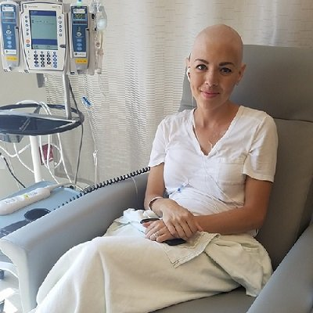
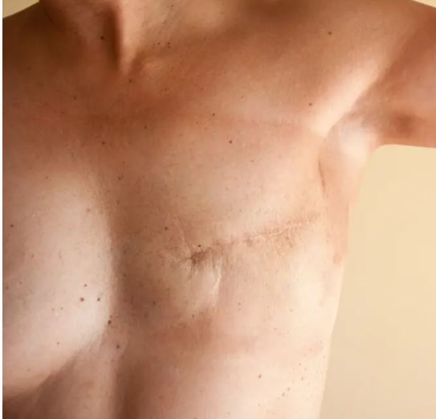
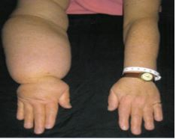
Benefits of Screening- Morbidity

Slide 14
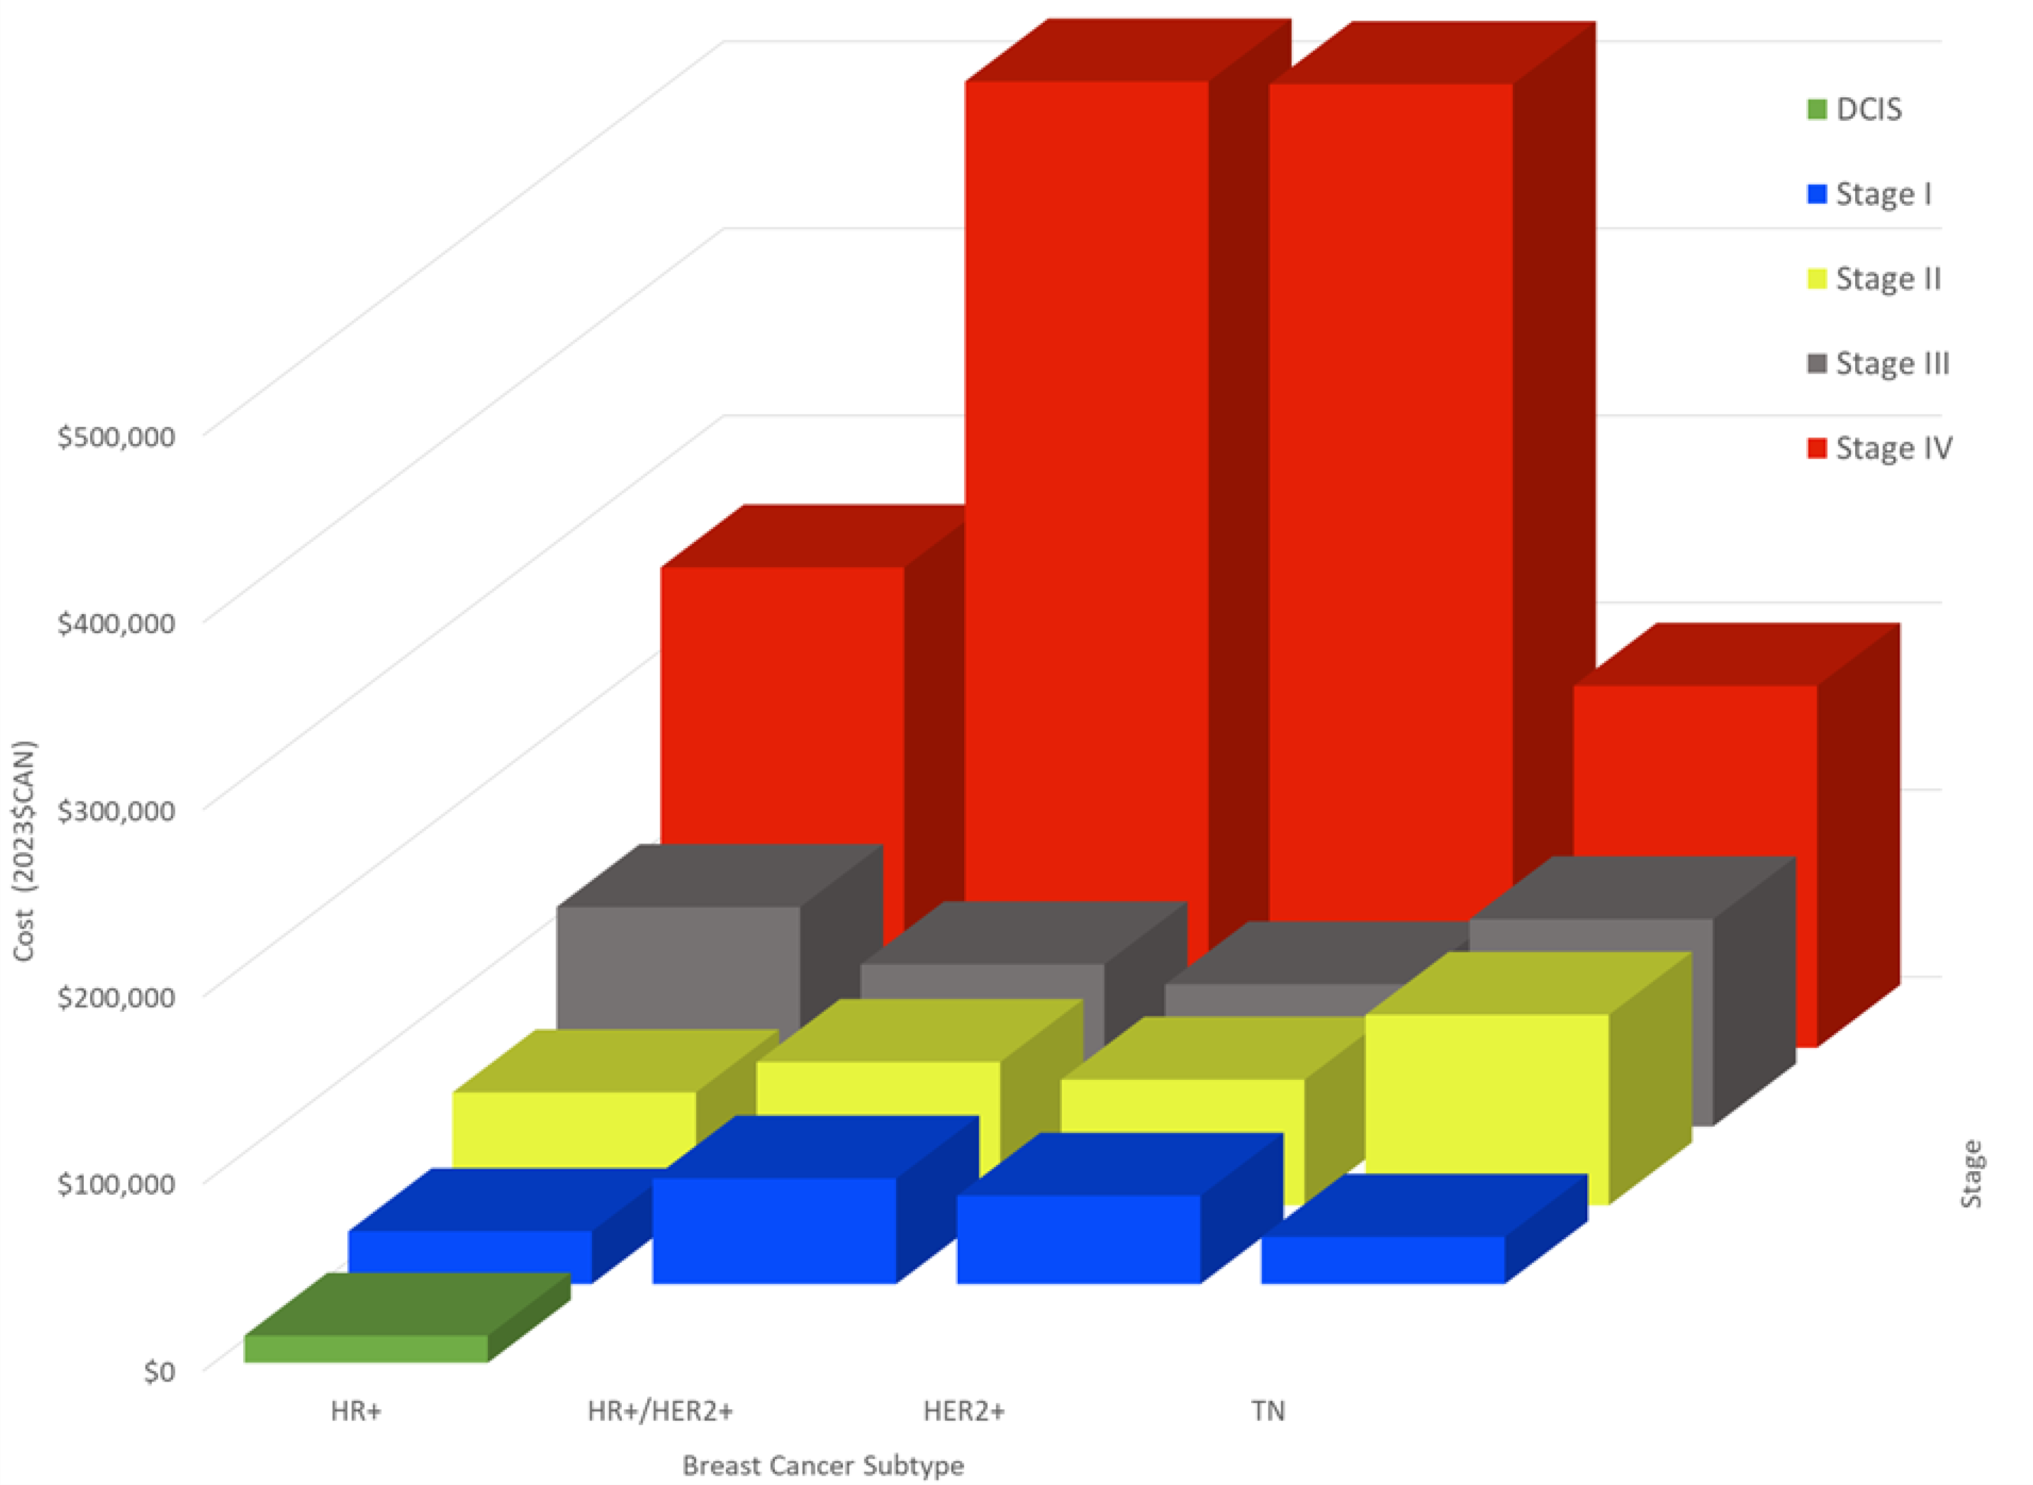
Benefits of Screening- Cost Savings
Screening saves $417 million dollars annually
Wilkinson A.N., Seely J.M.; Rushton M.;. Curr. Oncol. 2023, 30, 7860-7873

Slide 15
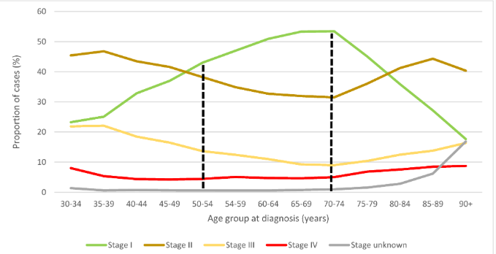
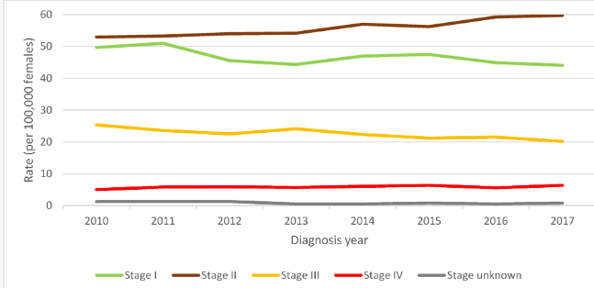
Real World Data shows Impacts of Screening on Breast Cancer Outcomes
All women by age
Women 40-49 over time
Notes:
Can look at real life data to see impact of screening on cacner outcomes

Slide 16
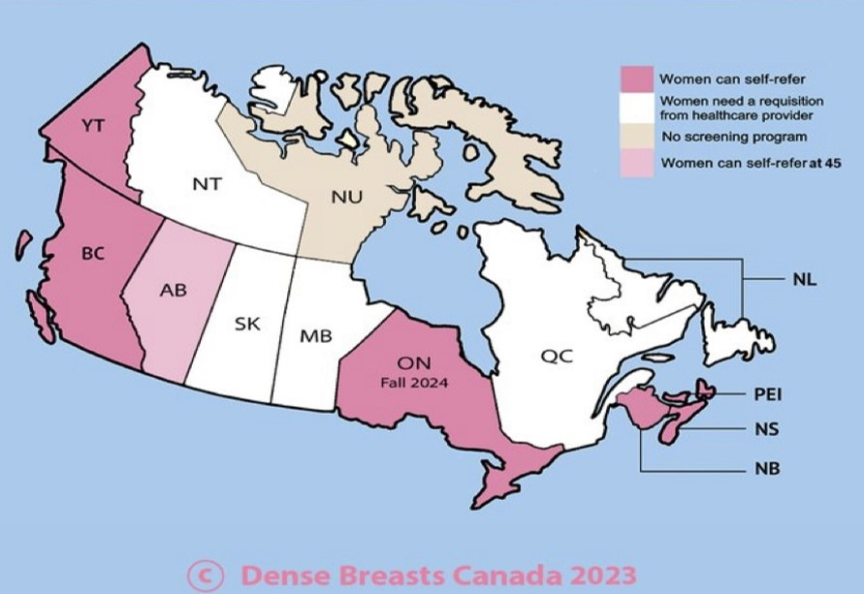
A Natural “Experiment”
Screener:
Organised program with annual recall
Comparator:
Opportunistic screening only
p<0.001
P=0.001
Provincial differences allow assessment of screening outcomes
Wilkinson, A. N. et al. Curr Oncol 29, 5627-5643
Notes:
. Take CCR and use registry data to understand and does this give us info fro women in 40s.
Luckliy or unluckily enough, we had been running a “real life experiment”
-screening available in some and no access in others- opportunistic screening only. Not part of organized.
Organised: important. Invitainots. Recalls, (annual) quality assessment- recall waits wait times.
-if running natural experiment, ?diff in 40s who could access and who could not.
We did see diff.
We saw stage diff.
Access to screening = higher stage 1, lowere rates 2,3,4
Diff on stage distribution based on wether screening program
-if you have more advanced stage-> ?survival?
Built on earlier work
-leveraged nat experiment in Canada
-used diff in screening regimes with CCR to determine outcomes.
-earlier- more advanced stga
-logical question- ?confer survival?
-that was question

Slide 17
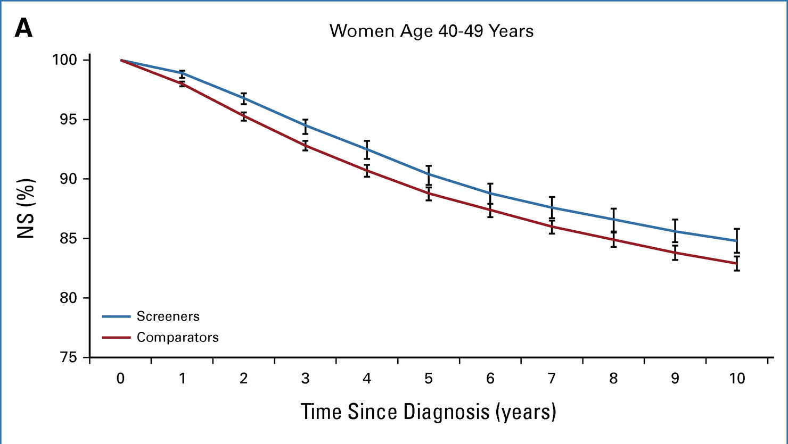
Increased Net Survival
Increased 10-year net survival:
40-49: 1.9 pp
40-44: 0.9 pp
45-49: 2.6 pp
Notes:
Dcis/recurrence
Cost effectiveness

Slide 18
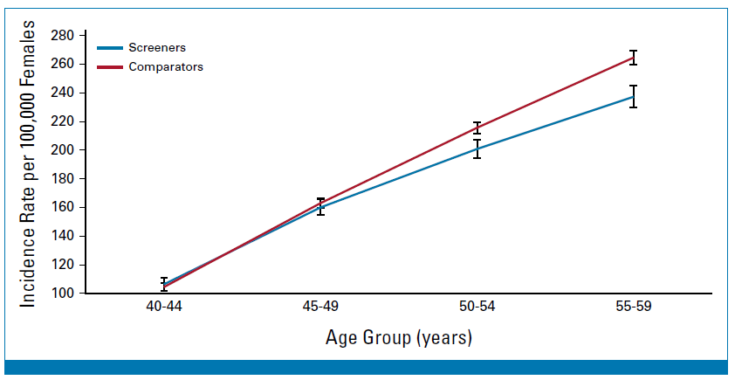
Decreased Incidence of Breast Cancer for Women in 50s
Incidence rate
Similar in 40-49 screener and comparators (p=.976)
Significantly higher in 50-59 comparators (p<.001)
Notes:
Dcis/recurrence
Cost effectiveness

Slide 19



Barriers to Screening
Patient
System
Guidelines
Inconsistent Messages= Confusion
Awareness
Fear and anxiety
Misinformation
Cultural/language
barriers
Competing priorities
Primary Care Crisis
Rural/Remote access
Inadequate resourcing
Lack of Supplemental screening
Lack of High Risk
Old RCT data hardwires racial inequities
Conflicting recommendations
Geographical inequity
One-size fits all
Provider bias
Notes:
Ontarion 6 monthts post program start ~14%.; BC 21%
If screening so helpful Awareness particularly important in trans/2 spirit
- Call to action: strengthening national screening uptake.

Slide 20
Call to Action- Strengthening our National Screening Uptake
Modernise National Screening Guidelines
Geographical Disparities
Equity Matters
Knowledge Translation
Accessibility
Adequate Resources
Patient Empowerment
Notes:
Modernise: relying on old RCTs which hardwire inequites, leave us behind new innovations
Geographical: -uneven availability: screenign 40s, end age, supplemental screening, high risk program
Equity: uptake lowest in rural/indigenous/marginalised, -Screenign outreach!
Knowledge translation: inconsistent guidelines and public debate leads to confusion. women unaware of personal risk, screenign guidelsines.
Accesibility : lackof PCPS as gatekeepers, lack of of organised programs.
Resources: -lack of HR, imaging resources. i.e. supplemental, diagnosic, bx wait times.
Patient enmpowerment: app

Slide 21
THANK YOU!
Anna N. Wilkinson, MSc, MD, CCFP, FCFP
Associate Professor, University of Ottawa
Family Physician, The Ottawa Academic Family Health Team
GP Oncologist, The Ottawa Hospital Cancer Centre
Program Director, PGY-3 FP-Oncology
@anwilkinson

Slide 22
Dr. Sandeep Sehdev
Dr. Sehdev is currently a medical oncologist and Assistant Professor at The Ottawa Hospital Cancer Centre, focusing on the treatment of breast and skin cancers and lead for the breast cancer disease site. He previously worked at The William Osler Health System (Toronto) for 25 years (-2016) and while there was Chief of the Pharmacy & Therapeutics Committee, and lead of the oncology clinical trials program and continuing medical education in oncology. He was a past lead of CME for the Community Oncologists of Metropolitan Toronto (COMET), and a past Director of the Cancer Advocacy Coalition of Canada. He is a co-founder of the Physician Alliance for Cancer Care and Treatment (Canada), an oncologist led advocacy coalition, and is a scientific advisor for the Canadian Cancer Survivor Network, and the Canadian Breast Cancer Network.
Dr. Sandy Sehdev MD FRCPC
Medical Oncologist, Ottawa Hospital Cancer Centre (University of Ottawa)

Slide 23

Hurry Up: Advocacy for Better Outcomes
CAPT — Early Detection and Better Access
Sandy Sehdev, The Ottawa Hospital Cancer Centre
Assistant Prof, U of Ottawa
Founder: CCAF (Cancer Clinician Advocacy Forum)
Nucleus Committee: REAL (Research, Excellence, Active Leadership — breast cancer guidelines)
A past director: CCAC (Canadian Cancer Advocacy Coalition)
Scientific Advisor: CBCN (Canadian Breast Cancer Network)
Scientific Advisor: CCSN (Canadian Cancer Survivor Network)
Past CHE lead, COMET (Community Oncologists of Metropolitan Toronto)

Slide 24

Disclosures
Speaking fees and advisory boards:
Novartis, Roche, Lilly, Pfizer, BMS, Merck, AstraZeneca, Helsinn, Knight, Gilead, Viatris, Seagen, Abbvie, Daiichi Sankyo, Bayer
Clinical trial support:
Novartis, Roche, Lilly, Pfizer, BMS, Merck, AstraZeneca, Seagen
Government of Ontario
My patients

Slide 25
Objectives
Review clinical advocacy
Discuss equity and speed challenges
Learn about emerging challenges
Discuss opportunities

Slide 26

WHY?
Rapid advancements
Sluggishness of our drug access systems
Patients suffer / die
Impact on our work (stress, burnout)
specialists spend 18.5M h/year on administrative paperwork in Canada

Slide 27


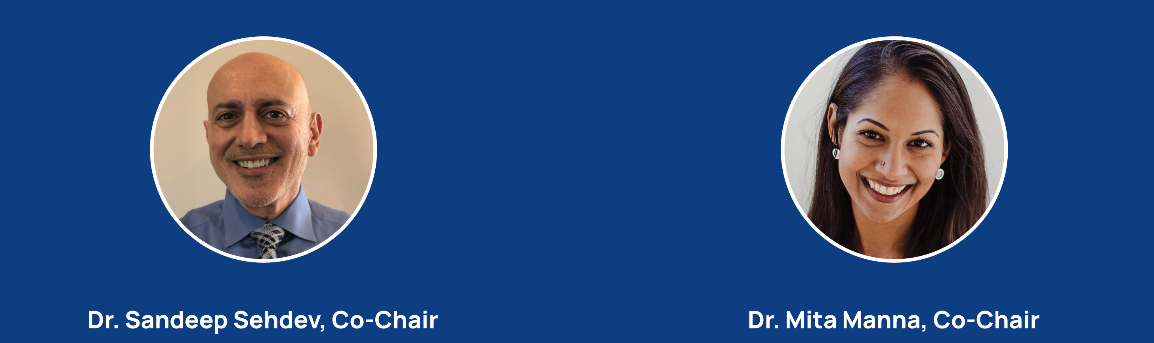
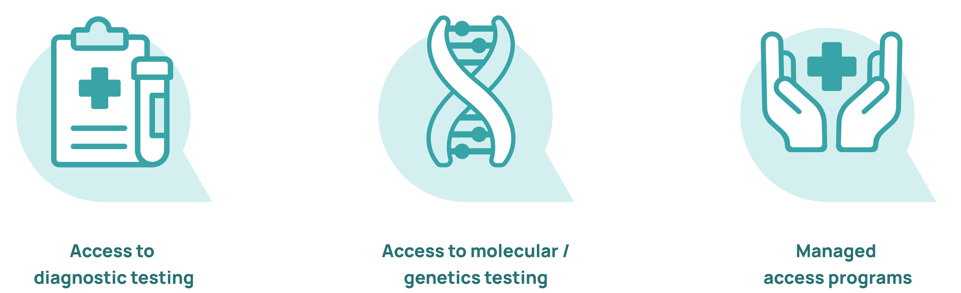

Slide 28
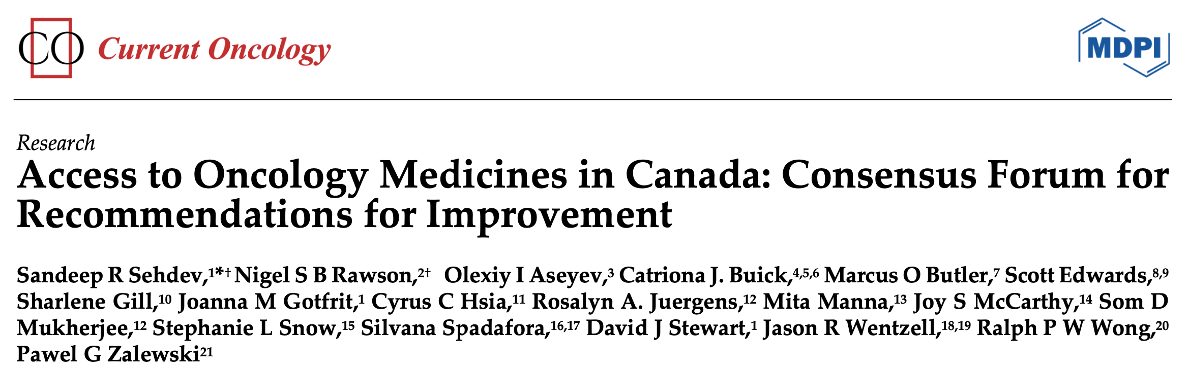
Advocacy in Canada
April 2024

Slide 29
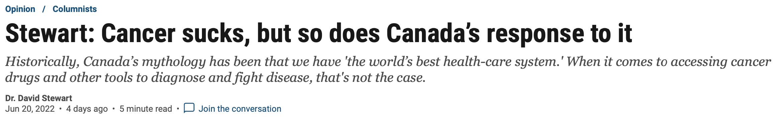
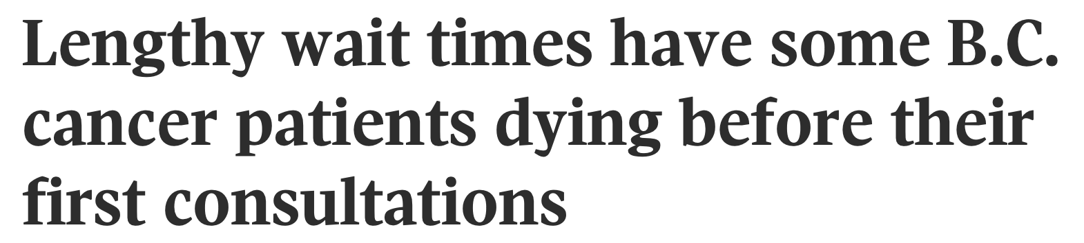
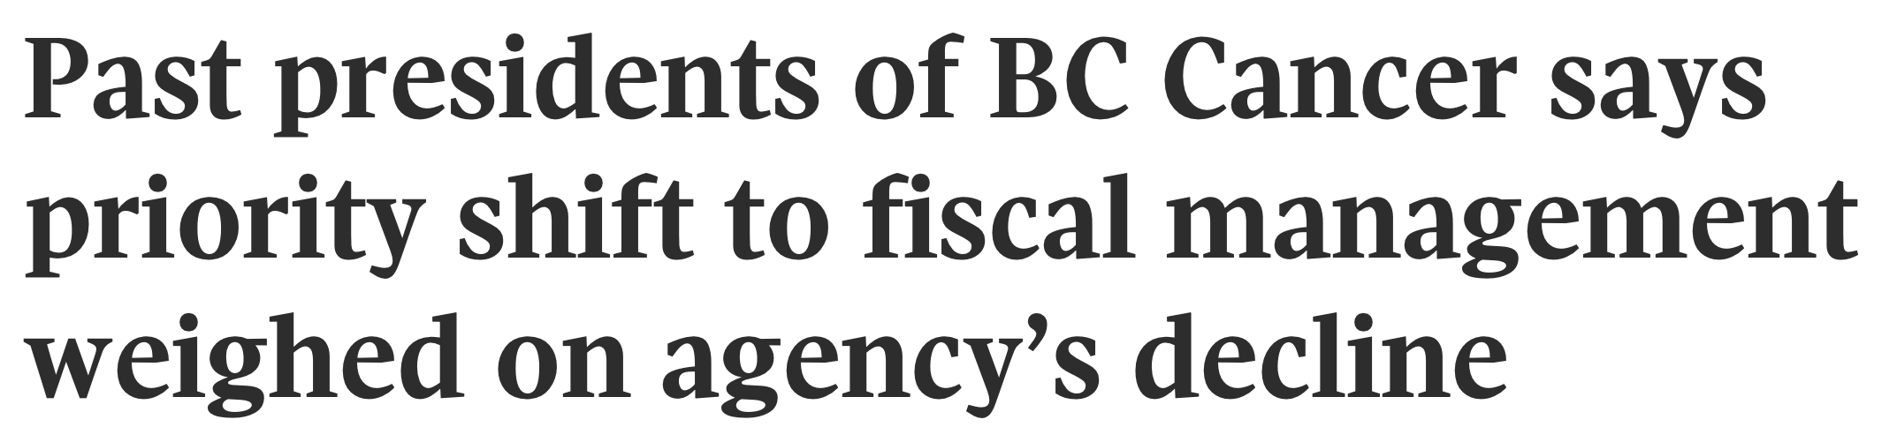
Realities
The Globe & Mail, Canada

Slide 30

Let’s Set the Stage: Examples

Slide 31
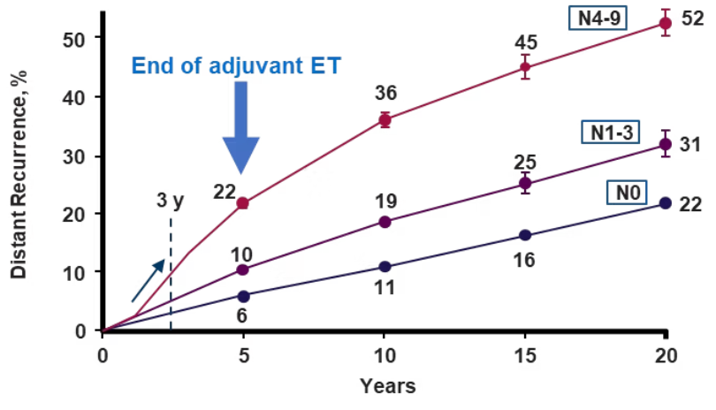




HR+/HER2− EBC Face Risk of Both Early and Late Recurrence
Early Relapse (Within 5 Years)
Late Relapse (Beyond 5 Years)
Approximately 50% of recurrences in estrogen receptor-positive (ER+) breast cancer occur within the first 5 years after diagnosis.
The risk of recurrence in HR+/HER2− breast cancer persists beyond 20 years after initial diagnosis, creating a long-term clinical challenge.
In contrast, Her2+ and ER-negative tumours typically recur earlier, with most recurrences happening in the first 5 years.
Key Points About Recurrence Risk
Nodal Status
Metastasis
Treatment Challenge
Risk of recurrence remains irrespective of nodal status
The majority of invasive disease events are distant recurrences (metastasis)
No cure currently exists for metastatic disease
References: 1. Foldi J, et al. J Clin Oncol. 2019;37:1365-1369. 2. Gomis RR, et al. Mol Oncol. 2017;11:62-78. 3. Pedersen RN, et al. J Natl Cancer Inst. 2022;114:391-399. 4. Pan H, et al. N Engl J Med. 2017;377:1836-1846. 5. Johnston SR et al. Lancet Oncol. 2023;24:77-90. 6. Gnant M, et al. J Clin Oncol. 2022;40(3):282-293. 7. Slamon D, et al. ASCO 2023. LBA500. 8. Early Breast Cancer Trialists' Collaborative Group. Lancet. 2015;386:1341-1352.

Slide 32
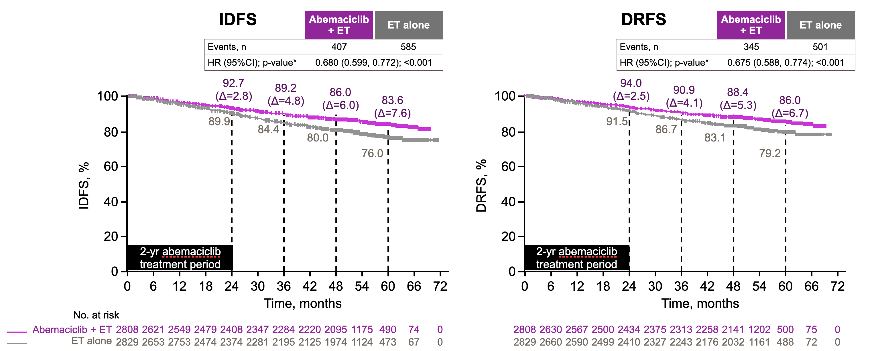
High risk HR+/HER2– Early Breast Cancer
Adjuvant Abemaciclib
2 years of additional Rx
diarrhea
OS data: +
pnd Oct/25
monarchE trial: 5y results
CI, confidence interval; DRFS, distant relapse-free survival; ET, endocrine therapy; HER, human epidermal growth factor receptor-2; HR, hazard ratio; HR, hormone receptor; IDFS, invasive disease-free survival.
Rastogi et al, JCO 2024.

Slide 33
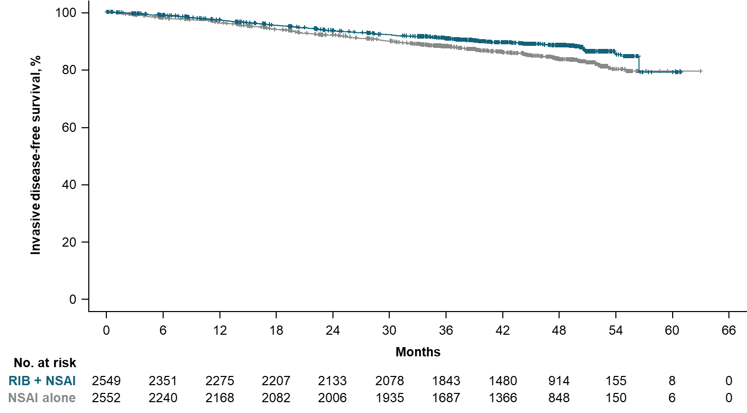
Mod-High Risk Early Breast Cancer: Adjuvant Ribociclib (NATALEE)
90.8% 88.1% ∆2.7% Median follow-up for iDFS, 44.2 moª
 | RIB + NSAI | NSAI alone
Events/n (%) | 263/2549 (10.3) | 340/2552 (13.3)
Hazard ratio (95% CI) | 0.715 (0.609-0.840)
Nominal 1-sided P value | <0.0001
88.5%
83.6%
∆4.9%
iDFS
ESMO 2024
Content of this presentation is copyright and responsibility of the author. Permission is required for re-use.

Slide 34
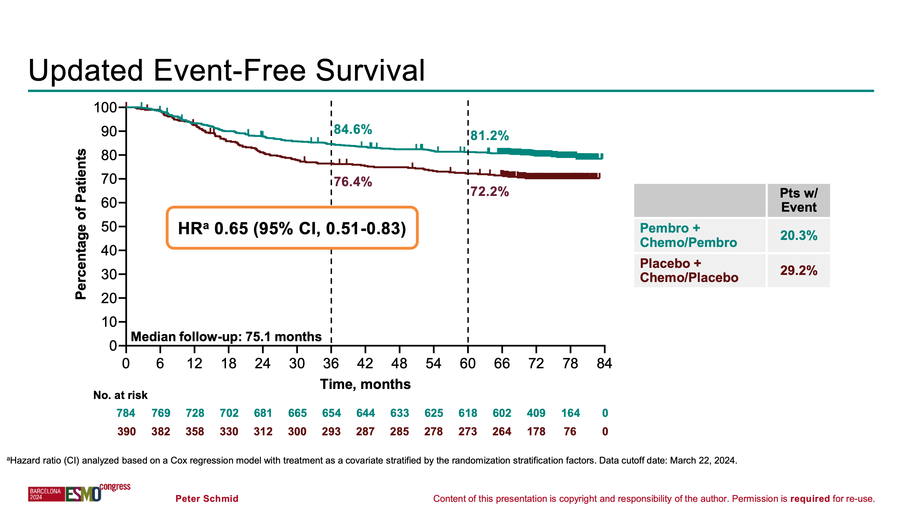
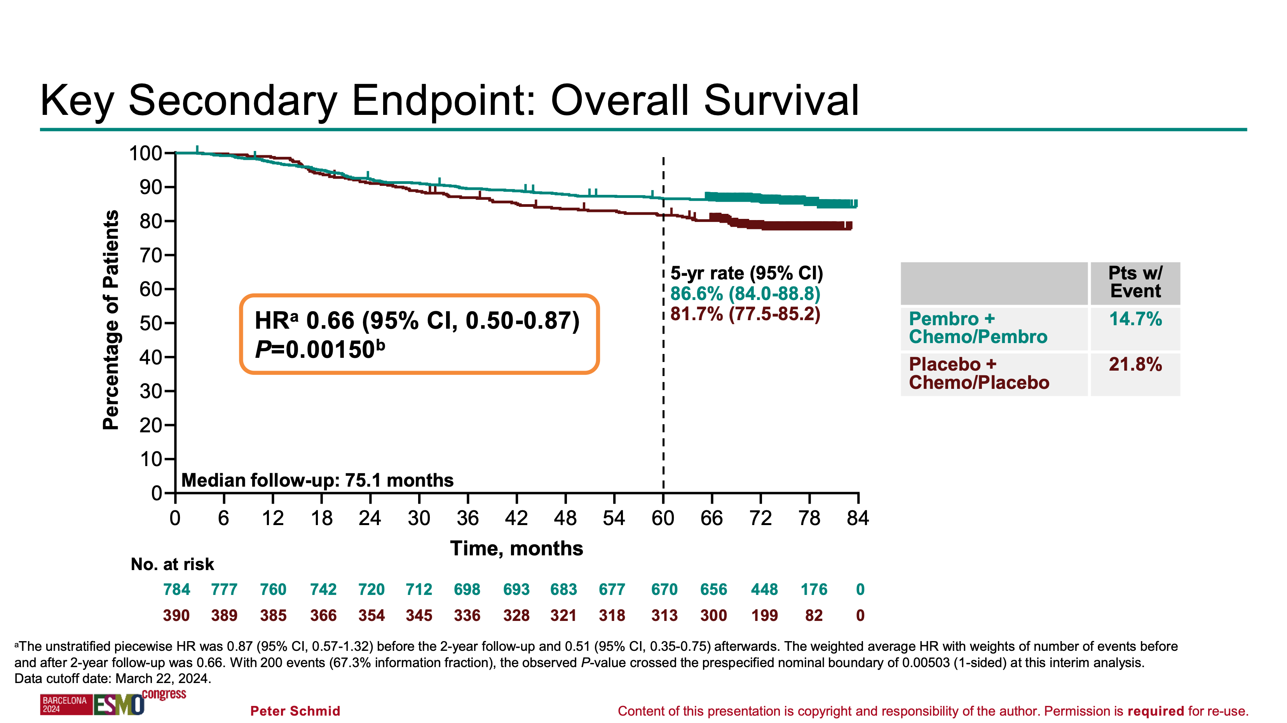
KN522: Stage II-III Early TNBC: Pembrolizumab
more common in younger women
immunotherapysometimes dangerous and unpredictable toxicities (some lifelong)
one year Rx: $$$
Peter Schmid: ESMO 2024

Slide 35
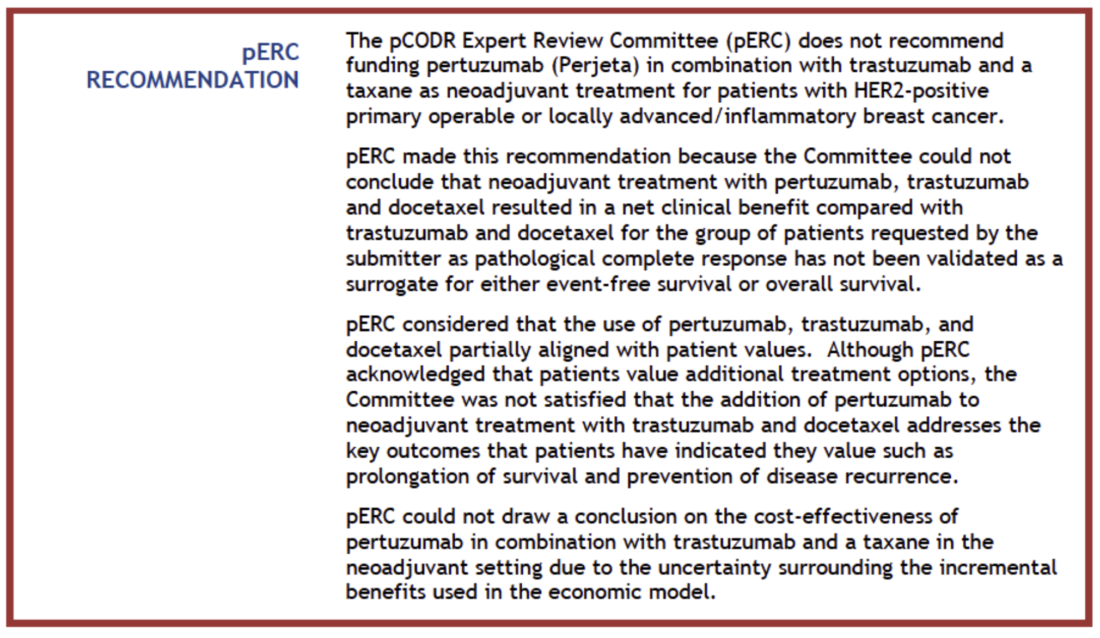
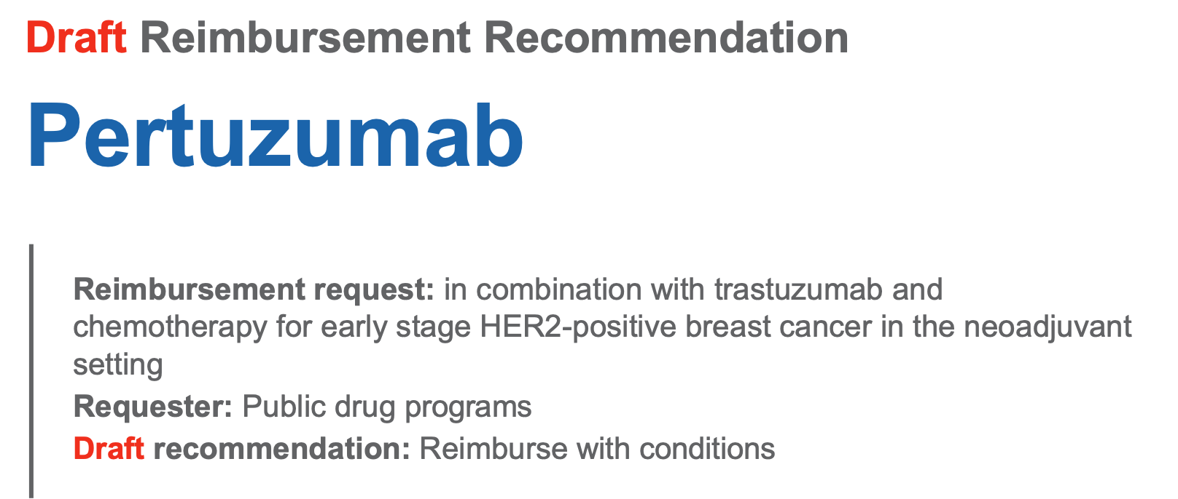
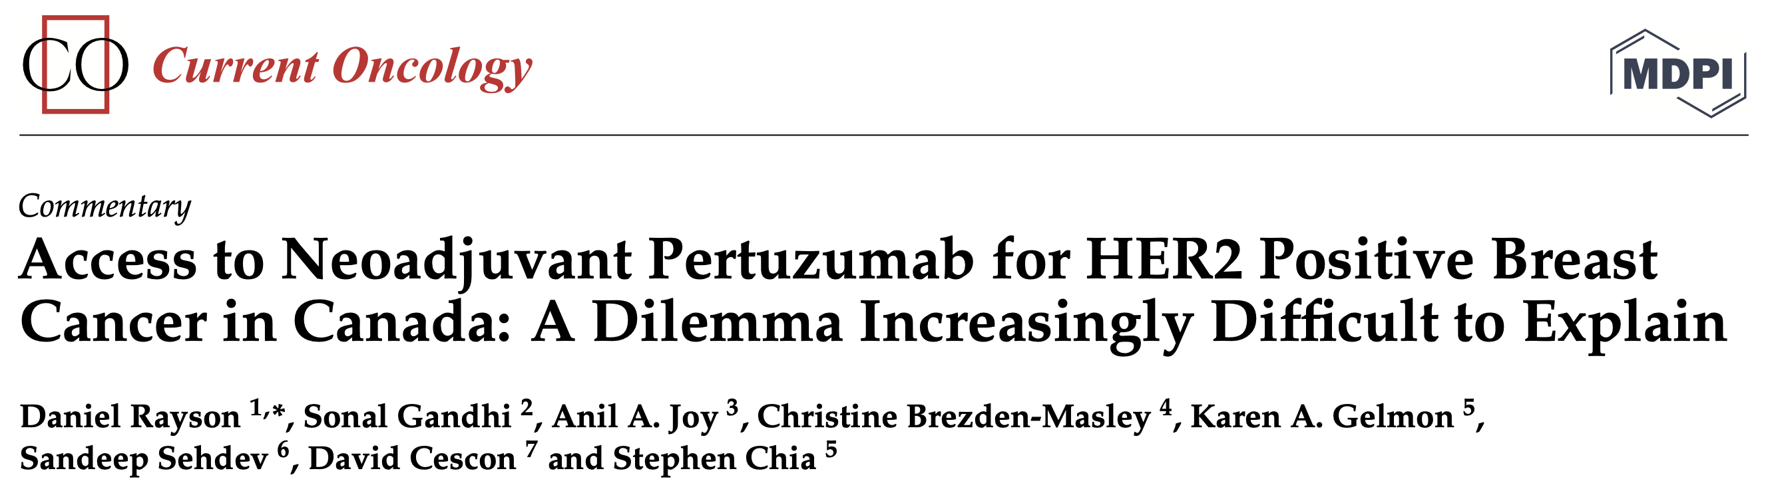
Stage II-III Her2+ Early Breast CA: Neoadjuvant Pertuzumab
10 year wait
Inequity: privately funded
International consensus
+Québec
CDA
2025
CADTH
2015

Slide 36
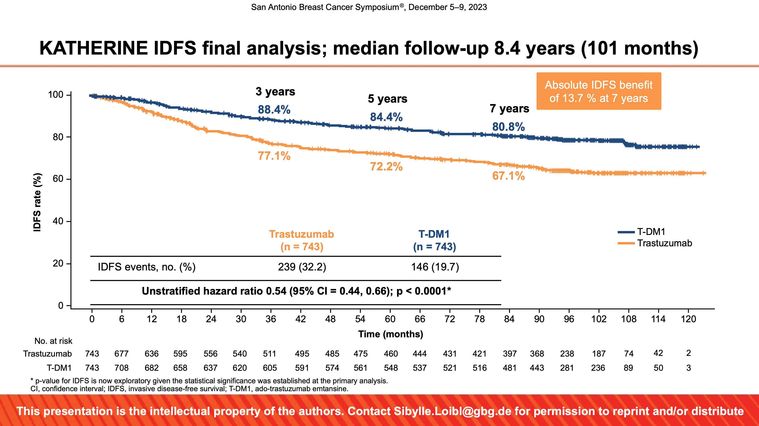
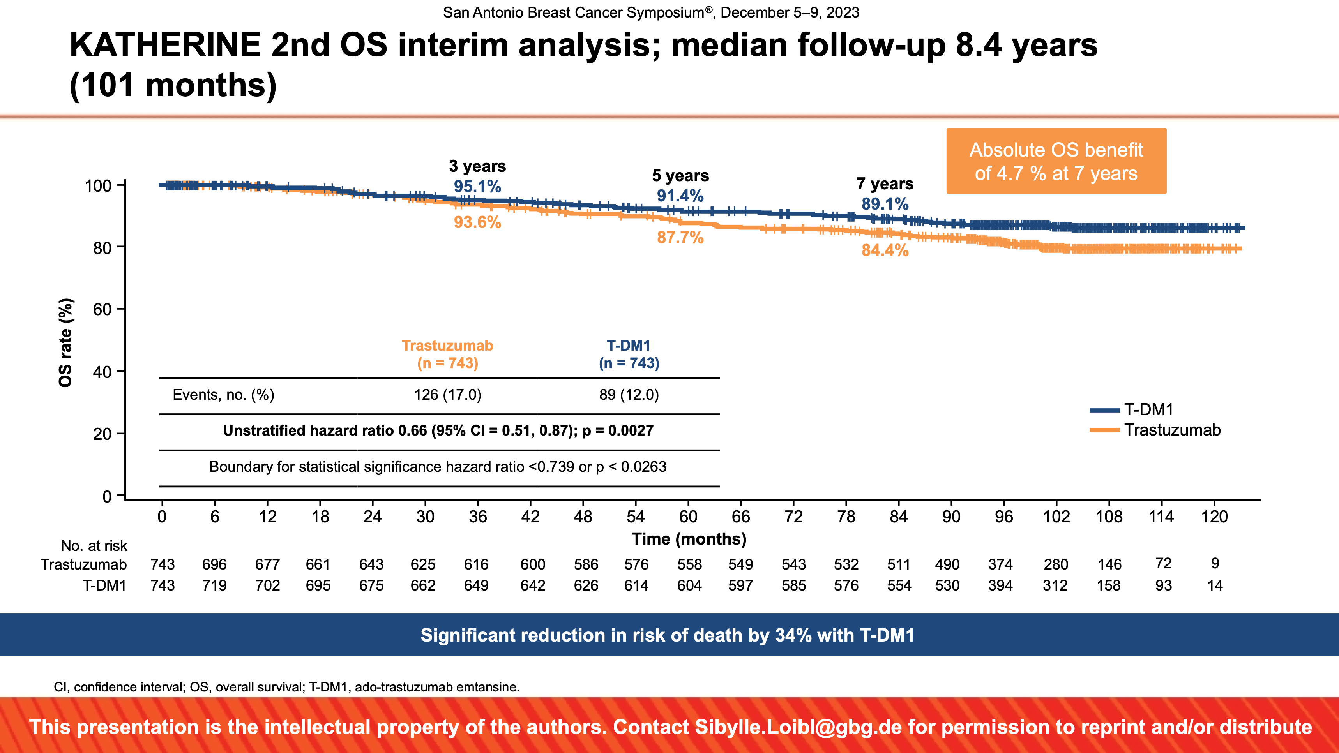
KATHERINE: Stage II-III Her2+ Breast Cancer: Adjuvant T-DM1
neoadjuvant pertzumab: CADTH declined in 2018, approved 2025
⬆︎ pCR = less need for T-DM1
can consider shorter course postop transtuzumab (biosimilar)
~ cost neutral
less toxicity, less Rx
T-DM1 = trastuzumab emtansine, Kadcyla™
S Loibl: SABCS 2023

Slide 37
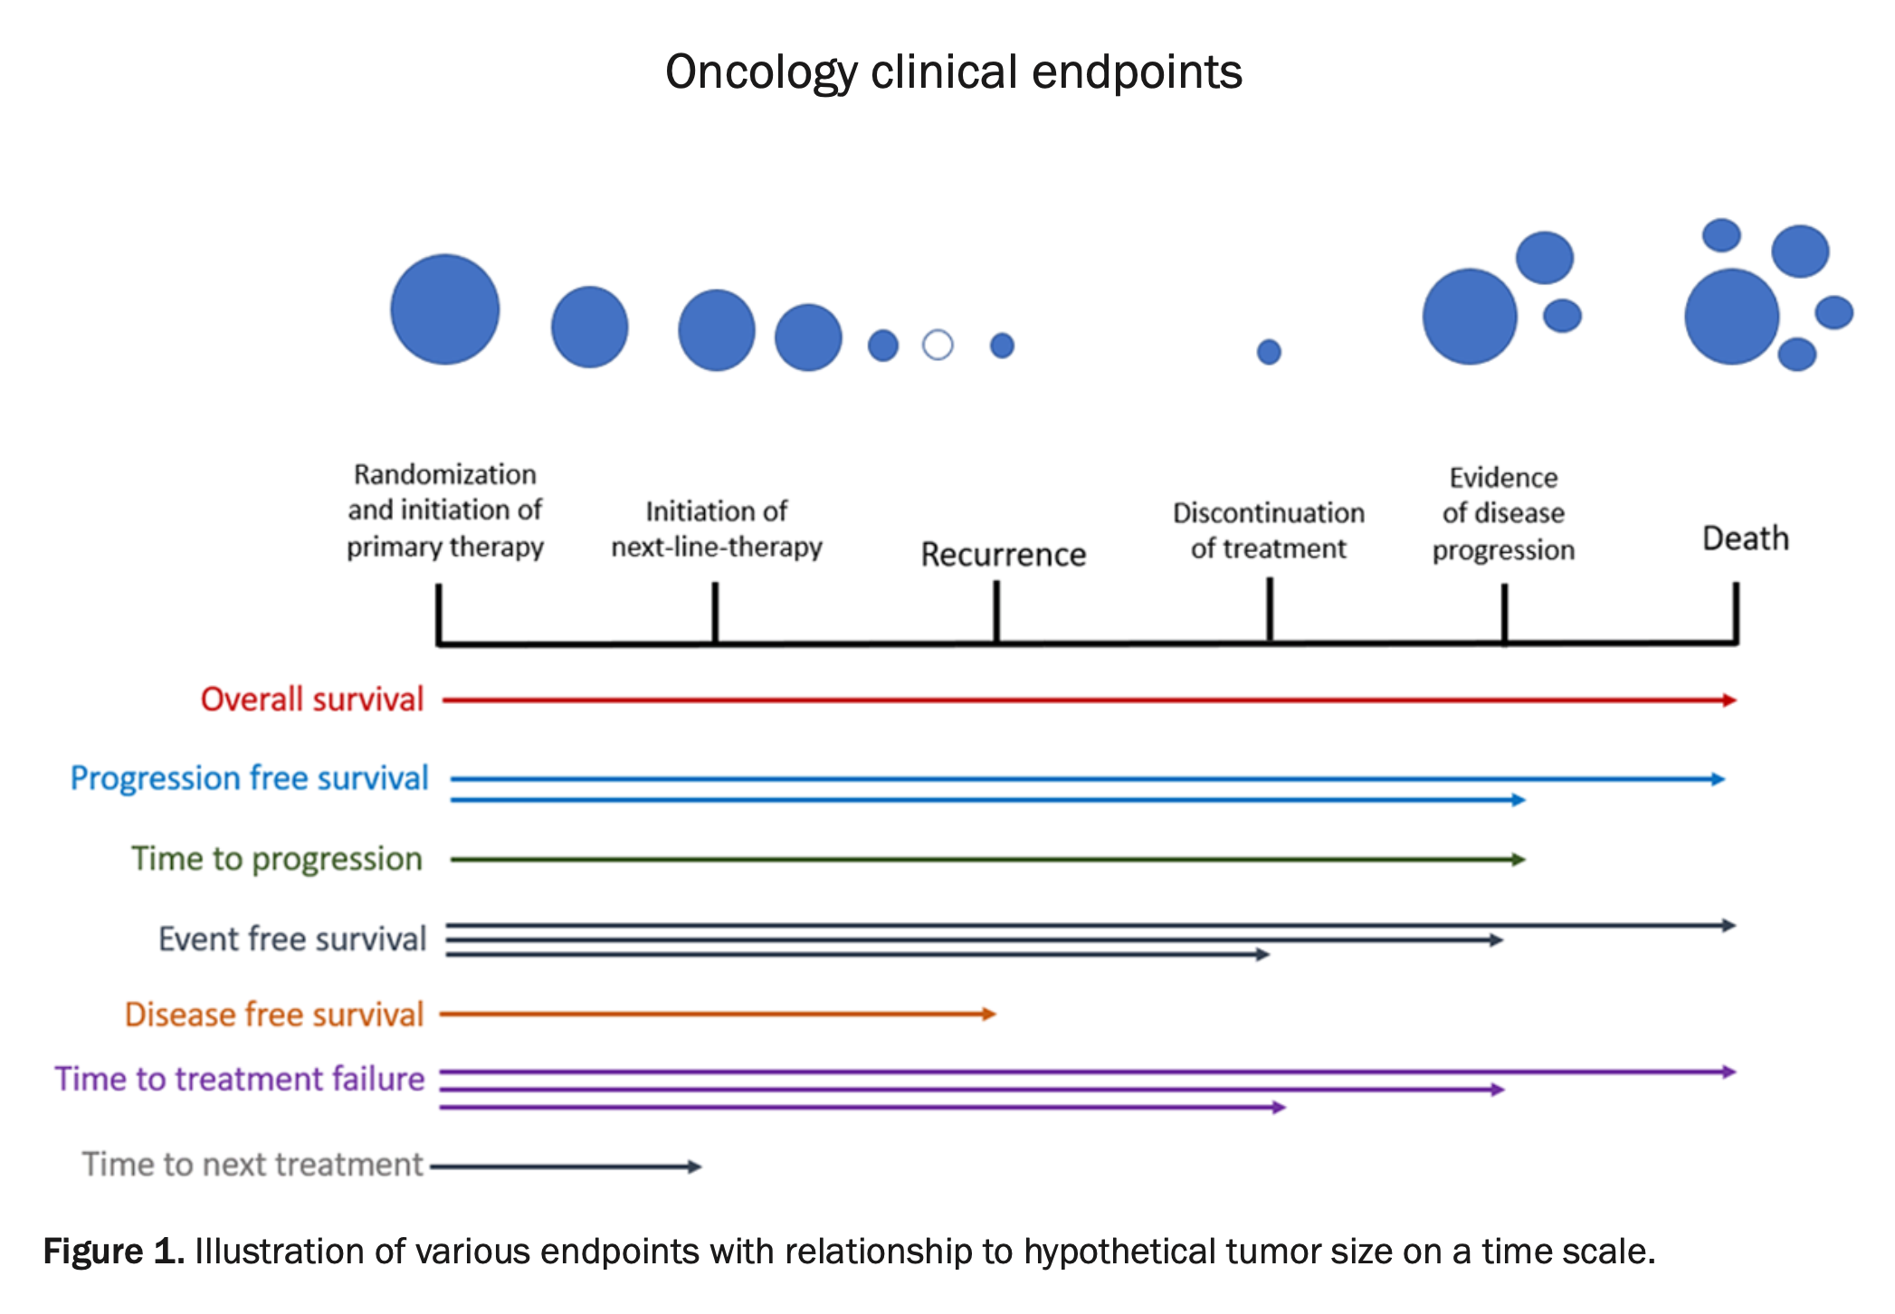
Surrogate Endpoints in Oncology Trials
Am J Cancer Res 2021;11(4):1121-1131. www.ajcr.us /ISSN:2156-6976/ajcr0130927
Amanda Delgado, Achuta Kumar Guddati. Clinical endpoints in oncology - a primer

Slide 38

Surrogate Endpoints in ADJUVANT Trials
METS
Am J Cancer Res 2021;11(4):1121-1131. www.ajcr.us /ISSN:2156-6976/ajcr0130927
Amanda Delgado, Achuta Kumar Guddati. Clinical endpoints in oncology - a primer

Slide 39

PROBLEMS
Up front: primary care
Specialist shortages: delays (surgeons, oncs)
Diagnostic imaging: U/S, CT, …
for diagnosis and for follow up
Biomarkers
Drug access delays
Clinical trial access
Human resources — across the board
Infrastructure: space/ rooms/ beds
Implementation: training, rollout

Slide 40
Drug Access Landscape
Passing the torch(es)

Slide 41
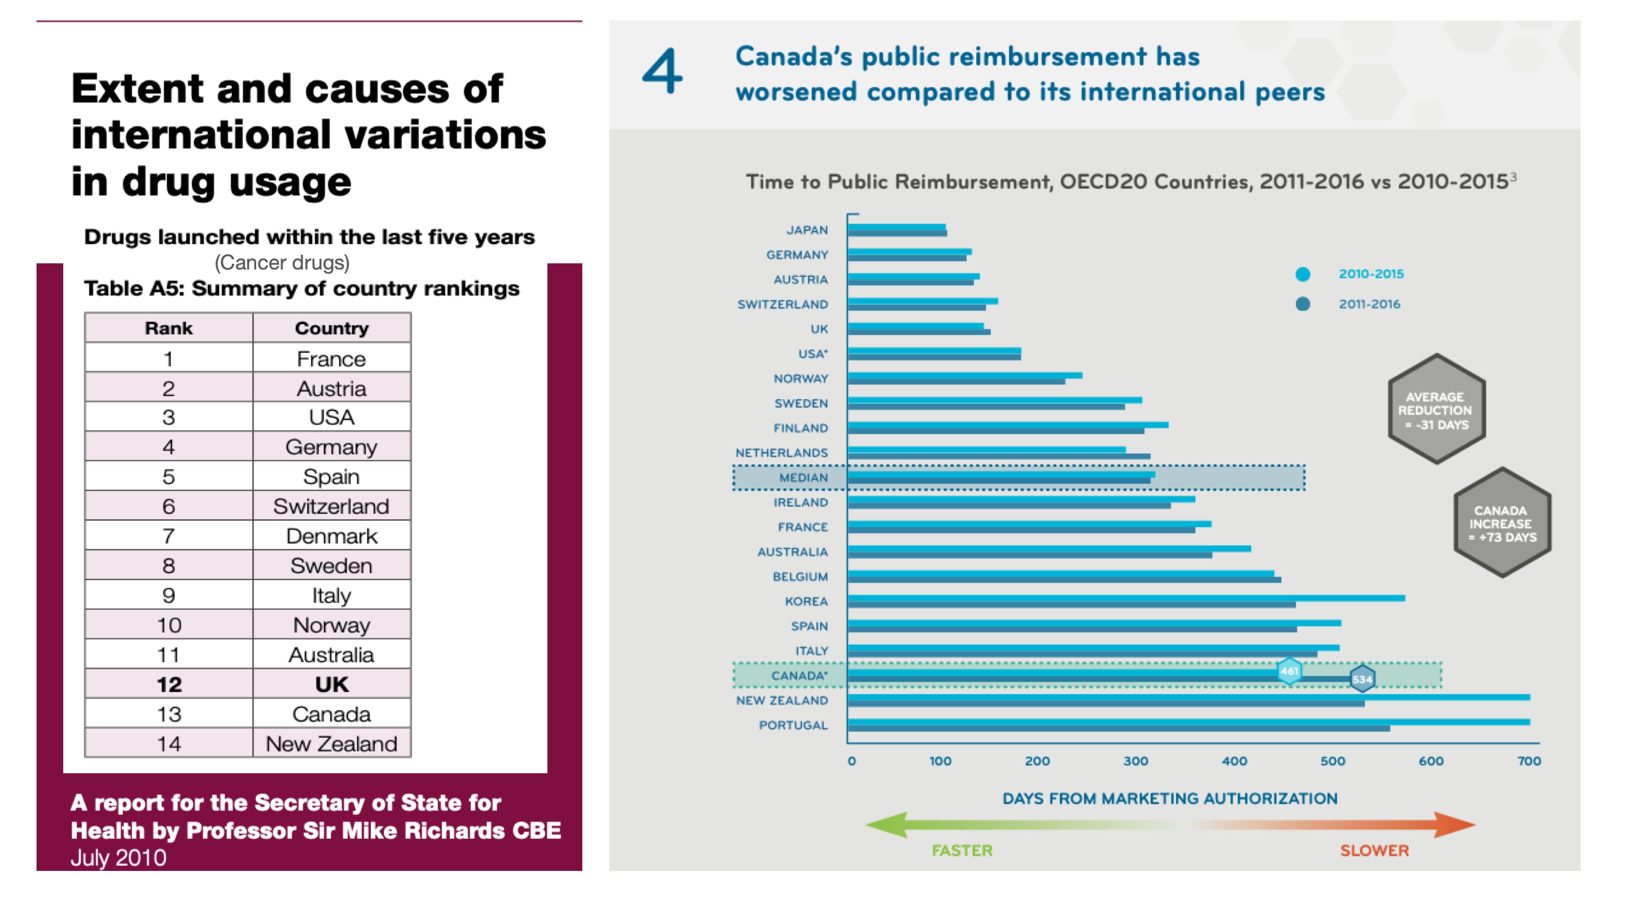
Accessibility

Slide 42

Systemic Barriers
Problems we’ve created

Slide 43
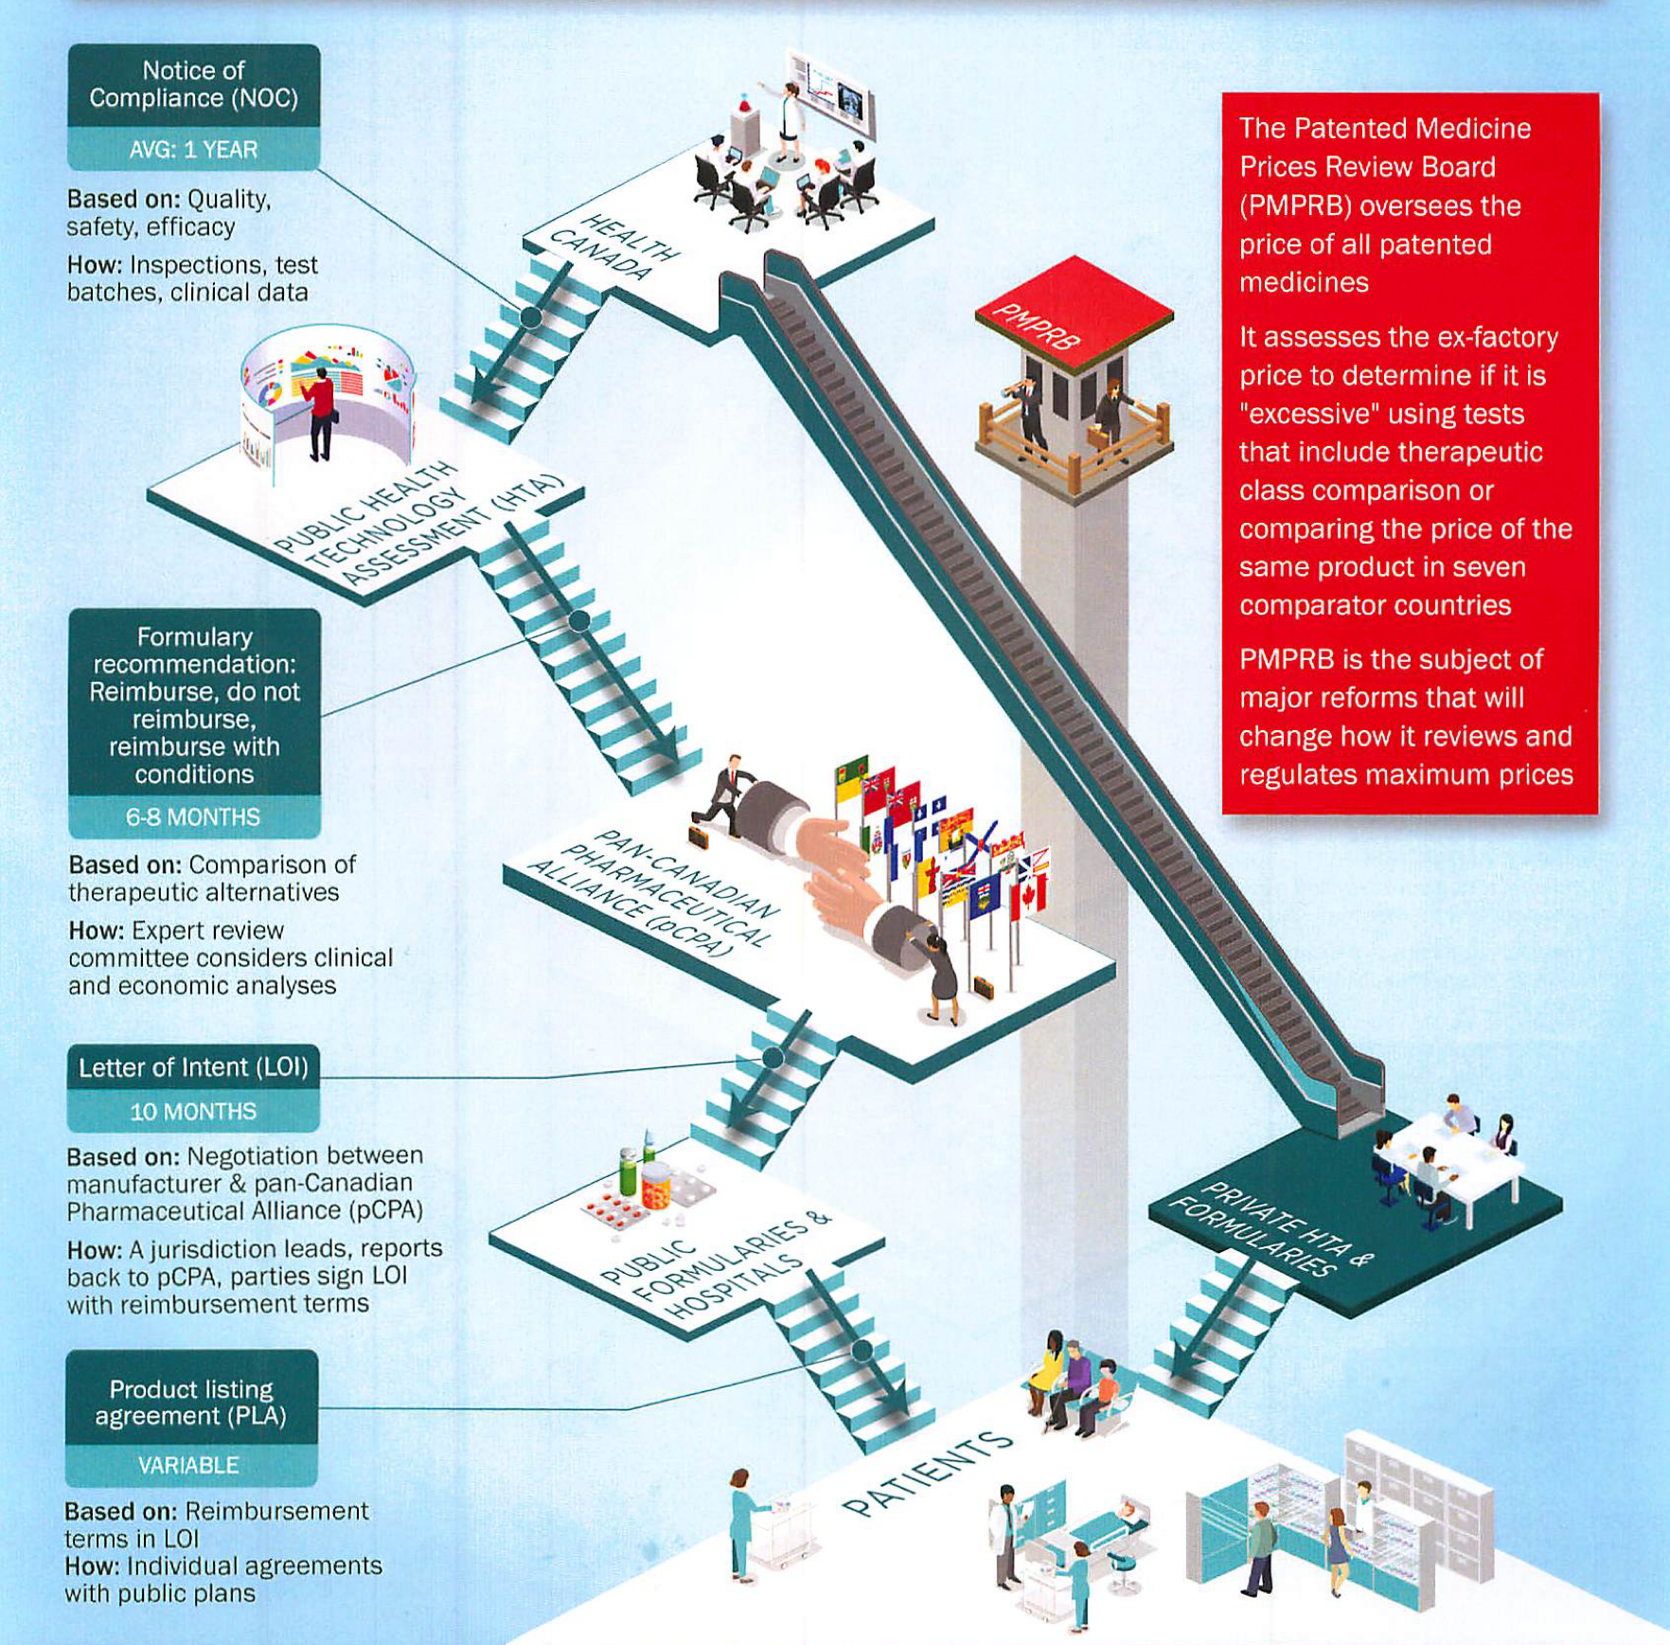
Health Canada: timelines, endpts
PMPRB: $50K/QALY
CADTH - INESSS / CDIAC
PCPA: $ 50 - 100 K / QALY
Provinces
Private Insurance: Alignments
Graphic from 3Sixty Public Affairs
CADTH: Cdn Agency for Drugs and Technology in Health; CDIAC: Cdn Drug Implementation Advisory Committee;
PCPA: Pan Cdn Pharmaceutical Alliance; PMPRB: Patented Medicines Prices Review Board

Slide 44
Sequential process leads to long reimbursement timelines
Development of funding algorithms
pCPA negotiation process (Avg 10 months)
Health Canada review
(6-12 months)
CADTH review process (Avg 7 months)
Provincial listing
(variable)
Average time Health Canada takes to review a medicine
Average time CADTH review process takes for medicines following Health Canada’s approval
Average time it takes to complete pCPA negotiation process
Average time it takes for provinces to add product to their formularies following pCPA deal
Possibility of parallel reviews
What time is reasonable?
CADTH source: IQVIA, Provincial Reimbursement Advisor pCPA wait time source: IMC data based pCPA brand name drugs negotiations status: https://www.pcpacanada.ca/negotiations

Slide 45
Problems / Solutions?
Health Canada: Approves drug safety and effectiveness
Outcome 6-12 mos after US FDA approval, behind Europe
NOCC
Project Orbis — cooperation with FDA/Europe but only for some reviews
CDA (Canada Drug Agency): the 3 “A’s”:
Accessibility — top priority, not being achieved for many drugs
Affordability — new drug costs will rise, benchmarks (other countries)
Cost thresholds old, out of date, never inflation adjusted x 30 yrs
Appropriateness — Evolution of targets, access to biomarkers / scans
meaningful expert input
Parallel reviews with Health Canada (HTA)

Slide 46
Problems / Solutions?
CPAC: Priorities
Diagnose cancer faster, accurately and at an earlier stage
screening, education, awareness, and delivery!
Deliver high quality care in a sustainable world class system
need metrics — more action
tailored for Canadians, including underprivileged and indigenous
Eliminate barriers to people getting the care they need
technology: xrays, ultrasound
human resources — techs, docs… (GPs, …)

Slide 47
pCPA Timelines
From PCPA decision: 44 up to >300 days for provincial signoff
implementation planning and coordination !
Target Timeline 180 days
N = number of completed negotiations
Source: IMC analysis of pCPA data collected from https://www.pcpacanada.ca/negotiations

Slide 48
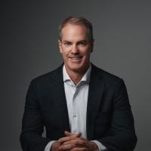
Problems / Solutions?
CDA: TLA: temporary listing agreements
Rare disease framework, ph2 data
PCPA:
Ramping up staff / capacity
pTAP: Temporary Access Program (“front door?”)
Collaborative approach
Need solutions for proven, ph 3 data !
Short - mid term challenging
Doug Clark

Slide 49

Problems / Solutions?
Ontario: Fast track pilot
Provinces: Speed up sign-offs and implementation
Inter-provincial barriers?
Alignment
Licensing
Doug Ford

Slide 50


THANK YOU!

Slide 51
Kimberly Carson
Kimberly Carson is a dynamic leader in the charitable sector with over 25 years of experience driving impact through innovation and strategy. Since joining Breast Cancer Canada as CEO in 2015, she has transformed the organization by restructuring operations, expanding fundraising initiatives, and championing cutting-edge research across the country.
A recognized voice in national and global breast cancer forums, Kimberly serves on multiple advisory boards and patient panels, shaping conversations on patient experiences and precision oncology. Her expertise in government and media relations further strengthens Breast Cancer Canada’s role as a leader in advancing breast cancer research and ensuring equity and access to the best care for Canadian breast cancer patients.
Under Kimberly’s leadership, the organization has bridged national research with local communities through volunteer hubs across Canada and a national, first of its kind, patient-reported outcomes study, ensuring the patient voice is included in research. She continues to push the boundaries of patient-focused projects, integrating AI and precision medicine to redefine breast cancer care—because at Breast Cancer Canada, progress is beautiful.
Kimberly holds an MA in Leadership from Royal Roads University, a BA in Psychology from York University, and a BA in Nonprofit Management from Western University. Her vision and commitment to bridging critical gaps in the patient journey have positioned Breast Cancer Canada as a driving force for change, transforming the landscape of breast cancer research.
Kimberly Carson
CEO
Breast Cancer Canada

Slide 52


Slide 53


Slide 54
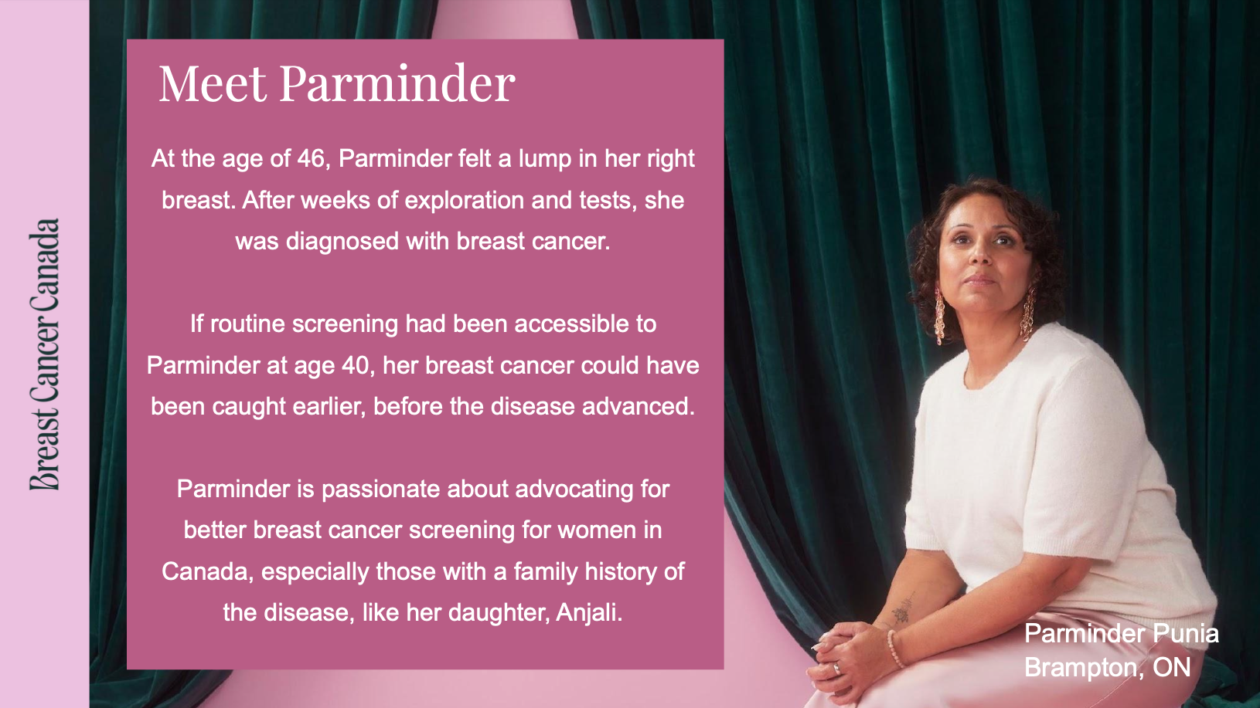

Slide 55
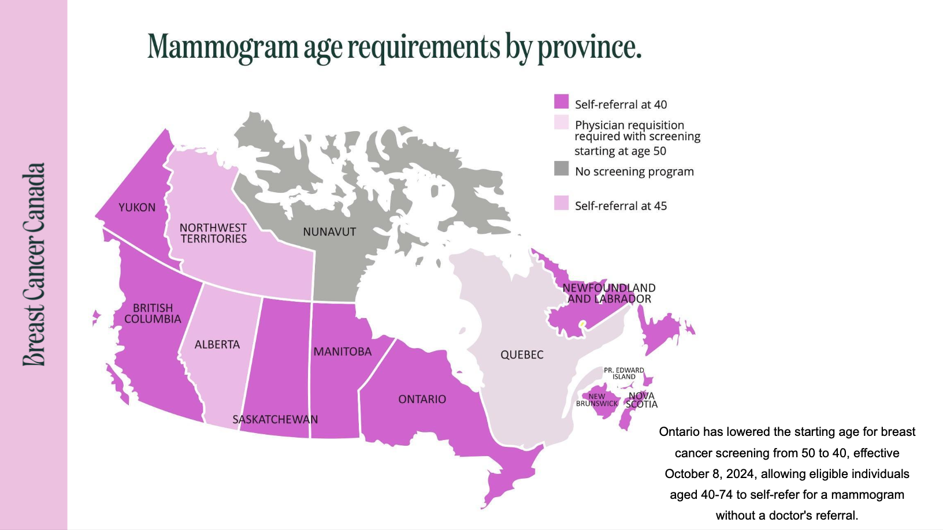

Slide 56
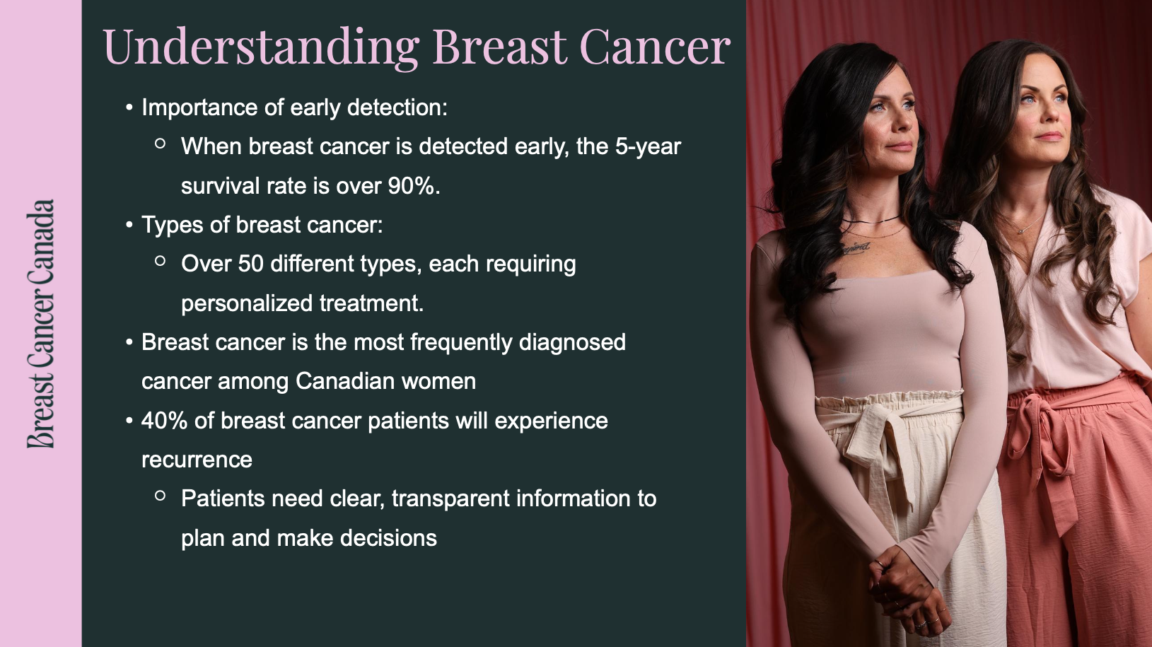

Slide 57


Slide 58


Slide 59
Panel Discussion

Slide 60
Panelists
Moderator:
Speakers:
Jefferson Tea
CEO,
Agilis Health
Dr. Anna Wilkinson
MSc., MD, CCFP, FCFP
GP Oncologist,
The Ottawa Hospital (University of Ottawa)
Dr. Sandeep Sehdev MD FRCPC
Medical Oncologist, Ottawa Hospital Cancer Centre (University of Ottawa)
Kimberly Carson
CEO
Breast Cancer Canada

Slide 61

THANK YOU!

