Slide 1
Patient impact in CDA-AMC reimbursement reviews:
How can we build on progress to date?
September 23, 2025
9:15 – 10:15 am
Toronto, Ontario
Notes:
Bill’s introductory remarks:
Deliberative frameworks are used in health technology assessment (HTA) to discuss – and help address – the complexities surrounding the value of new technologies and to provide recommendations to payers regarding public reimbursement. They are intended to provide a balanced, fair, and transparent decision-making process that integrates diverse perspectives and values, ultimately leading to better health outcomes and greater public trust.
This panel will discuss, and illustrate via concrete examples, how this collaboration between leaders from patient organizations, CDA-AMC, and industry led to meaningful change in CDA-AMC’s reimbursement review process and will aim to explore ways to advance and sustain progress towards greater patient-centricity in HTA-decision making frameworks.

Slide 2
Disclosures
Patient organizations:
All patient organizations on the Steering Committee received modest compensation from Johnson & Johnson for the initial work of this project, which involved completing an interview survey. However, no individual members were provided compensation, and no compensation was provided to the patient organizations for attendance or participation in meetings for the project, including participation at the CAPT Conference.
3Sixty Public Affairs:
Bill Dempster leads 3Sixty Public Affairs and provides consulting services to innovative pharmaceutical companies, including developers of oncology medicines, as well as health data providers, not-for-profit health organizations, health charities, healthcare professional associations and other health system stakeholders.​
Canada’s Drug Agency:
Canada’s Drug Agency is funded by contributions from the Canadian federal, provincial, and territorial ministries of health. We receive application fees from the pharmaceutical industry for:
    Our Reimbursement Review processes, including those used for:
      oncology drugs
      non-oncology drugs
      plasma protein and related products reviewed through the interim process
    Scientific Advice

Slide 3
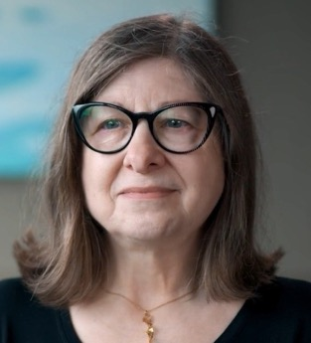
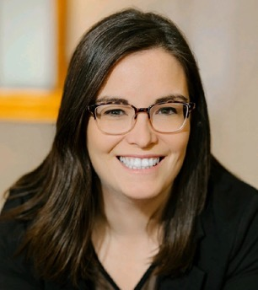
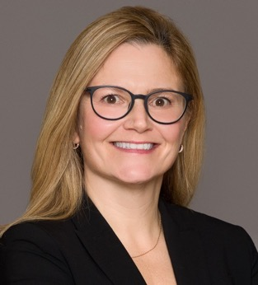
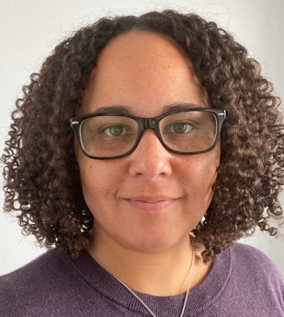

Panel
Speakers
Moderator
Gail Attara
CEO & Co-Founder
Gastrointestinal Society
Jessy Ranger
Director, Patient Programs, Health Policy & Advocacy
Myeloma Canada
Bonnie Macfarlane
Associate Director – HTA, Submissions and Analytics
Johnson & Johnson
Deirdre DeJean
Lead, Health Technology Assessment and Deliberation
Canada’s Drug Agency (CDA)
Bill Dempster
President
3Sixty Public Affairs
Notes:
Bill to provide an overview of the leaders from CDA-AMC who have been involved in this initiative, and introduce those representing CDA-AMC on today’s panel:
Bill to provide an overview of all steering committee members, and introduce those representing the steering committee on today’s panel:
Gail Attara, Chief Executive Officer & Co-Founder, Gastrointestinal Society
Jessy Ranger, Director, Patient Programs, Health Policy and Advocacy, Myeloma Canada
Bill to thank Johnson and Johnson for their support and leadership on this initiative and introduce Bonnie for participating on today’s panel:
Bonnie Macfarlane, Associate Director, Health Technology Assessment, Submissions and Analytics, Johnson & Johnson
Deirdre DeJean, Lead, Health Technology Assessment and Deliberation, Canada's Drug Agency

Slide 4







CAPACITY
BUILDING
RELEVANCE
FAIRNESS
EQUITY
LEGITIMACY

Slide 5
“Our work in patient engagement in HTA is not complete”
“What could CDA be doing differently to
closer align to these values and standards?”
https://www.cda-amc.ca/framework-patient-engagement-health-technology-assessment
Notes:
https://www.cadth.ca/cadth-framework-patient-engagement-health-technology-assessment
CADTH’s commitment to patient centricity is reflected in its public acknowledgement of the weakness in its approach to patient engagement and processes and its desire to better align with international values and standards in this regard.
.

Slide 6

Analysis : CADTH procedures vs. HTAi Values and Standards
Patient Organization interviews and survey
Steering Committee established
Roundtable discussions: Steering Committee & CADTH executives
Panel Discussion at CDA-AMC Symposium
CAPT Panel Discussion
2022
2023
2023
2024
2024
2025
34 opportunities identified
Alignment on opportunities for improvement & collaboration to address them
Opportunities prioritized, position paper developed
Opportunities for collaboration identified
Publication of collaboration pursued

Slide 7






Steering Committee
Barry Stein
Susi Vander Wyk
Gail Attara
Jessy Ranger
Stephanie Hamzo
Dave Gallson
Bonnie Macfarlane
Nancy Zorzi

Slide 8
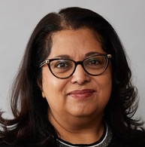
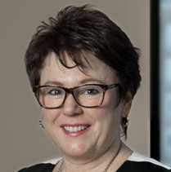
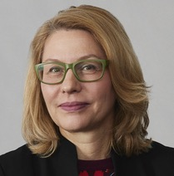
Sudha Kutty
Heather Logan
Nicole Mittmann
Executive Vice-President, Evidence, Products, and Services
Vice-President, Strategic Relationships and Initiatives
Chief Scientist and Vice President of Evidence

Slide 9

Opportunity #1
Improved representation of the lived patient experience in expert committee deliberations.
Informing a fair selection process for patient organizations / patients with lived experiences who attend expert committee meetings
Creating a standardized procedure for selecting patient organizations, patients with lived experience, as well as clinician experts
Notes:
(5 min.) Jessy to provide the background and rationale behind the steering committee's recommendations and progress on Opportunity 1:
Why did the steering committee choose to focus recommendations within the theme of ‘improved representation of the lived patient experience in expert committee deliberations?’
(5 min.) Bill to open it up to Deirdre to highlight how the work of the steering committee has informed / influenced CDA-AMC’s own work, focusing specifically:
What progress has CDA-AMC made toward the opportunities?
Specifically, how has the steering committee's work informed this progress?
Informing a fair selection process for patient organizations / patients with lived experiences who attend expert committee meetings
Creating a standardized procedure for selecting patient organizations, patients with lived experience, as well as clinician experts

Slide 10
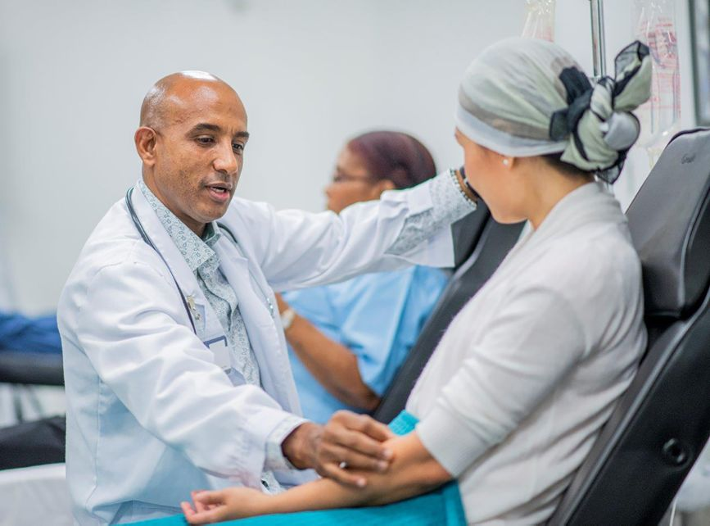
Opportunity #2
Transparent use of clinician(s) with relevant experience as clinician expert(s) weighing in on the deliberations.
Patient organization support for identification of clinician experts, including supporting greater transparency regarding the qualifications and selection criteria
CDA-AMC collaboration with stakeholders to create a registry of clinician experts by therapeutic area
Notes:
(5 min.) Gail to provide the background and rationale behind the steering committee's recommendations and progress on Opportunity 2:
Why did the steering committee choose to focus recommendations within the theme of ‘Greater transparency in the selection and qualifications of clinicians providing input and advice in the deliberations?’
(5 min.) Bill to open it up to Deirdre to highlight how the work of the steering committee has informed / influenced CDA-AMC’s own work, focusing specifically:
What progress has CDA-AMC made toward the opportunities?
Specifically, how has the steering committee's work informed this progress?
How patient organizations can support identification of clinician experts, including supporting greater transparency regarding the qualifications and selection criteria
How CDA-AMC can work with stakeholders to potentially create a registry of clinician experts by therapeutic area
Image source: https://www.nice.org.uk/news/blogs/how-my-experience-as-a-patient-helped-shape-nice-guidelines-for-colorectal-cancer

Slide 11



Opportunity #3
Consideration of the totality of patient group input and clarity regarding how this input is valued and integrated into the expert committee’s recommendation.
Steering committee to inform the redesign of the recommendation document to better reflect how patient input was considered and integrated into the recommendation, which will be initiated through a review and sample edit of a recent CDEC recommendation
Notes:
(5 min.) Jessy and Gail to provide the background and rationale behind the steering committee's recommendations and progress on Opportunity 3:
Why did the steering committee choose to focus recommendations within the theme of ‘consideration of the totality of patient input, and clarity regarding how expert committees evaluate this input and integrate it into their considerations and recommendations?’
(5 min.) Bill to open it up to Deirdre to highlight how the work of the steering committee has informed / influenced CDA-AMC’s own work, focusing specifically:
What progress has CDA-AMC made toward the opportunities?
Specifically, how has the steering committee's work informed this progress?
Steering committee to inform the redesign of the recommendation document to better reflect how patient input was considered and integrated into the recommendation, which will be initiated through a review and sample edit of a recent CDEC recommendation

Slide 12



What words or phrases come to mind when you think about the role of patients in HTA considerations and recommendations?
Notes:
(10 min.) Bill to generate dialogue among the panelists by using the following probing questions. Slido poll will open in the background and can help generate discussion:
What other changes to the reimbursement review process could advance progress toward the opportunities discussed today? Are these considered priorities for CDA-AMC?
Are there other emerging opportunities at CDA-AMC that the steering committee or other patient groups / industry hasn’t considered that would strengthen the patient voice and impact within its HTA process?
How can this type of collaborative approach be used in other areas of health care decision-making? Can you identify specific opportunities?
What do each of you think the biggest opportunity is moving forward? (address to each panelist as a closing remark)

Slide 13

QUESTIONS?
Notes:
(10 min.) Bill to open it up to the audience to engage them and hear their reactions to what they learned during the panel using the following question as a probe:
Considering the important role patients play (Reference word cloud if possible), what refinements to CDA’s reimbursement review process do you think could help patients be better represented and have more impact in this process?

Slide 14




THANK YOU!

