Slide 1
Generation of real-world data for CAR-T Cells. A European perspective
Canadian Association for Population Therapeutics Conference 2021
CAPT Conference Panel Discussion
Christian Chabannon. Aix-Marseille Université & Institut Paoli-Calmettes Comprehensive Cancer Center. Marseille. France
Chair. EBMT Cellular Therapy & Immunobiology Working Party

Slide 2
DISCLOSURES OF COMMERCIAL SUPPORT
Name of Company | Research support | Employee | Consultant | Stockholder | Speaker’s Bureau | Scientific Advisory Board | Other
Sanofi SA | X |  | X |  |  |  | X
Bellicum Pharmaceuticals |  |  | X |  |  | X
Kite / Gilead |  |  | X |  |  | X | X
BMS / Celgene |  |  | X |  |  | X | X
Novartis |  |  | X |  |  |  | X
Janssen |  |  | X |  |  | X
Terumo BCT |  |  | X |  |  |  | X

Slide 3
The European landscape for CAR-T Cells (1)
CID | MAH | Date of MA in Europe | Indications | Targeted tumor antigen
tisagenlecleucel | Novartis | August 2018 | r/r ALL (< 26 years old) r/r NHL | CD19
axicabtagene ciloleucel | Kite / Gilead | August 2018 | r/r NHL & PMBCL | CD19
brexucabtagene autoleucel | Kite / Gilead | December 2020 | r/r MCL r/r ALL | CD19
lisocabtagene maraleucel | Celgene / BMS | not yet approved | r/r NHL | CD19
idecabtagene vicleucel | Celgene / BMS | August 2021 | adv Multiple myeloma | BCMA
ciltacabtagene autoleucel | Legend Pharm. / Janssen Pharm. / J&J | not yet approved | adv Multiple myeloma | BCMA

Slide 4
The European landscape for CAR-T Cells (2)
Participation of EU centers and investigators to industry-sponsored clinical trials
The EBMT Cellular Therapy & Immunobiology Working Party (CTIWP) survey 2018 (A Urbano-Ispizua et al; unpublished)
The EBMT CTIWP Workshops
  Newly designed CAR-T Cells and IECs
    Targeting other tumor antigens, new CAR design …
  “biosimilars”
    Covering indications that are not covered by approved and commercially available CAR-T cells

Slide 5
A short history of EBMT and its registry (1)
EBMT was established more than 4 decades ago by a small group of European scientists who were working on the early development of autologous and allogeneic hematopoietic cell transplantation
Hematopoietic cell transplantation never reached the status of a medicinal product (no marketing approval)
  Different regulatory framework applies to an organization that largely draws on point-of-care organizations
The procedure is entailed with significant toxicities, that derives in part from the long-term persistence and activity of infused hematopoietic cells
The role of auto-HCT and allo-HCT has greatly evolved over time as new indications were explored, but also as the development and commercialization of other categories of innovative therapies reduced or in some instances near annihilated the need for HCT

Slide 6
A short history of EBMT and its registry (2)
Practice surveys
PASS / PAES Studies

Slide 7
A short history of EBMT and its registry (3)
Scientific activities
  10 working parties and additional committees
Defining best care practices in the field
Educational activities
  Annual meeting (48th edition in Prague in 2022)
  Small to middle-size events
  The EBMT – EHA European CAR-T Cells Meeting (1st edition in Paris in 2019)

Slide 8
Reasons for EBMT to invest in Immune Effector Cells (IECs) based therapies
Commonalities in supply chains for hematopoietic cell transplants and CAR-T Cells
  Cell procurement through apheresis
  Thawing of the cryopreserved graft / gene therapy
Commonalities in short-term side effects to be managed after HCT or CAR-T Cells
  CRS, cytopenias, infectious complications ….
Overlap in indications between HCT and CAR-T Cells
  Autologous HCT vs CAR-T cells in lymphoid malignancies

Slide 9
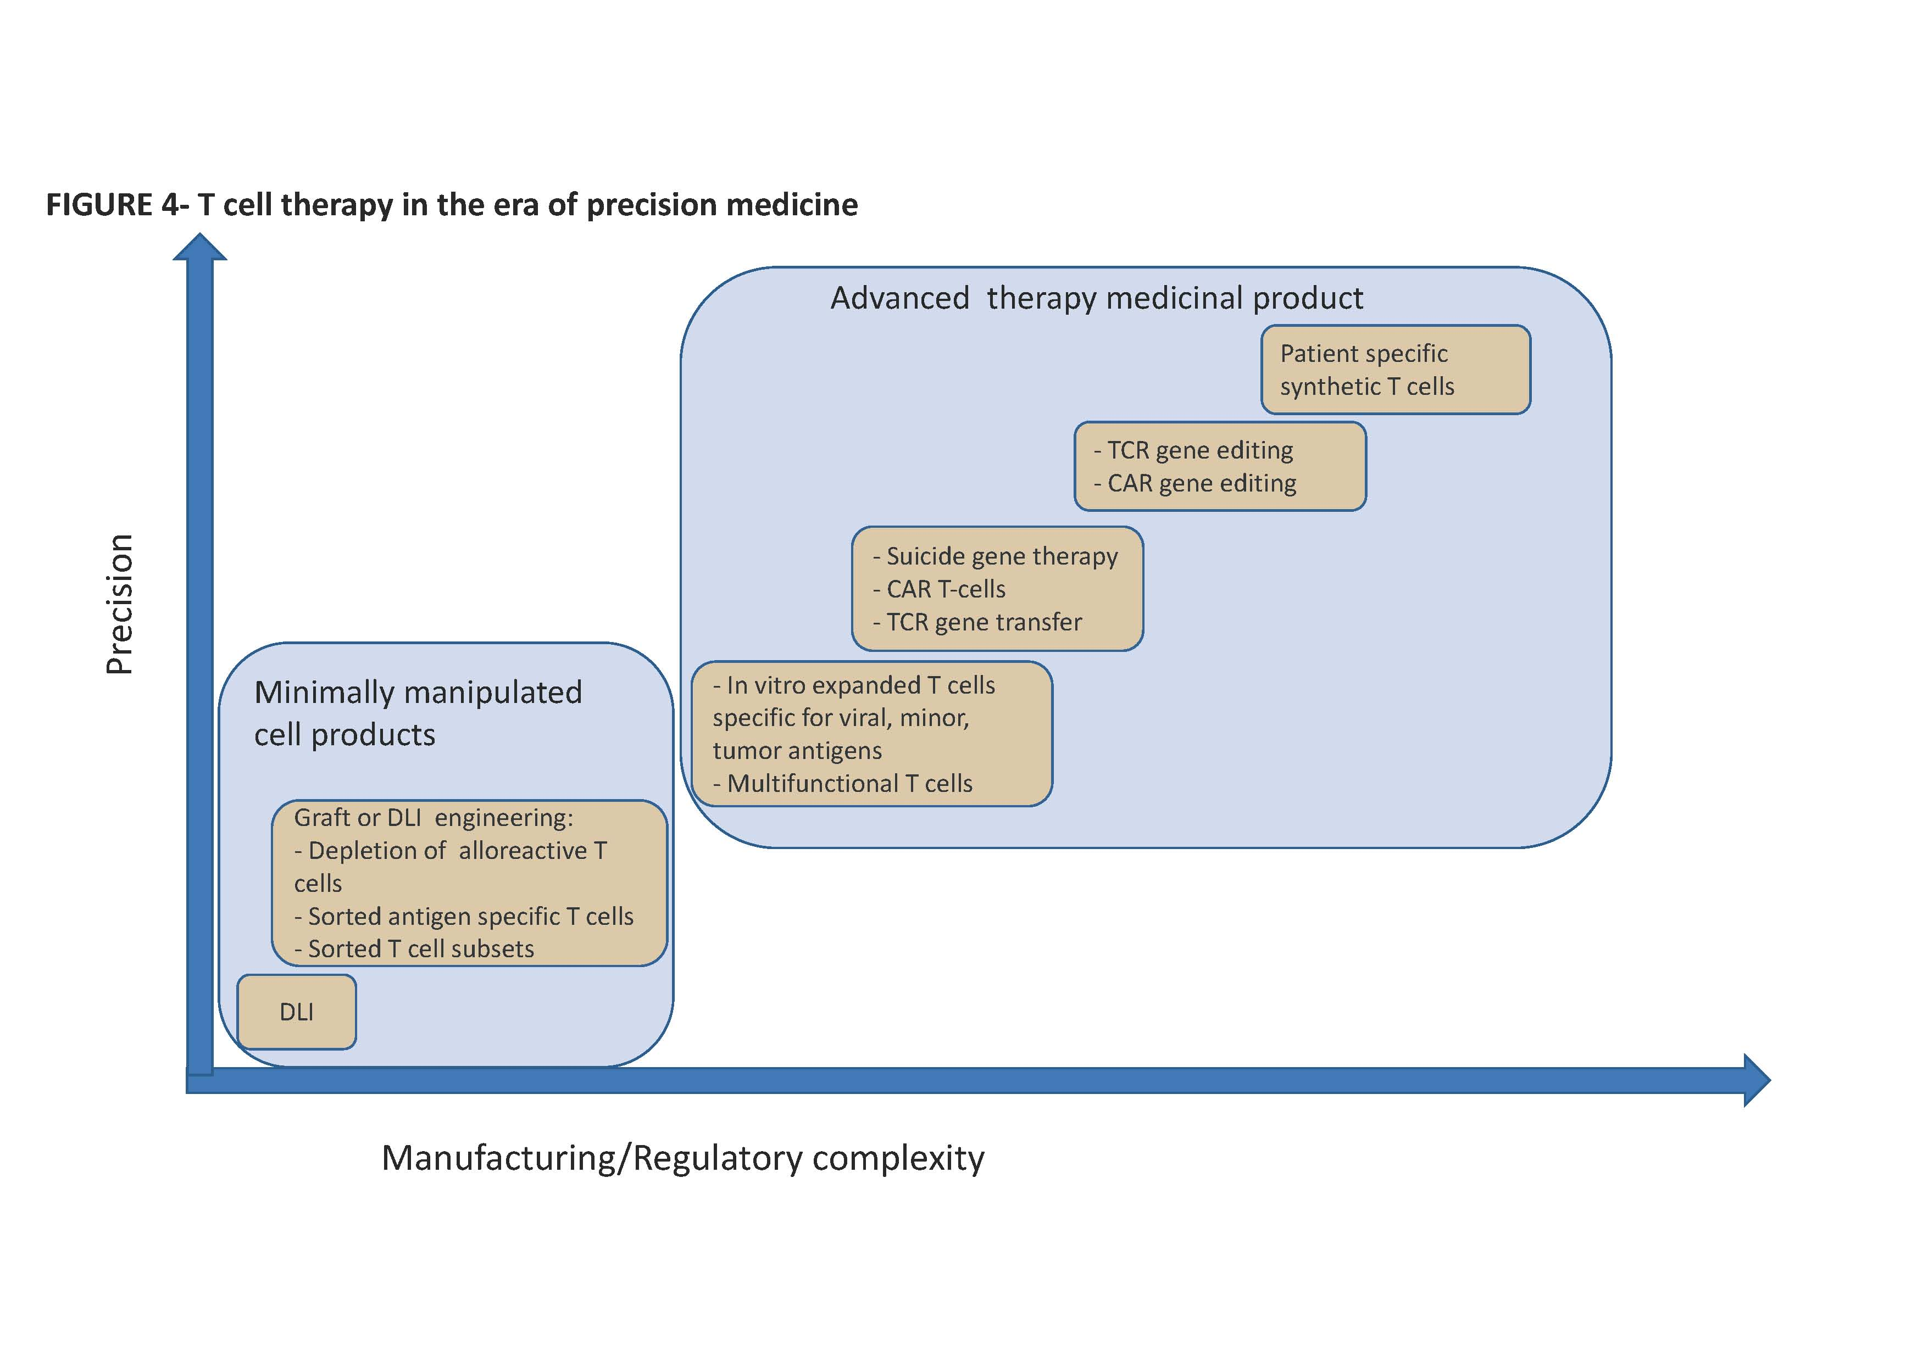

Slide 10
Actions taken by EBMT
Add to the EBMT registry capacities to collect data on patients treated with medicinal products manufactured from hematopoietic cells, whether Somatic Cellular Therapy Medicinal Products or Gene Therapy Medicinal Products, whether commercial products or investigational products
  Design of a Cellular Therapy Form (CTF)
  Meant to collect data on Immune Effector Cells based therapies as well as Hematopoietic Stem Cells based therapies
  Added / connected to the Med-A, Med-B and Med-C forms that have existed for years and allow to collect minimal essential data (Med-A) or additional (Med-B, Med-C) data

Slide 11
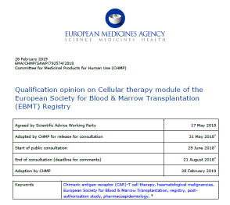
The EMA Registry initiative
Lengthy process, allowing EMA to consider:
  Existing structure of registry
  Improvements necessary to adapt the registry for CAR-T cells LTFU
    “Must have” / “Should have” / “Nice to have” data
  Data monitoring and check
  Interactions with stakeholders
  Resource availability and use

Slide 12
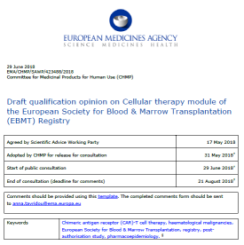
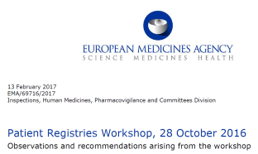

Slide 13
Post-Authorization Safety Studies (PASS) (1)
Mandated by EMA – similarly to the US situation
  Registration trials were phase I/II trials
  Relatively small numbers of patients
  Relatively small numbers of treating centers
  No comparison with Standard-of-Care (SOC)
  No direct comparison of products used in comparable indications
    Patient populations are not exactly comparable
  Relatively short follow-up

Slide 14
Post-Authorization Safety Studies (PASS) (2)
The very nature of these living drugs that have been genetically engineered raises specific concerns
  Short to middle-term complications
    Frequency, severity and proper care for “specific” side-effects such as Cytokine-Release Syndrome (CRS) or Immune effector Cells Associated Neurotoxicity Syndrome (ICANS)
    Other less specific complications
  Long-term complications
    Secondary malignancies and the risk of insertional mutagenesis
    Transmission to the offspring

Slide 15
Post-Authorization Safety Studies (PASS) (3)
CAR-T cells are among the most costly medicinal products ever marketed and administered on such a relatively large scale
There is a need to explore whether the response rate in real-world conditions is similar or different from data produced in registration studies

Slide 16
Post-Authorization Safety Studies (PASS) (4)
Mandated by EMA – similarly to the US situation
  15 years follow-up of a predefined number of patients
The obligation is upon the MAH
Nevertheless EMA has encouraged pharmaceutical companies to partner with EBMT
EBMT contracted with Novartis, Kite / Gilead and Celgene/ BMS to collect data in the EBMT Registry
  EBMT has produced regular reports to Novartis and Kite / Gilead

Slide 17
Hurdles to the collection of real-world data (1)
Human resource available at treating centers
  Healthcare professionals
  Data managers
  The EBMT registry has traditionally captured minimal essential data (med-A form) on transplanted and now CAR-T cells treated patients that were registered on a volunteer (unpaid) basis
Quality / potency of IT systems at treating centers
  Electronic Medical Records
  Interoperability of EMR with data collection form
Changes in IT systems that support the EBMT Registry

Slide 18
Hurdles to the collection of real-world data (2)
Collection of informed consent
  Compliance with GDPR
    Cross-border transfer of medical data
    Secondary use of data (transfer from EBMT to Pharma companies)
Transfer of individual level data to a 3rd party (in this case, Pharma companies), requires full information of consented patients
  Need to deploy an updated consent form
  Need to reconsent the first patients treated with CAR-T Cells
  Joint controller agreement established between EBMT and each treating center
  Once signed, allows for financial compensation for each registered patient and entry of follow-up

Slide 19
Hurdles to the collection of real-world data (3)
Data currently transferred to Pharma are aggregated data
Once JCA are in place and patients are properly consented / reconsented, individual level data will be used to prepare reports to the Pharma

Slide 20
Hurdles to the collection of real-world data (4)
CAR-T Cells administration happens in the context of increasingly complex therapeutic protocols in which sequential infusions of cellular therapies of different nature and regulatory status is no longer an exception

Slide 21
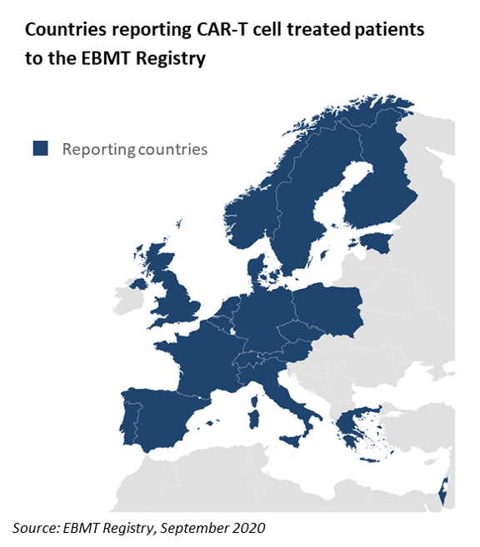
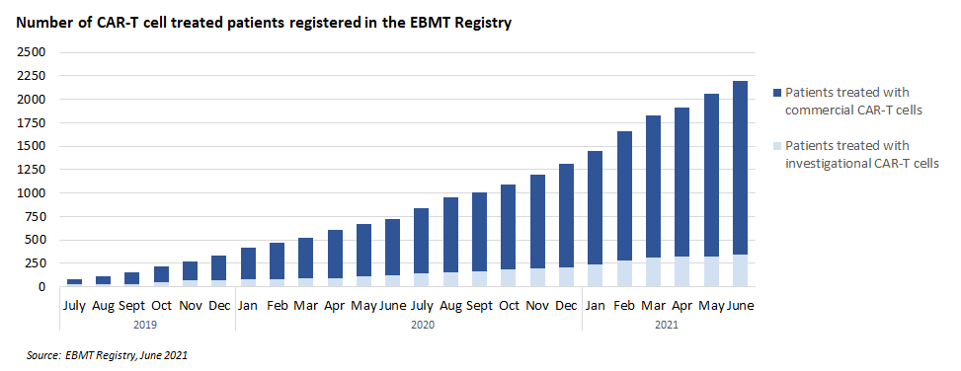

Registration of CAR-T Cells treated patients

Slide 22
Dealing with competing initiatives (1)
Some national cooperative groups or disease-oriented cooperative groups have established CAR-T Cells Registries
  An example is the DESCART Registry in France
    Established by LYSARC
    Endorsed by the French Health technology Assessment agency (HAS, Haute Autorité de Santé)
    Financially supported by Pharmas
    Currently collects data on patients treated with autologous CAR-T Cells targeting CD19 for r/r ALL or NHL
    Now joined by IFM (Intergroupe Français du Myélome) to further collect data on patients treated with autologous CAR-T Cells targeting BCMA for advanced MM
    Provides French reporting centers with the opportunity to fulfil their obligation to health authorities to report on treated centers (data in the DESCART Registry will be automatically transferred to ATIH)

Slide 23
Dealing with competing initiatives (2)
Co-existence of competing registries results in duplication of efforts at center level
Negotiations are ongoing between the EBMT Registry and National Registries for exchange of data, however are slowed down
  By the terms of contracts signed between EBMT and Pharmas for the PASS studies
  By the terms of contracts signed between national registries and their sponsors
  By the need to comply with GDPR requirements
  By the need for an agreement on conditions to access and use data by the different stakeholders

Slide 24
Reported real world data from Europe
Iacoboni G et al. Real-world evidence of tisagenlecleucel for the treatment of relapsed or refractory large B-cell lymphoma. Cancer Med. 2021 May;10(10):3214-3223. doi: 10.1002/cam4.3881. Epub 2021 May 1. GETH, GELTAMO Spanish Groups
  « best ORR and CR in infused patients (75/91 or 82%) were 60% and 32%, as compared to 52% and 40% in the JULIET registration trial »
Additionnal data shown in abstract forms
  Le Gouill S et al. EHA-ICML 2021. Best ORR in 481 patients: 74.2%. Best CRR: 53.0%. Data from the DESCAR-T registry, mixing tisacel and axicel data
  More to come from DESCAR-T and other national registries or large institutions

Slide 25
Issues with real-world data
Proportion of treated patients who are registered
Timeliness of follow-up reporting
Accuracy of follow-up reporting
Length of follow-up

Slide 26
Once data are there, what to do with them ?
Defining rights of access for all interested stakeholders
  Beyond PASS studies that are planned to enroll limited numbers of patients, work to take full advantage of the global repository that is underway
Updating / upgrading the CTF
  To take into account new knowledge
  To enrich “Must have” data with “Should have” and potentially “Nice to have”, based on all stakeholders’ input
Harmonization of data format with CIBMTR and other comparable organizations

Slide 27

Contact: sofie.terwel@ebmt.org ; y.cabrerizo@ehaweb.org

Slide 28
WP6: Scientific Excellence
We recently launched a call of interest for studies using data collected in the EBMT Registry
Of 12 Applications, 2 were selected to receive financial support, and 2 others were merged and will be supported

Slide 29
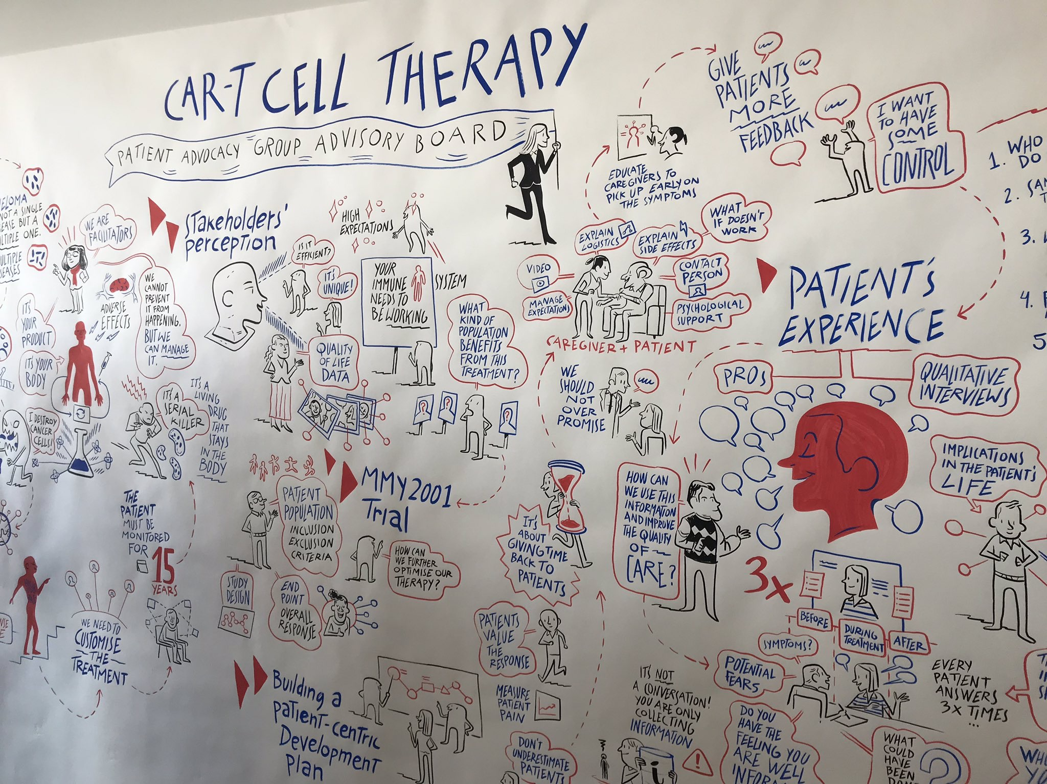

Slide 30
Conclusions
New class of medicinal products
The field is thriving with innovations
The role of CAR-T cells to treat advanced lymphoid malignancies remains to be fully explored, in an ever evolving context that brings other types of medical innovations to the market
There are high stakes in terms of individual pricing, cumulated costs and budget, equal access for patients in need of these treatments
Collection and analysis of high-quality real-world data remain challenging

Slide 31

Acknowledgements
EBMT
  EBMT Board and Executive Committee
  EBMT Offices
    Registry Office (London)
    Clinical Trial Office (Leiden)
    Administrative Office (Barcelona)
  GoCAR-T Consortium
Société Francophone de Greffe de Moelle Osseuse et de Thérapie Cellulaire (SFGM-TC)
Institut Paoli-Calmettes, Marseille, FR
  Centre de Thérapie Cellulaire
  Inserm CBT-1409
  Pharmacie à Usage Intérieur
  Département d’Oncohématologie
  Direction de la Recherche Clinique et de l’Innovation (DRCI)

Slide 32
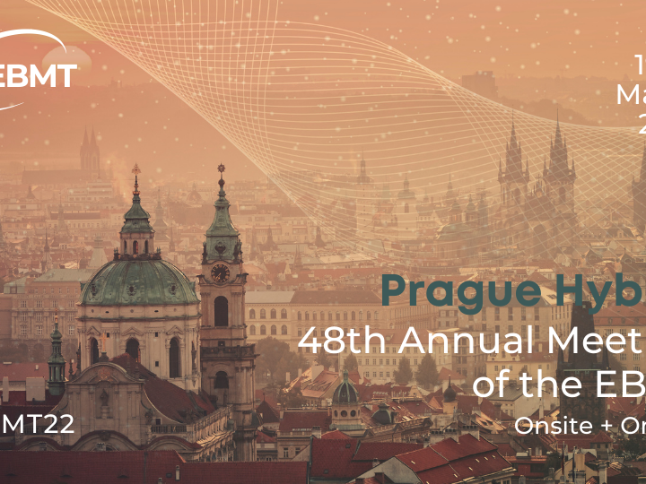

Slide 33
Thanks!

Slide 34



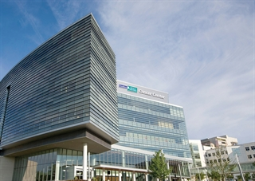

Navigating uncertainty: real-world experience with CAR-T in an International Context
CAPT Conference October 2021
Marcelo C Pasquini, MD, MS

Slide 35
DISCLOSURE
Grant/Research Support:
  Novartis
  Kite Pharma
  Bristol Myers Squibb
  Janssen
  Glaxo Smith Klein
Consultant:
  Bristol Myers Squibb
Major Shareholder: no disclosure.
Other: no disclosure.

Slide 36
Introduction
Health authority approval of CAR T cells in the US required implementation of a REMS program at centers and long term follow up of patients for 15 years.
Similar requirements are seen worldwide
LTFU were structured as prospective observation studies in the real-world setting using existing outcomes database.

Slide 37




Timeline and Milestones of CT Registry
Japanese Platform tocapture CT Data
2,000 CAR T- cell Infusions reported
Forms Harmonization with EBMT
Accrual completion of the first Post Approval Safety Study (Yescarta)
NCI funded CT Registry Pilot
Approval of Yescarta
Approval of Tecartus
Approval of Beyanzi
Establish the CT Task Force
Approval of Kymriah
Approval of Kymriah
Approval of Yescarta
Approval of Abecma
2015
2016
2017
2018
2019
2020
2021
First CT Registry Annual Forum
CIBMTR LTFU for Tecartus
Launch of the Cellular Therapy Registry
CIBMTR LTFU for Axi-cel
CIBMTR LTFU for Tisagenleclecel
CIBMTR LTFU for Breyanzi and Abecma

Slide 38
Data Collection Can Scale to Meet Need
Any center can participate.
  Allows for multiple centers at a single institution.
All centers must have current IRB approval for data collection and sharing protocol.
A data transmission agreement between each center and the CIBMTR defines allowable uses of the data.
All patients must sign Informed Consent.
The program is compliant with provisions of the US Health Information Protection and Portability Act (HIPAA) and General Data Protection Regulation (EU GDPR).

Slide 39
Data Collection Requirements Emerging
FDA requires the sponsors to have a structure in place to collect long-term follow-up data from patients
Data collection by the center remains voluntary (as opposed to the federal mandate for reporting allogeneic HCT) but strongly recommended for commercial CAR T-cell recipients
  Implications for the informed consent process
National payers beginning to require data submission
Patients have the right not to consent to share data for research

Slide 40
PASS (Post Approval Safety Study) vs.
REMS (Risk Evaluation and Mitigation Strategies)
 | PASS | REMS
Structure | Observational prospective study | Comprehensive program to ensure safe of use, teaching, accessibility and assessments.
Requirement | Voluntary | Mandatory
Outcomes | Subsequent neoplasms plus other safety and efficacy outcomes determined by a protocol | CRS/ICANS and treatment

Slide 41
Baseline Information Available in Registry
Patient-related
  Age, sex, race/ethnicity
  Comorbidities
  KPS prior to infusion
Disease-related
  Sub-disease at diagnosis
  Disease status prior to infusion
  Cytogenetics
  Lab values (CBC, blast %, etc)
Therapy-related
  Prior lines of therapies
  LD chemo
  Time of leukapheresis

Slide 42
Outcomes Derived from Registry Data
Safety outcomes
  CRS
  ICANS
  Prolonged cytopenia
  Grade 3-4 organ toxicities
  Hypogammaglobulinemia
  Tumor lysis syndrome
  Serious infections
  Subsequent neoplasm
  Pregnancy
Efficacy outcomes
  Best overall response (BOR)
  Duration of response (DOR)
  Relapse/disease progression
  Disease-free survival/progression-free survival (DFS/PFS)
  Overall survival (OS)

Slide 43
Number of CAR T cell infusions: 2016-2021
(4,886 patients and 5,129 infusions)
Cumulative

Slide 44
CAR T Cell Indications: 2016-2021 (N=4,886)
Centers: 176 (US 95%)
Median age: 59 y (<1-91)y
Prior HCT: 33%

Slide 45
Industry-sponsored Projects
Project | Sponsor | Objective | Timeline/Duration
Yescarta LTFU (Axicabtagene ciloleucel) | Kite | Safety and efficacy outcomes (PASS) N=1,800 (Current 1500 LBL, 79 FL) Diseases: DLBCL (1500), FL (300) | 07/2018 5 years of accrual 15 years of follow up
Kymriah LTFU (Tisagenlecleucel) | Novartis | Safety and efficacy outcomes (PASS) N=2,500 (Current N=1611) Diseases: DLBCL (1500) and ALL (1000) | 08/2018 5 years of accrual 15 years of follow up
Breyanzi LTFU (Lisocabtagene maraleucel) | BMS | Safety and efficacy outcomes (PASS) N=1,000 (Current N=35) Disease: DLBCL | 02/2021 5 years 15 years of follow up
Abecma LTFU (Idecabtagene vecleucel) | BMS | Safety and efficacy outcomes (PASS) N=1,000 (Current N=108) Disease: Multiple Myeloma | 03/2021 5 years 15 years of follow up
Tecartus (Brexucatagene autoleucel) | Kite | Safety and efficacy outcomes (PASS) N=1000 (Current, MCL N=200) Disease: Mantle Cell Lymphoma (500), ALL (500) | 07/2020 5 years 15 years of follow up
Ciltacabtagene autoleucel | Janssen/Legend | Safety and efficacy outcomes (PASS) N=1500 Disease: Multiple Myeloma | 5 years 15 years of follow up
Under Development

Slide 46
Commercial CAR T cell Indications Annually: 2016-2021

Slide 47
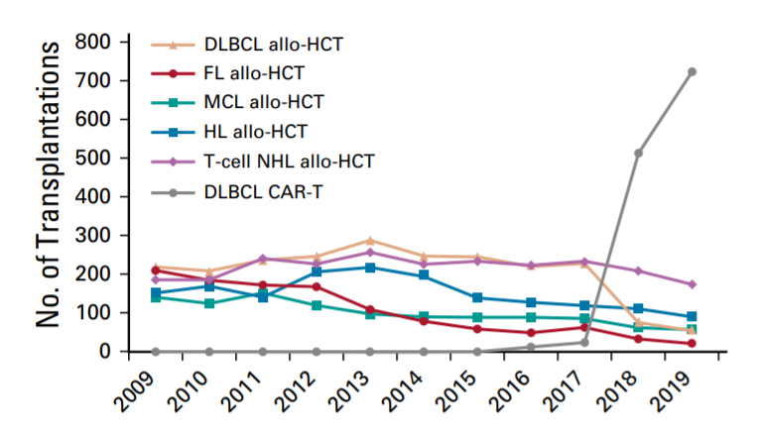
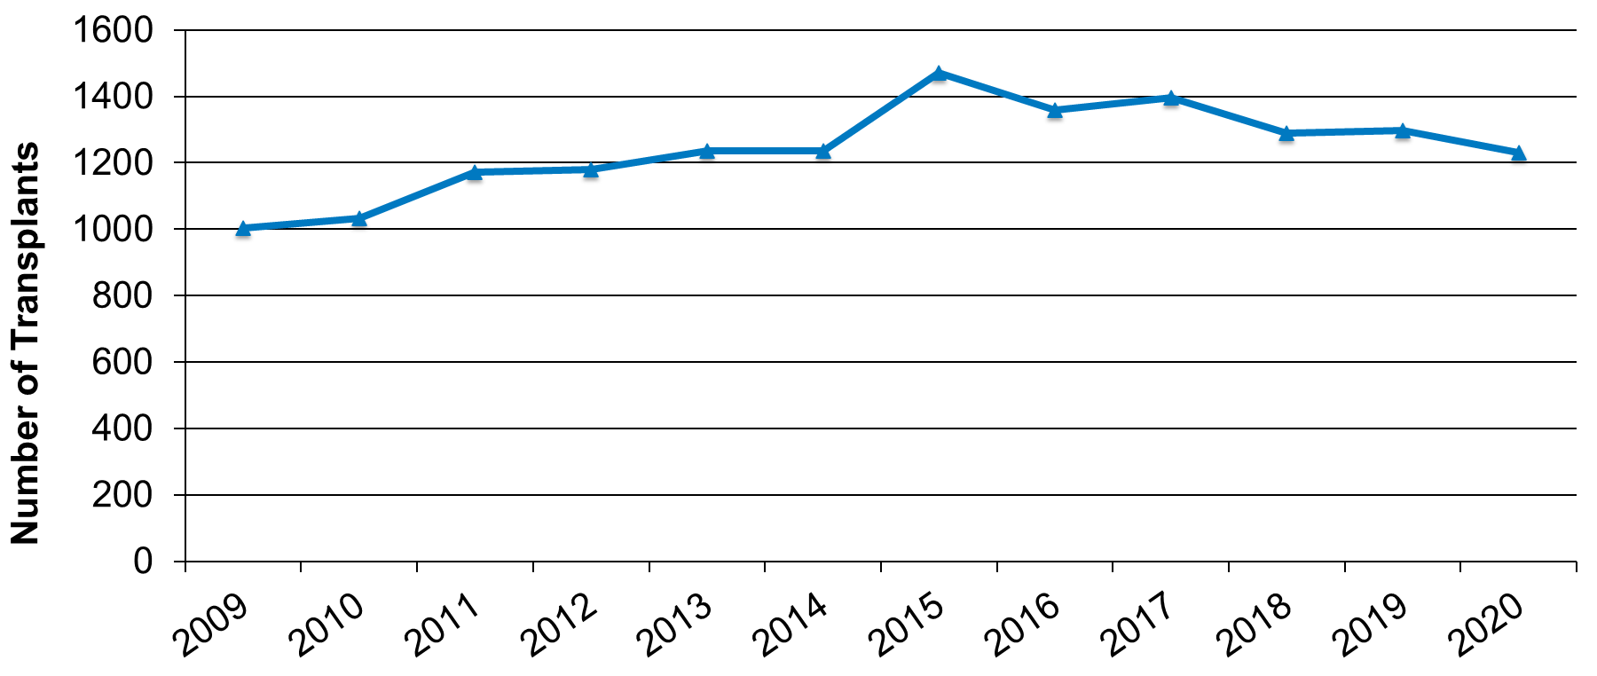
Trends in Transplants and Cellular therapies for NHL in the US
Autologous HCT for DLBCL
Allogeneic HCT and CAR T for NHL*
Decrease in both Allos and Auto HCTs for DLBCL since 2018.
*Shah N. and Hamadani H JCO 2020

Slide 48
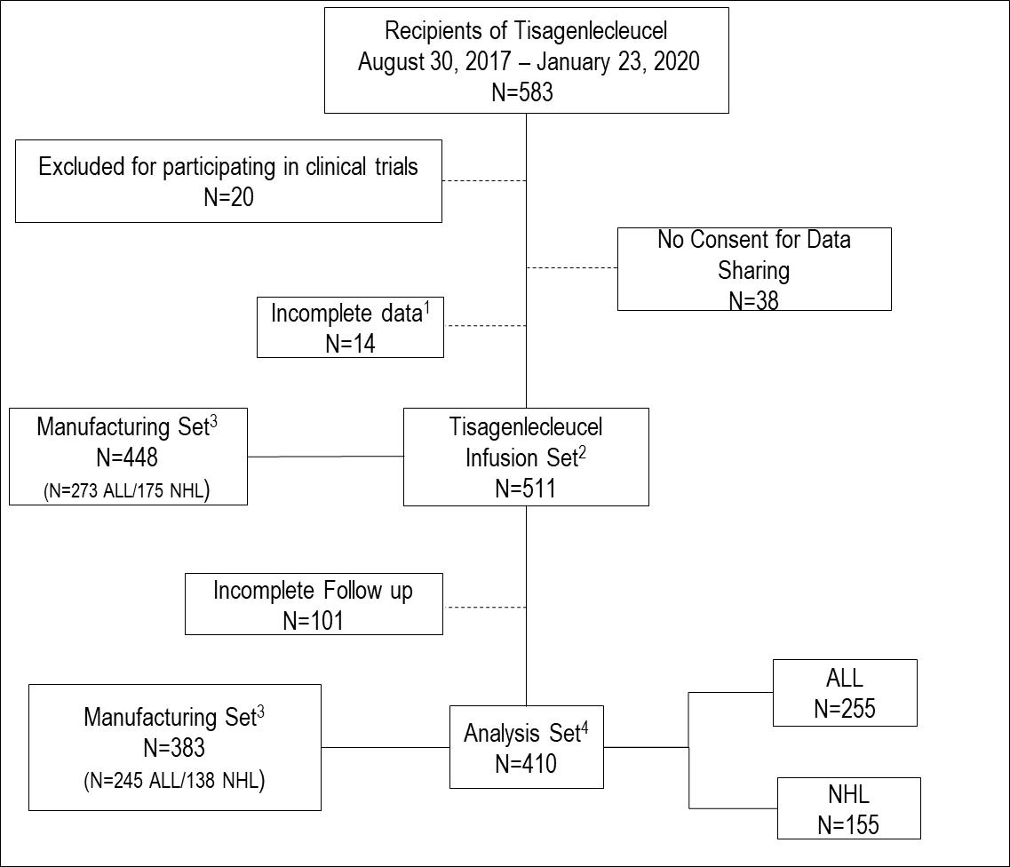
Tisagenlecleucel Real World Data

Slide 49
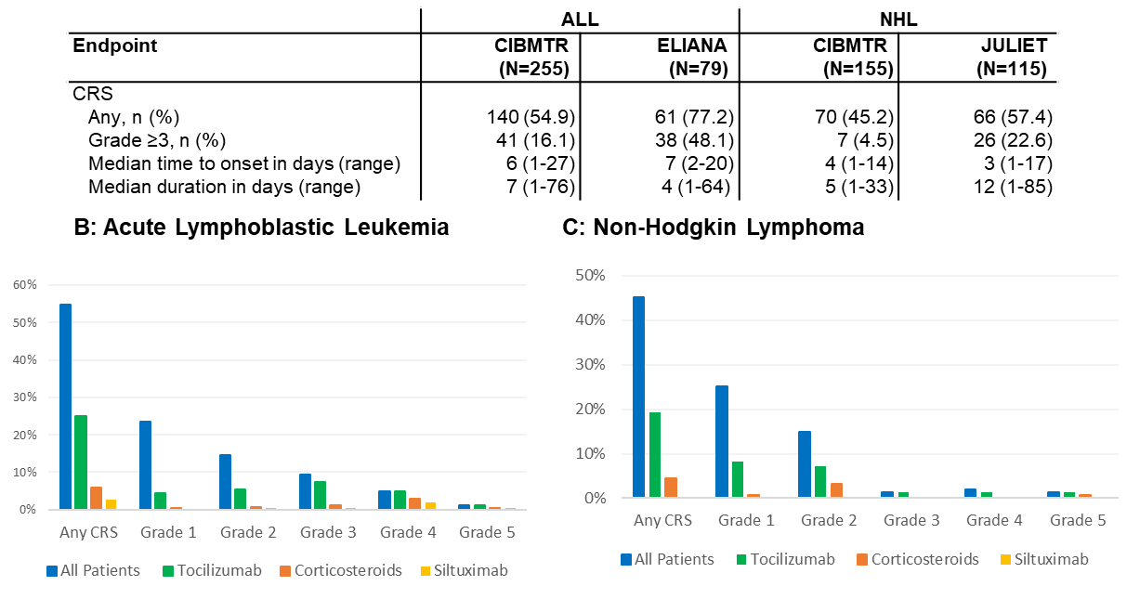
CRS with Tisagenlecleucel by indication

Slide 50
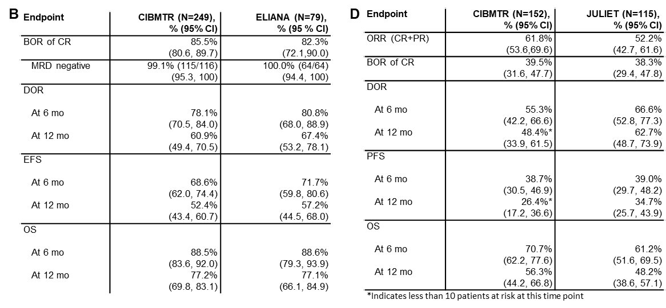
Responses and Survival Outcomes with Tisagenlecleucel

Slide 51
Yescarta Post Approval Safety Study - US
Axi-Cel for LBCL
Oct 2017 – Aug 2020
N=1,734
Exclusions:
No Consent, N=146
Axi-Cel on
Clinical Trials, N= 88
Patient Enrollment N=1,500
Exclusions:
Withdrew Consent, N=1
Incomplete, N= 8,
Follow up < 6mo,
N=268
6 mo Follow up N=1,223*
Analysis Set
Median follow-up 12 months
(6-29 months)
Datacut January 22, 2021
Jacobson C et al, ASCO 2021

Slide 52
Patient Demographics (Yescarta PASS)
Characteristic | Total
No. of patients | 1,223
No. of US centers | 76
Median age, years (range) | 62 (19-91)
≥65 y | 38%
Male | 65%
ECOG performance status 0-1 | 83%
Prior History of Malignancy | 16%
Transformed lymphoma | 26%
Double/triple hit lymphoma | 15%
Chemotherapy resistant disease | 66%
Prior auto-HCT | 27%
Time from diagnosis to Axi-Cel, median months | 14
Jacobson C et al, ASCO 2021

Slide 53
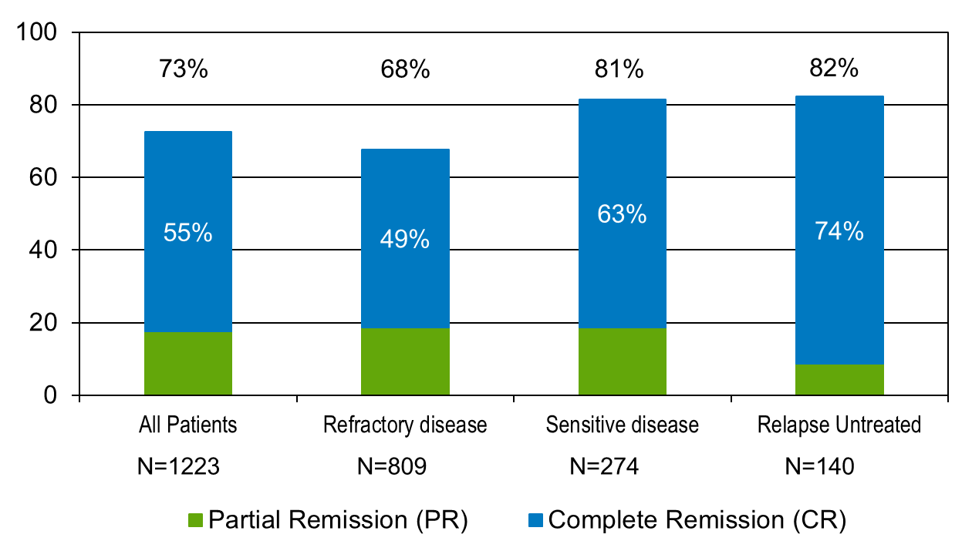
Disease Overall Response after Yescarta
Jacobson C et al, ASCO 2021

Slide 54
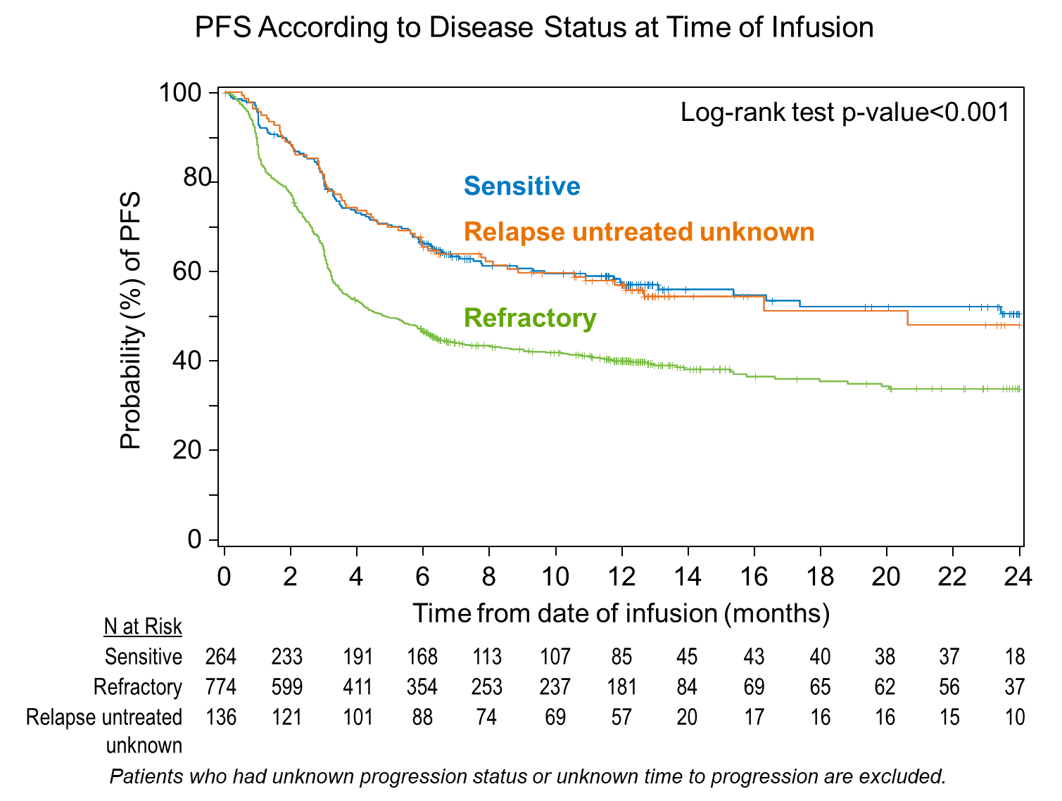
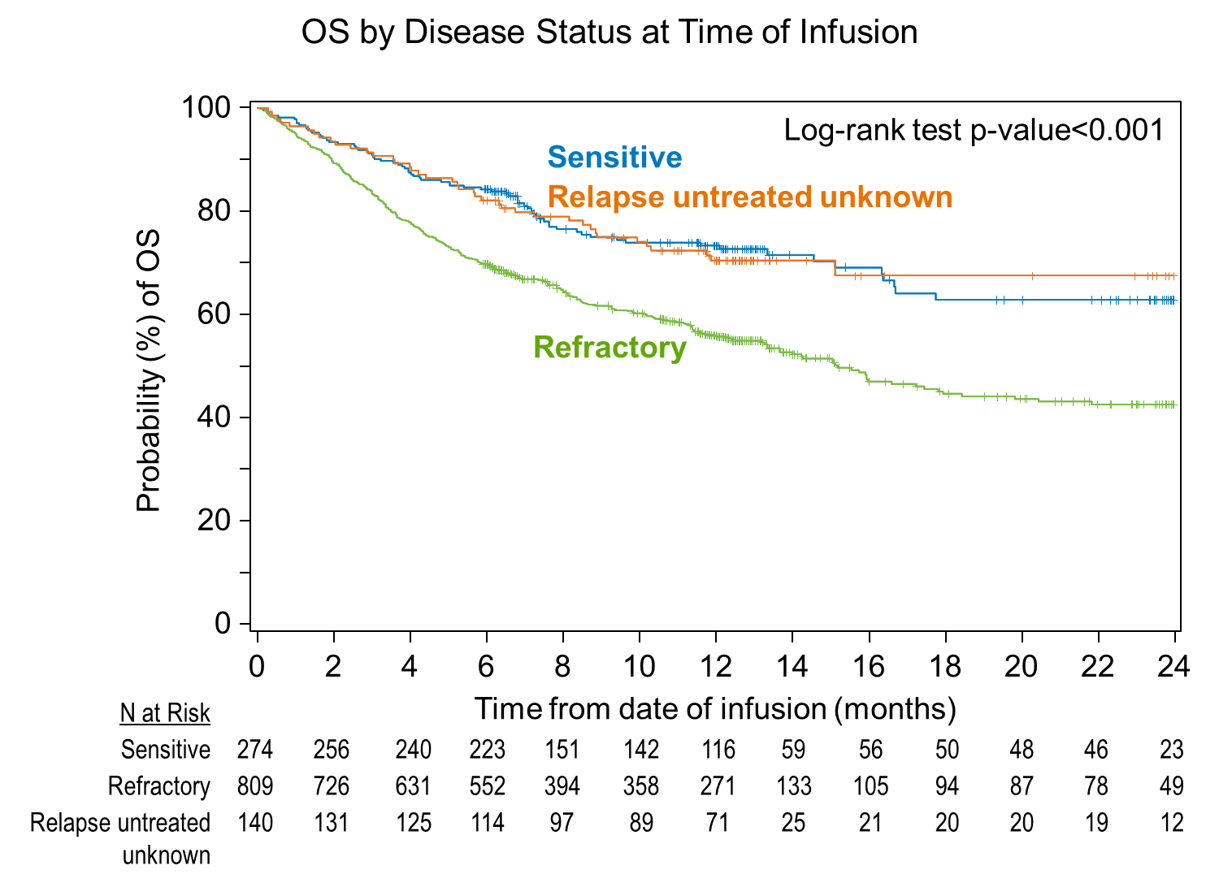
PFS and OS by Disease Status for patients with DLBCL after Yescarta

Slide 55
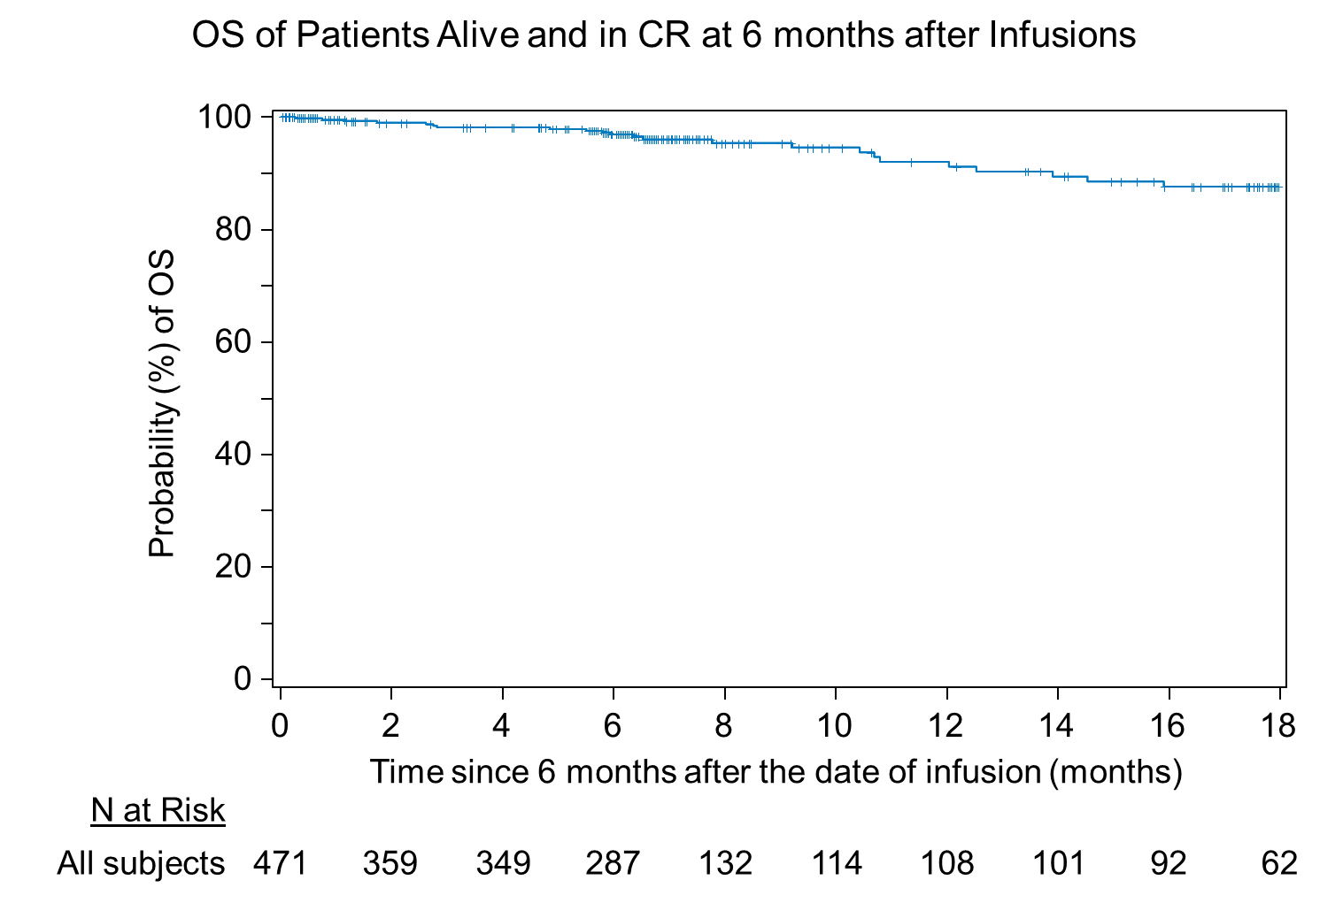
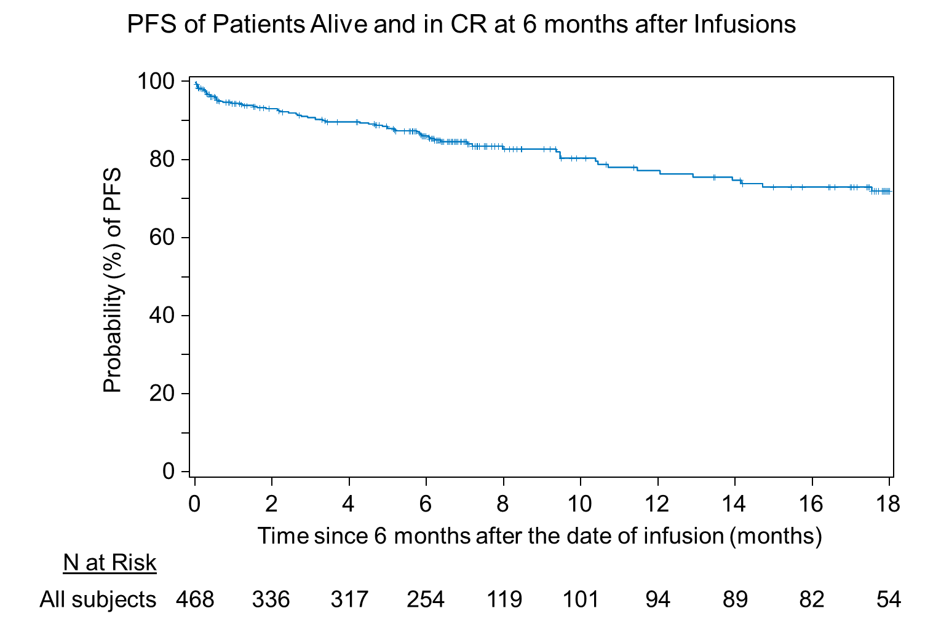
Landmark Analysis at 6 months after Yescarta for DLBCL
Jacobson C et al, ASCO 2021

Slide 56
CRS Grading and Treatment Patterns after Yescarta (N=1,223)
Characteristic | Total
Any CRS / Grade ≥3 ¹ | 82% / 9%
Time to CRS, median (range) in days | 4 (1-28)
CRS resolved by day 14 post Axi-Cel | 89%
Duration of CRS, median in days | 7
CRS Treatment* according to grading¹
¹
²

Slide 57
Neurologic Toxicity and ICANS* Grading (N=1,223)
N=556
N=1223
Developed NT
N=317
Developed NT
N=678
ICANS* Grade
N=191
ICANS* Grade
N=608
Characteristics | ICANS
Any ICANS / Grade > 3 / Unknown Grade | 55% / 24% / 6%
Time from CT to onset, median (range) in days | 7 (1-82)
Neurologic toxicity resolution at 21d post Axi-Cel | 77%
Duration of Neurologic Toxicity, days – median | 9
Corticosteroids, Tocilizumab, Siltuximab | 73%/17%/3%

Slide 58

Subsequent Neoplasms and Biospecimen Collection
Approach to test the association of a subsequent neoplasm and CAR T cells
Subsequent Neoplasm
Form 3500/4100
Eligibility for Sample Collection
Sample Collection Kits
Yes
No
Reference Laboratories
Detection of insertion mutagenesis and Replicant Competent Retrovirus

Slide 59
Representativeness of RWE
Reconciliation of number of shipped CAR T/ center reporting
  Tisa-cel US
    64% NHL/70% ALL
  Tisa-cel Canada: 23%
  Axi-cel US: 65%
Reporting Centers

Slide 60
Challenges with RWE in CAR T cells
Voluntary reporting
Personnel (i.e. data managers) at centers with competing responsibilities (reporting transplants or CAR T Cells)
Comprehensive forms.

Slide 61
Conclusions
Regulatory requirements for CAR T Cell treatment with 15 year follow up were unprecedent.
Utilization of secondary databases such as CIBMTR and EBMT has demonstrated that capture of RWD is possible and the data is comparable to pivotal trials.
The value is to capture the data in a standardize matter to advance the field understand patients who can best benefit from these therapies

Slide 62
Acknowledgments
CT Registry
Bronwen Shaw
Jeff Auletta
Patricia Steinert
Steve Devine
Kathryn Flynn
Stats
Michael Heim
Ben Jacobs
Soyoung Kim
Data Ops
Tiffany Hunt
Jaime Santi
Jenni Bloomquist
Mandi Proe
IT
Laura Clements
Matthew Prestegaard
Erik Bergman
Read Fritsch
Eric Zink
Simeona Trayanov
Thomas Degen
Business Ops
Carlos Litovich
Robert Thompson
Sharniece Covill
Research Funding:
National Cancer Institute
CIDR (U24 CA233032)
Kite, a Gilead Company
Novartis
Bristol Myers Squibb
Janssen Legend
Patients
Participating centers

Slide 63
Using RWE to accelerate drug development: Pragmatic approaches using registries.
Imi Faghmous MA MSc (MPH)

Slide 64
Disclosure
Imi Faghmous is a full-time employee of Kite, A Gilead company.
The contents of this presentation are non promotional and contain no information on Gilead or Kite specific products.
The contents of this presentation are purely related to methodological aspects to study design.

Slide 65
The Question?
How do we use RWD to accelerate drug development?
Faster internal go no go decisions
Faster regulatory approvals
Faster payer decisions
Faster transition from the bench to the bedside.

Slide 66
Typical Response
Often, we think of the classical external control arm
We contextualize a single armed interventional study with data extracted from EHRs/Registries to estimate a treatment effect
These are valid in a rather limited number of settings and are rather complex to get right:
    Setting
    Endpoint selection & derivation
    PS Assumption expense
    Quality of data source

Slide 67
Can we think a little differently
A well-designed registry provides an opportunity to use alternative designs
Pragmatic trial(s) that maintain randomization yet benefit from the aspects found in RWE
What would such a design look like?

Slide 68
Introducing the TWICS design
OU
T
COME
S
Patients are randomly selected from
a registry or prospective cohort study.
Same rigor of I/E criteria can be applied
Since randomization of some is equal to
the randomization of all this is equivalent to a two armed parallel design
Since we have randomization assumptions based on approaches such as PS are unnecessary
A single registry can support multiple interventional studies
Disease specific registry
Random selection
OU
T
COME
S
Interventional arm
Time

Slide 69
No such thing as a free lunch
Aspect | Issue | Mitigation
Operationalization | Few examples of such a design being operationalized by sponsors – experience is currently lacking in such areas | Proof of concepts from a NDA/BLA/SBLA perspective are needed – Academic / industry partnership
Registry quality | Data quality must be “regulatory grade” this can be quite resource intensive for registry sites | Use of EDC Site/industry partnership SOPs Collaborative mindset – Value of such approaches is shared by the entire stakeholder/ecosystem
Endpoint definitions | Due to heterogeneity of clinical practice certain endpoints may not be suited to a registry study. | Careful clinical trial design Agreed upon response charter from participating registry sites LIS type approach to registry
Patient consent | Complexities around how consenting patients to such a study. | Consent patients to participate in a registry The consent form specifically outlines that patients consent to being contacted to participate in future clinical studies If a patient is selected, they are asked to sign a further consent form related to the trial.
Ethical Aspects | Only patients who are randomly selected to enter an interventional study are made aware of the study – patients who act as controls are unaware | Current literature supports that this is ethical as-long as the informed consent form is very specific. Best practice would be to include patient advocates and support groups in the design and operationalization of such a study

