Slide 1

Vaccine Selection: Decision Making in Real-Time
During a Pandemic
CAPT Conference Keynote Lecture
Dr. D. Lorne Tyrrell
Distinguished University Professor
Founding Director, Li Ka Shing Institute of Virology
University of Alberta
October 26, 2021

Slide 2



Osler Quote
“Humanity has but three great enemies:
fever, famine, and war;
of these by far the greatest, by far the most terrible,
is fever.”
Sir William Osler
Canadian physician, 1849-1919
Sir William Osler (Canadian physician, 1849-1919).
In: Cushing H. The life of Sir William Osler. vol I, ch 14. Oxford: Clarendon, 1925

Slide 3

Prediction of Pandemics: 2018
Respiratory-Borne RNA Viruses Most Likely Cause of Future GCBRs
Characteristics likely to be common to any pandemic-inducing pathogen:
  efficient human–human transmissibility
  nontrivial fatality rate
  no widely available medical countermeasure
  immunologically naïve population
  capability of immune system evasion
  respiratory mode of spread
  transmissibility during incubation period
  some percentage of mild infections
RNA viruses deemed the most likely
pandemic-inducing pathogens
Adapted from: Report from the Johns Hopkins Center for Health Security, Bloomberg School of Public Health Adalja, A. A.; et al. 2018.

Slide 4

Top 10 Global Threats to Human Health (2019)
Air pollution and climate change
Non-communicable diseases
Threat of a global influenza pandemic (Coronaviruses)
Fragile and vulnerable settings, such as regions affected by drought and conflict
Antimicrobial resistance
Ebola and high-threat pathogens
Weak primary care
Vaccine hesitancy
Dengue
HIV

Slide 5
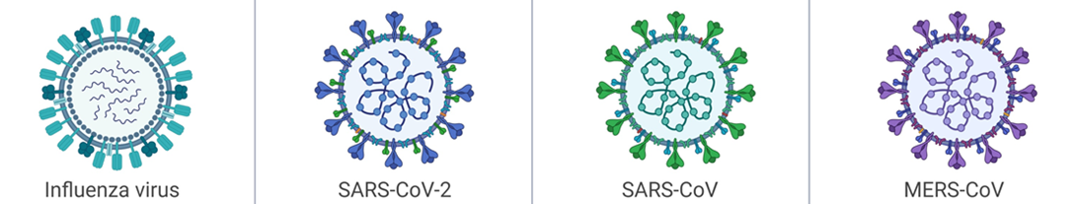
Epidemiological Comparison of Major Respiratory Viral Infections
Disease | Flu | COVID-19 | SARS | MERS
Incubation Period | 1 – 4 days | 4 – 14 days | 2 – 7 days | 6 days
R_{o} | 1.3 | 2.0 –5.5 (as of Oct 25, 2021) | 3 | 0.3 - 0.8
Fatality Rate | 0.05 – 0.1% | 2.03% (as of Oct 25, 2021) | 9.6 – 11% | 34%
Notes:
Ro value reference: https://ipac-canada.org/coronavirus-resources.php
Fatality reference: https://covid19.who.int/

Slide 6
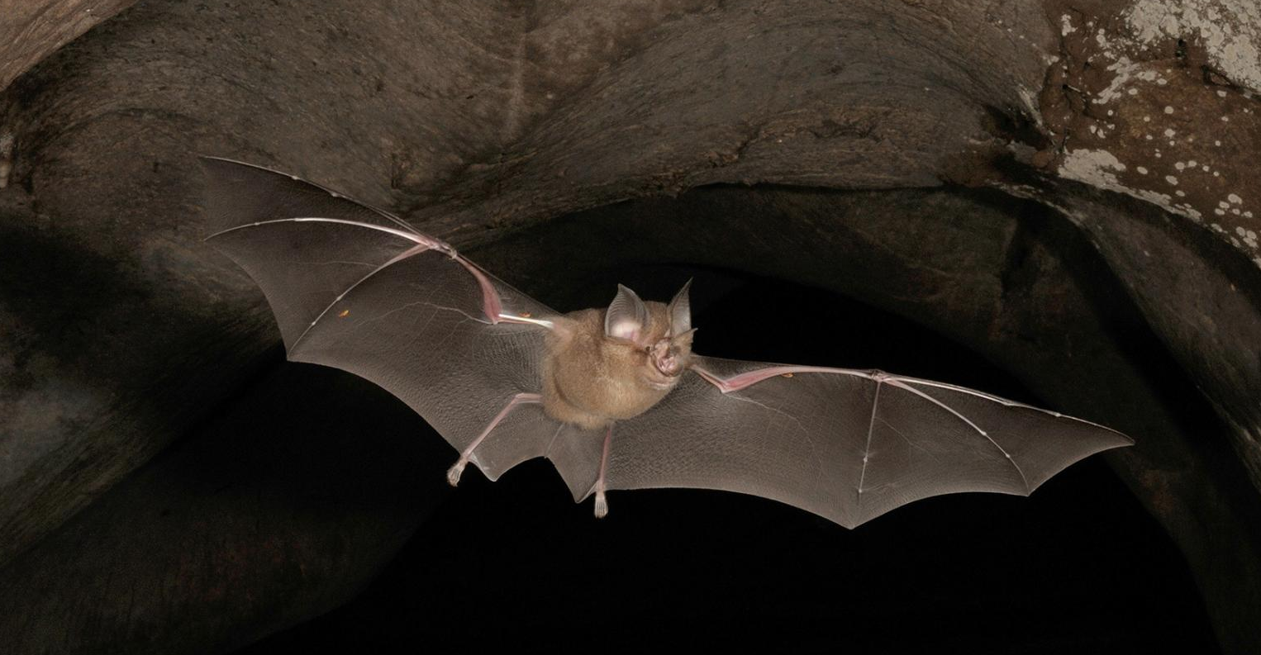
Origin of COVID-19
Viruses from the coronavirus lineage responsible for COVID-19 have been circulating in bats (and others i.e.: pangolins) for decades
How did the virus jump to humans? → still unknown
  Some suggest the coronavirus most likely evolved in the intermediate horseshoe bats (Rhinolophus affinis)
Figure adapted from: https://www.nationalgeographic.com/animals/2020/03/coronavirus-animal-reservoir-research/
Adapted from: Mallapaty S. Coronaviruses closely related to the pandemic virus discovered in Japan and Cambodia. Nature. 2020 Dec;588(7836):15-16. doi: 10.1038/d41586-020-03217-0. PMID: 33230273.
Zhou, P., Yang, XL., Wang, XG. et al. A pneumonia outbreak associated with a new coronavirus of probable bat origin. Nature 579, 270–273 (2020). https://doi.org/10.1038/s41586-020-2012-7

Slide 7
COVID-19: Timeline of Key Events
Jan 9, 2020:
Novel coronavirus identified
Feb 11, 2020:
Disease named COVID-19
Dec 23, 2020:
Health Canada authorizes Moderna COVID-19 mRNA vaccine
Dec 8, 2019:
First Case – Wuhan, China
Feb 11, 2020:
Novel coronavirus named SARS-CoV-2
Oct / Nov 2020:
Vaccine phase III results
Dec 31, 2019:
27 cases of pneumonia
Mar 11, 2020:
WHO declared pandemic
Jan 24, 2020:
Sequence added into Genebank
Dec 9, 2020:
Health Canada approves
Pfizer-BioNTech mRNA vaccine
All within 1 year!

Slide 8
COVID Cases Worldwide: Infections & Deaths
 | World (as of Oct 25, 2021) | Canada (as of Oct 24, 2021) | Alberta (as of Oct 24, 2021)
Cases | 243,260,214 | 1,698,499 | 320,769
Deaths | 4,941,039 (2.03%) | 28,749 (1.69%) | 3,051 (0.95%)

Slide 9
Approaches to Control New Virus Outbreaks
Public Health Measures: very successful for SARS 2003 & MERS 2014
  Closure public events
  Social distancing
  Hand washing
  Testing and tracing
  Lockdown
Antivirals: >180 in studies well over 200 clinical trials & 3 approved
Vaccines: over 237 in pre-clinical studies, 64 in clinical trials

Slide 10
Iceland’s Strategy to Contain COVID-19
Tracked the health of every person who has tested positive for COVID
Sequenced the genetic material of each viral isolate
Screened more than half of the island’s 368,000 residents for infection
Results:
  ~1/2 of infected people are asymptomatic
  Children are much less likely to become sick than adults
Prevented deaths:
  Reports fewer than 7/100,000 people, vs. 80/100,000 in the USA and the UK
Severe lockdowns estimated to reduced transmission by 98%
Scudellari M. How Iceland hammered COVID with science. Nature. 2020 Nov;587(7835):536-539. doi: 10.1038/d41586-020-03284-3. PMID: 33239802.

Slide 11
Canada’s COVID-19 Vaccine Task Force (June 6, 2020)
Co-chairs Joanne Langley
J. Mark Lievonen
Core Members Alan Bernstein
Robert Brunham
Michael De Wilde
Bartha Knoppers
Christopher Procyshyn
Benjamin Rovinski
D. Lorne Tyrrell
Sylvia van drunen Little-van den Hurk
André Veillette
Ex-Officio Members Mona Nemer
Public Health Agency of Canada
Simon Kennedy
Stephen Lucas
Secretariat Roger Scott-Douglas

Slide 12
Canada’s COVID-19 Vaccine Task Force Mandate
Vaccines for Canada:
  Safe
  Effective
  Timely Access
Vaccines are critical to controlling this pandemic

Slide 13
Vaccine Safety – Critically Important
Vaccines for large populations of healthy people
Antivirals are used in people with disease
  More tolerance as there is a balance of safety and benefits

Slide 14
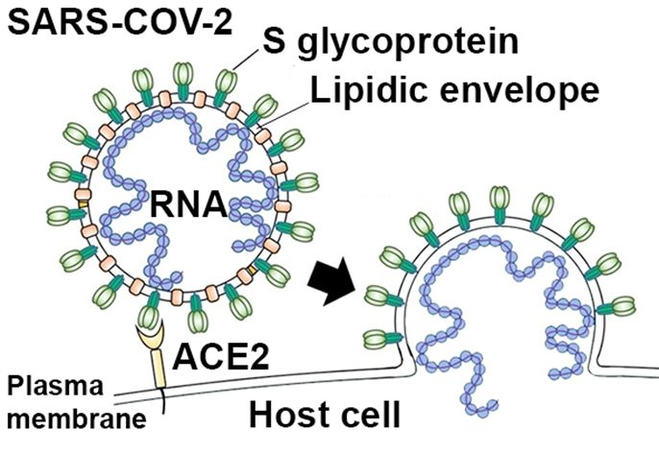
SARS CoV-2: ACE-2 Receptor Interaction
Figure adapted from: https://ecanews.org/blog/what-role-can-crystallography-play-in-the-fight-against-covid-19/

Slide 15
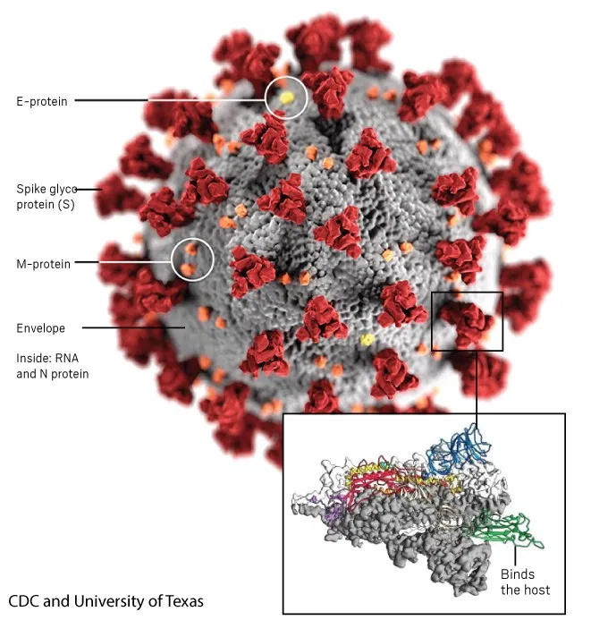
SARS-CoV-2 Virus

Slide 16
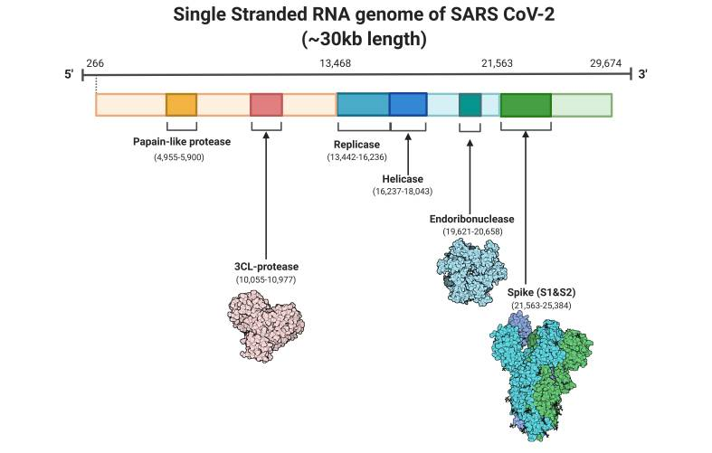
SARS CoV-2
Single Stranded RNA Genome
Figure adapted from: Cascella M, et al. Available from: https://www.ncbi.nlm.nih.gov/books/NBK554776/figure/article-52171.image.f5/

Slide 17
Vaccine Production:
New Platforms – Faster Development
  Inactivated vaccines
  Live attenuated vaccines
  Vector delivered (e.g. adenovirus)
  mRNA vaccines
  saRNA vaccines
  Protein subunit vaccines
  Virus-like particles
  DNA vaccines

Slide 18

mRNA Vaccine Candidates
Messenger RNA (mRNA)
  Genetic instructions for the coronavirus spike protein are encoded in modified mRNA, delivered via lipid nanoparticle
Benefits of mRNA vaccines over conventional approaches:
Safety:
Non-infectious
mRNA does not integrate into host genome
mRNA is degraded once protein is made
Production:
Vaccines can be produced more rapidly
Efficacy:
Vaccines generate a reliable immune response
Well-tolerated by healthy individuals, with very few side effects

Slide 19
mRNA Vaccine Candidates (cont’d)
Messenger RNA (mRNA)
  Genetic instructions for the coronavirus spike protein are encoded in mRNA, delivered via lipid nanoparticle
Challenges of mRNA vaccines:
Storage:
RNA vaccines, like conventional vaccines, need to be frozen or refrigerated
Storage outside the cold chain?
  Suitable for use in countries with limited or no refrigeration facilities
Delivery:
Free RNA in the body is quickly broken down
Modified mRNA is incorporated into packaged into particles or liposomes

Slide 20
Pfizer’s mRNA Vaccine (BNT162b2) Efficacy Against COVID-19 After the First Dose
Polack FP, et al. Safety and Efficacy of the BNT162b2 mRNA Covid-19 Vaccine.
N Engl J Med. 2020 Dec 31;383(27):2603-2615. doi: 10.1056/NEJMoa2034577. Epub 2020 Dec 10. PMID: 33301246; PMCID: PMC7745181.

Slide 21
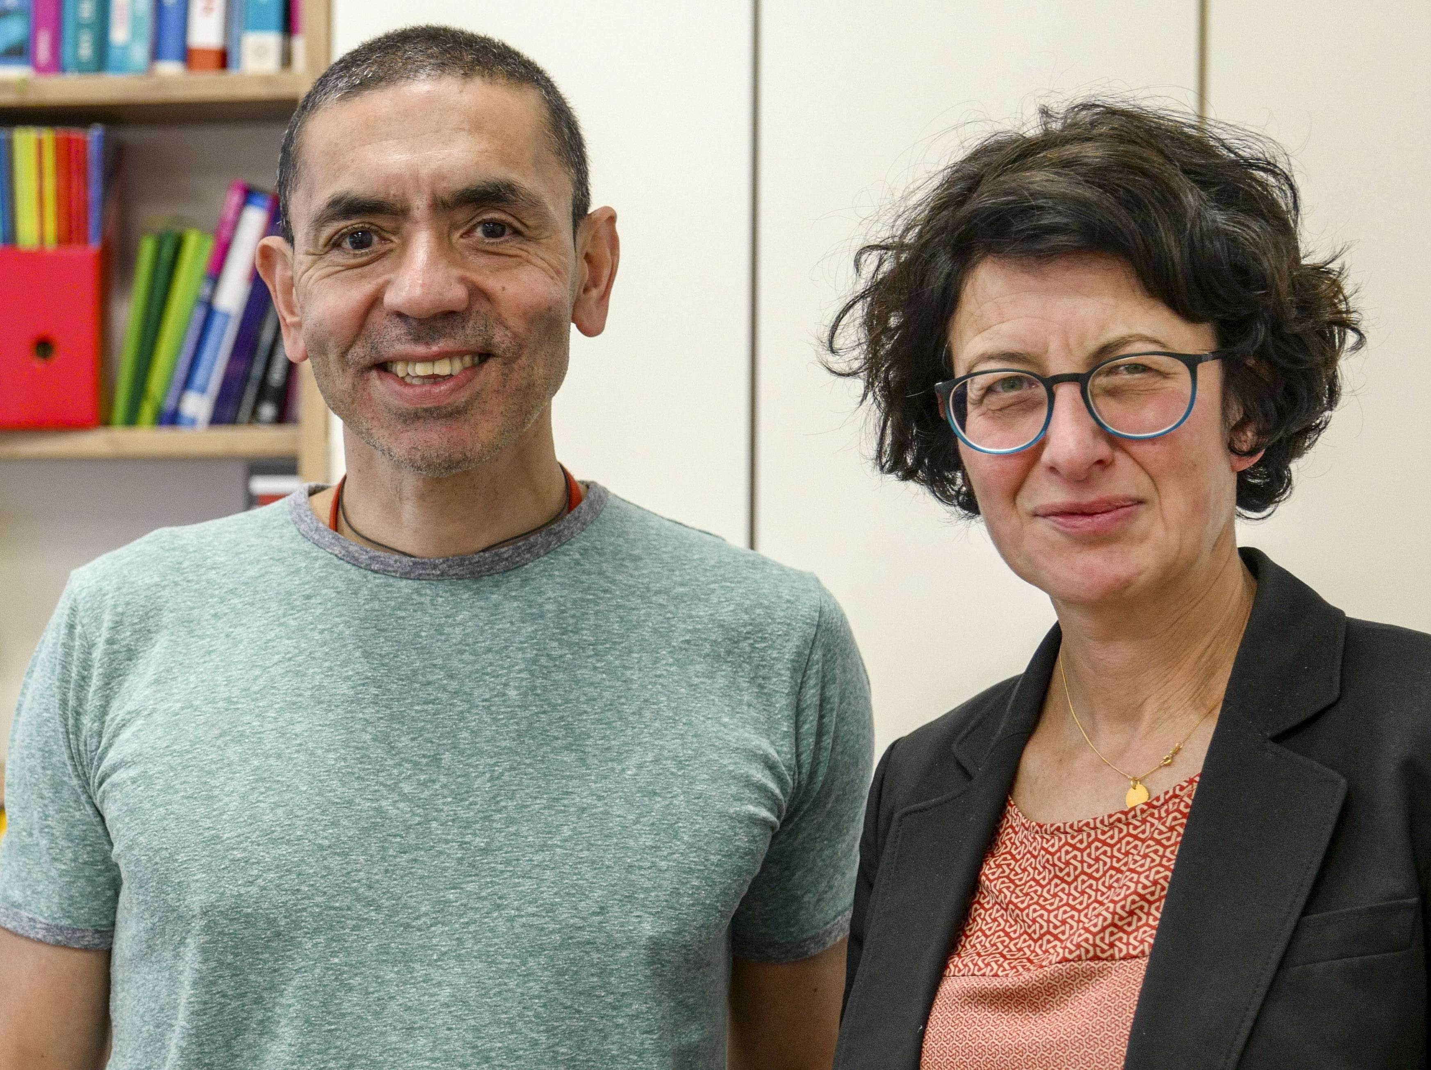
mRNA Vaccine - Pfizer / BioNTech
German company BioNTech, founded by two scientists, Drs. Ugur Sahin and Özlem Türeci
BioNTech teamed up with Pfizer on a COVID-19 vaccine
Drs. Ugur Sahin and Özlem Türeci

Slide 22
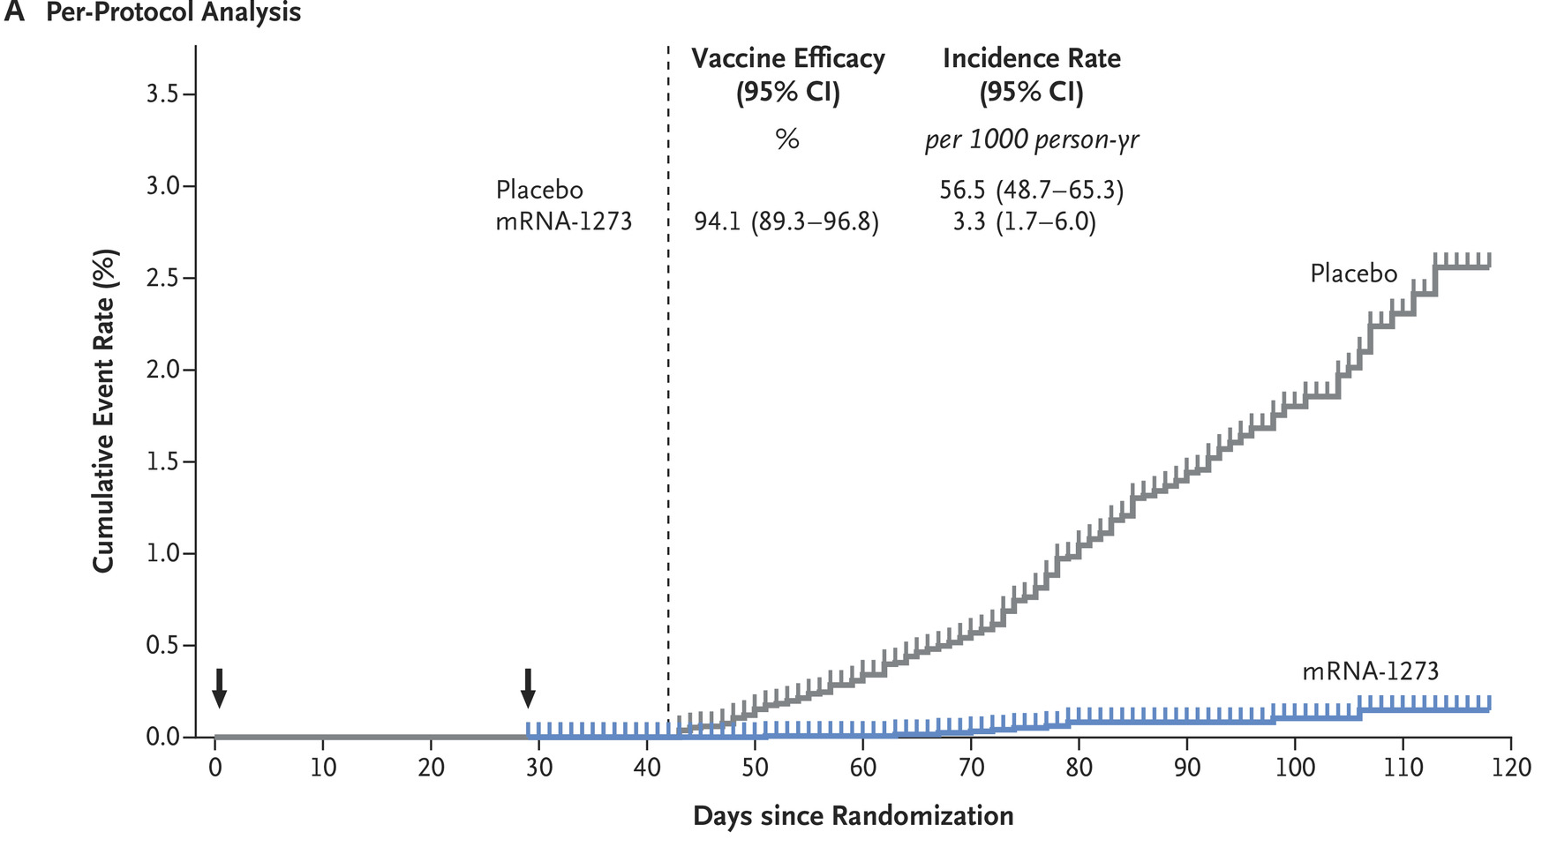
Vaccine Efficacy of Moderna’s mRNA-1273 Vaccine to Prevent COVID-19-Phase III
Cumulative incidence of Covid-19 events in the primary analysis based on adjudicated assessment starting 14 days after the second vaccination in the per-protocol population
Baden LR, et al. Efficacy and Safety of the mRNA-1273 SARS-CoV-2 Vaccine.
N Engl J Med. 2020 Dec 30:NEJMoa2035389. doi: 10.1056/NEJMoa2035389.
Epub ahead of print. PMID: 33378609; PMCID: PMC7787219.

Slide 23


Moderna’s Co-Founders
Noubar Afeyan
Derek Rossi

Slide 24
Phase 3 Trial Results: Efficacy of single-dose Ad26.COV2.S (J&J) vaccine against COVID-19
Randomized, double-blind phase 3 trial:
The incidence of moderate to severe - critical Covid-19 with onset ≥14 days and ≥28 days was lower among vaccine recipients;
The incidences of severe - critical Covid-19 hospitalization and death were lower with vaccine than with placebo.
Adapted from: Sadoff J, et al. Safety and Efficacy of Single-Dose Ad26.COV2.S Vaccine against Covid-19. N Engl J Med. 2021 Jun 10;384(23):2187-2201. doi: 10.1056/NEJMoa2101544.
Epub 2021 Apr 21. PMID: 33882225; PMCID: PMC8220996.

Slide 25
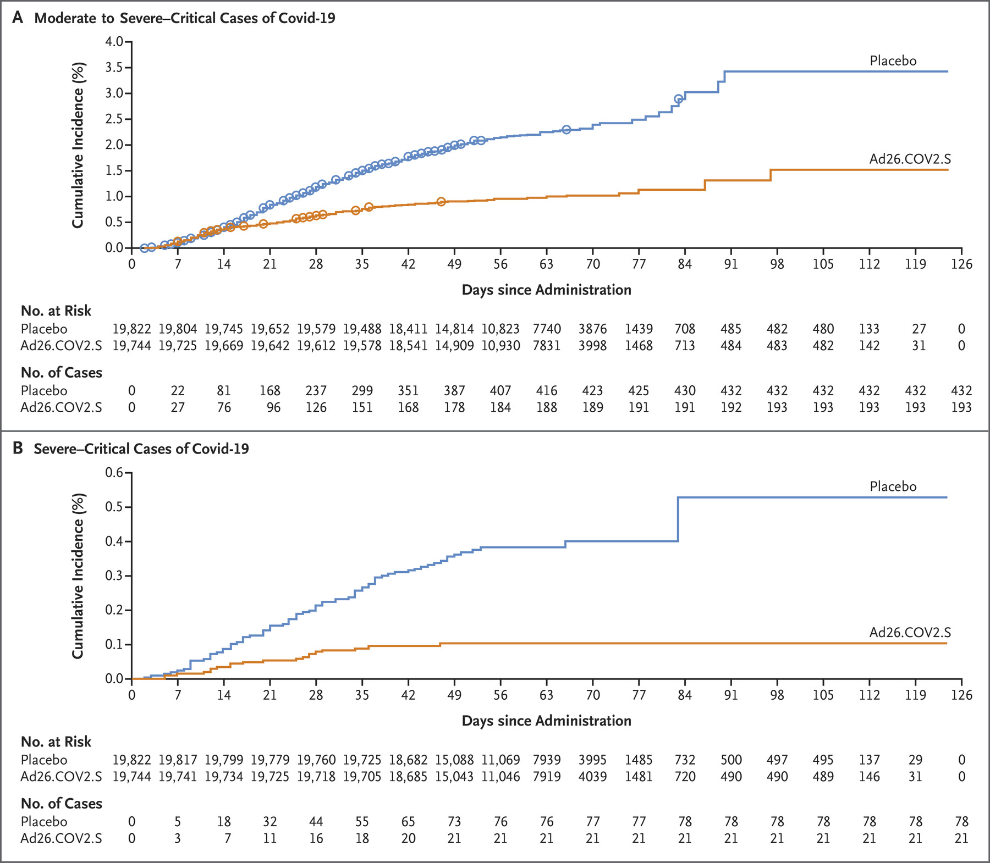
Phase 3 Trial Results: Efficacy of single-dose Ad26.COV2.S (J&J) vaccine against COVID-19
Adapted from: Sadoff J, et al. Safety and Efficacy of Single-Dose Ad26.COV2.S Vaccine against Covid-19. N Engl J Med. 2021 Jun 10;384(23):2187-2201. doi: 10.1056/NEJMoa2101544.
Epub 2021 Apr 21. PMID: 33882225; PMCID: PMC8220996.

Slide 26
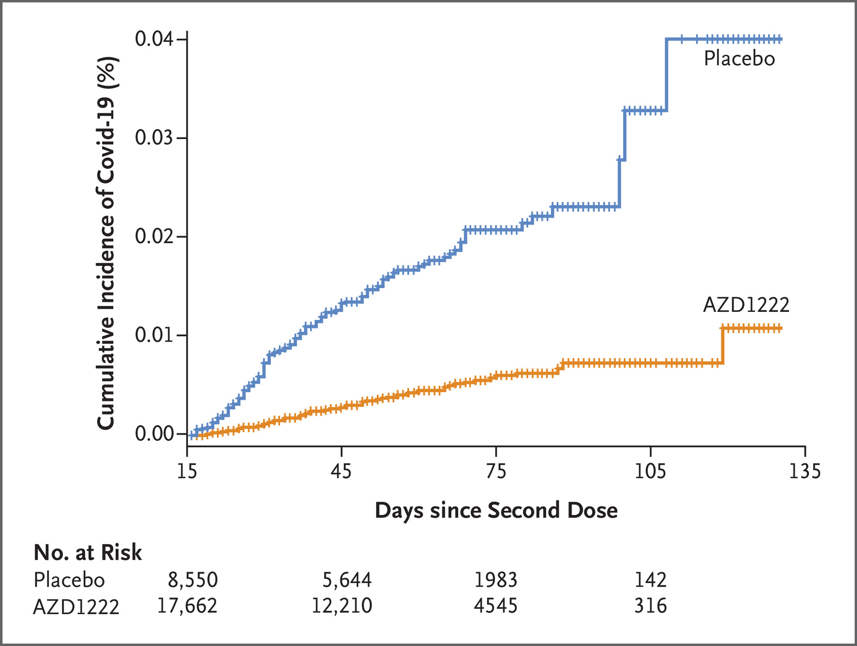
Phase 3 Trial Results: Efficacy of AZD1222 (ChAdOx1 nCoV-19) COVID-19 Vaccine (AstraZeneca)
Adapted from: Falsey AR, et al. Phase 3 Safety and Efficacy of AZD1222 (ChAdOx1 nCoV-19) Covid-19 Vaccine. N Engl J Med. 2021 Sep 29:NEJMoa2105290. doi: 10.1056/NEJMoa2105290. Epub ahead of print. PMID: 34587382; PMCID: PMC8522798.

Slide 27
COVID-19 Vaccine Procurements by the Government of Canada
Developer | Vaccine Type | # of Vaccine Doses Procured for Canada
Pfizer / BioNTech | mRNA | 40 million
Moderna | mRNA | 40 million
AstraZeneca / Oxford University | Adenovirus vector | 20 million
Janssen / Johnson & Johnson | Adenovirus vector | 38 million
NovaVax | Protein | 76 million
Sanofi / GSK | Protein | 72 million
Medicago / GSK | Virus-like particle | 76 million
Canada has the largest COVID-19 vaccine portfolio in the world

Slide 28
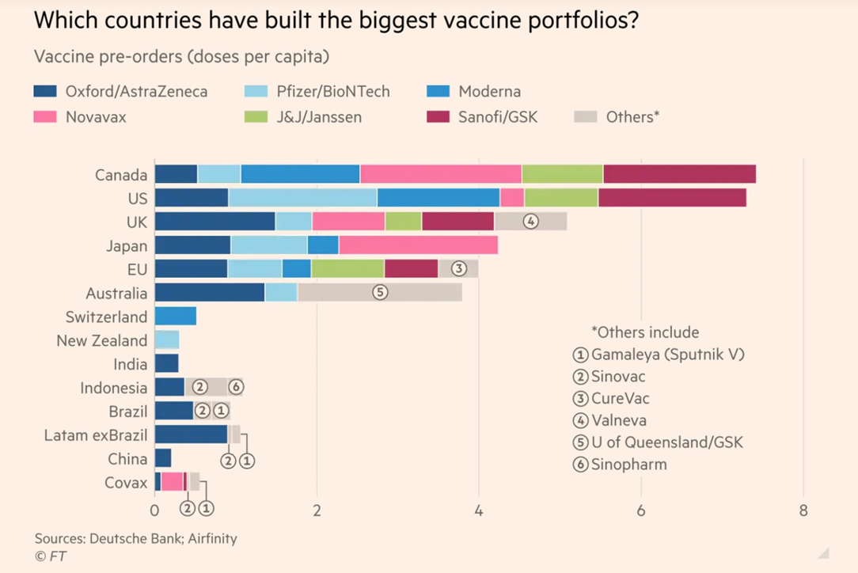
Countries with the Largest COVID-19 Vaccine Portfolios

Slide 29
Canadian Government’s Role
Canadian Government:
Complete the procurement agreements with manufactures of vaccines
Vaccines must pass the Health Protection Standards before licensed for use (Health Canada)
Public Health Agency of Canada distributes vaccines to provinces and territories
Provinces / Territories execute vaccinations and rollout strategies

Slide 30
Health Canada Regulatory Activities
Canada does not have Emergency Use Authorization (EUA)
  USA and EU do have EUA
Sept 16, 2020:
  Canada introduced “Interim Order” for one year to support access to COVID-19 Drugs and Vaccines

Slide 31
Interim Order
Allows for Rolling Submission of Data
Foreign Approvals
  A drug can be approved based on certain information from a trusted foreign regulator
Expedited Review
  Does not involve shortcuts of the review process
  Often improves the thoroughness of the reviews, as information is shared much more efficiently between countries

Slide 32
Stages of Vaccine Development
Pre-Clinical Stage
Vaccine Substance
Vaccine Product
Public Health
Basic research – laboratory work
Pre-clinical animal studies
Good immune response
No toxicity
Adjuvant?
How to manufacture:
  Large scale
  GMP standards
  Stability / cold chain
  Fill & finish
Distribution
Cold chain vs. stability
Public health (who gets vaccine first)
Vaccine hesitancy

Slide 33
Why was Drug Supply Initially Slower in Canada?
Biomanufacturing capabilities of large Pharma left Canada as Canada moved to less expensive drugs.
  Changed patent laws and encouraged generics beginning in 1968
Operation Warp Speed
  US invested $18 billion in seven major Pharmaceutical companies to get 300 million doses of vaccine
Vaccine nationalism – countries that have heavily invested in the vaccine production want access to it first
Canada has re-invested in several companies a total of $2B to restore biotech industry / manufacturing

Slide 34
Concerns with mRNA Vaccines
Risk of developing myocarditis or pericarditis (1:50,000 – 1:100,000)
Usually self-limited
More common after receiving the second dose
More common in young males

Slide 35
Concerns with AstraZeneca and J&J Vaccines
Generally safe - rare risk of developing rare clotting issue or low platelets
  Astra Zeneca vaccine studies initially estimated to be 1/600,000
  Ontario study May, 2021 estimated 1/61,000
  USA study with Johnson and Johnson vaccine estimated 1/310,000
Risk / Benefit:
Risk of a vascular event from COVID-19 is ~350X greater
than from the viral vector vaccine

Slide 36
Canada’s Vaccine Rate (as of October 21, 2021)
Total population of Canada:
1st dose = 77.5%
Fully vaxxed = 73.6%
Total population of Canada over 12 years of age:
1st dose = 88.6%
Fully vaxxed = 83.6%
Canada is adopting vaccine certification (i.e. passport) program
Vaccines for children aged 5-11 will soon be available

Slide 37
Viral Variants of Concern

Slide 38
How fast do human coronaviruses mutate?
Human coronaviruses have lower mutation rates than many RNA viruses
Viruses are always changing (=mutating)
  Acquire small mutations in their genetic material over time
Mutations are introduced through mistakes during replication
  The longer the virus circulates, the more potential for mutations to occur
The sooner we reach herd immunity,
the sooner we will slow down the occurrence of new mutations

Slide 39
Consequences of Virus Mutations
As viruses mutate, there are three major consequences:
  Viruses become more transmissible-R value increases
  Virus infections become deadlier
  Viruses develop ability to evade immune system

Slide 40
Current SARS-CoV-2 Variants of Concern
B.1.1.7 UK variant (alpha variant)
B.1.351 South African variant (beta variant)
P.1 Brazilian variant (gamma variant)
B.1.617 India variant (delta variant)
Current vaccines remain effective for these variants

Slide 41
Greater risk of disease, hospitalization and death among unvaccinated vs. vaccinated people: National estimates
Source: Meredith McMorrow, MD, MPH;
Colead Vaccine Effectiveness Team, CDC; July 29, 2021

Slide 42
Factors Resulting in Delta Dominance
The unique mutations in Delta spike protein (L452R, T478K, D614G and P681R) has caused:
  Significant increase in the binding energy between the spike & hACE2
  D614G enhances viral replication by increasing the stability of virions in human lung epithelial cells and airway tissues
  Allows for increased viral replication → increased transmissibility, R value increased to about 5.5
  Virus production higher by about 1000 times
  Incubation period about 3.6 days vs 5.8 days for Wuhan strain

Slide 43
Transmission of Delta variant vs. ancestral strain and other infectious diseases
Source: Meredith McMorrow, MD, MPH;
Colead Vaccine Effectiveness Team, CDC; July 29, 2021

Slide 44
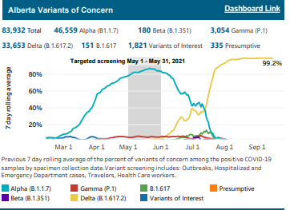
SARS CoV-2 Variants of Concern in Alberta
Source: Dr. Stephanie Smith, University of Alberta

Slide 45
Summary of Alberta’s four waves of COVID-19
Source: https://edmontonjournal.com/news/local-news/covid-19-live-updates-caf-nurses-head-to-alberta-pfizer-submits-trial-data-on-vaccine-use-in-children-aged-5-to-11-to-health-Canada. Oct 5, 2021.

Slide 46
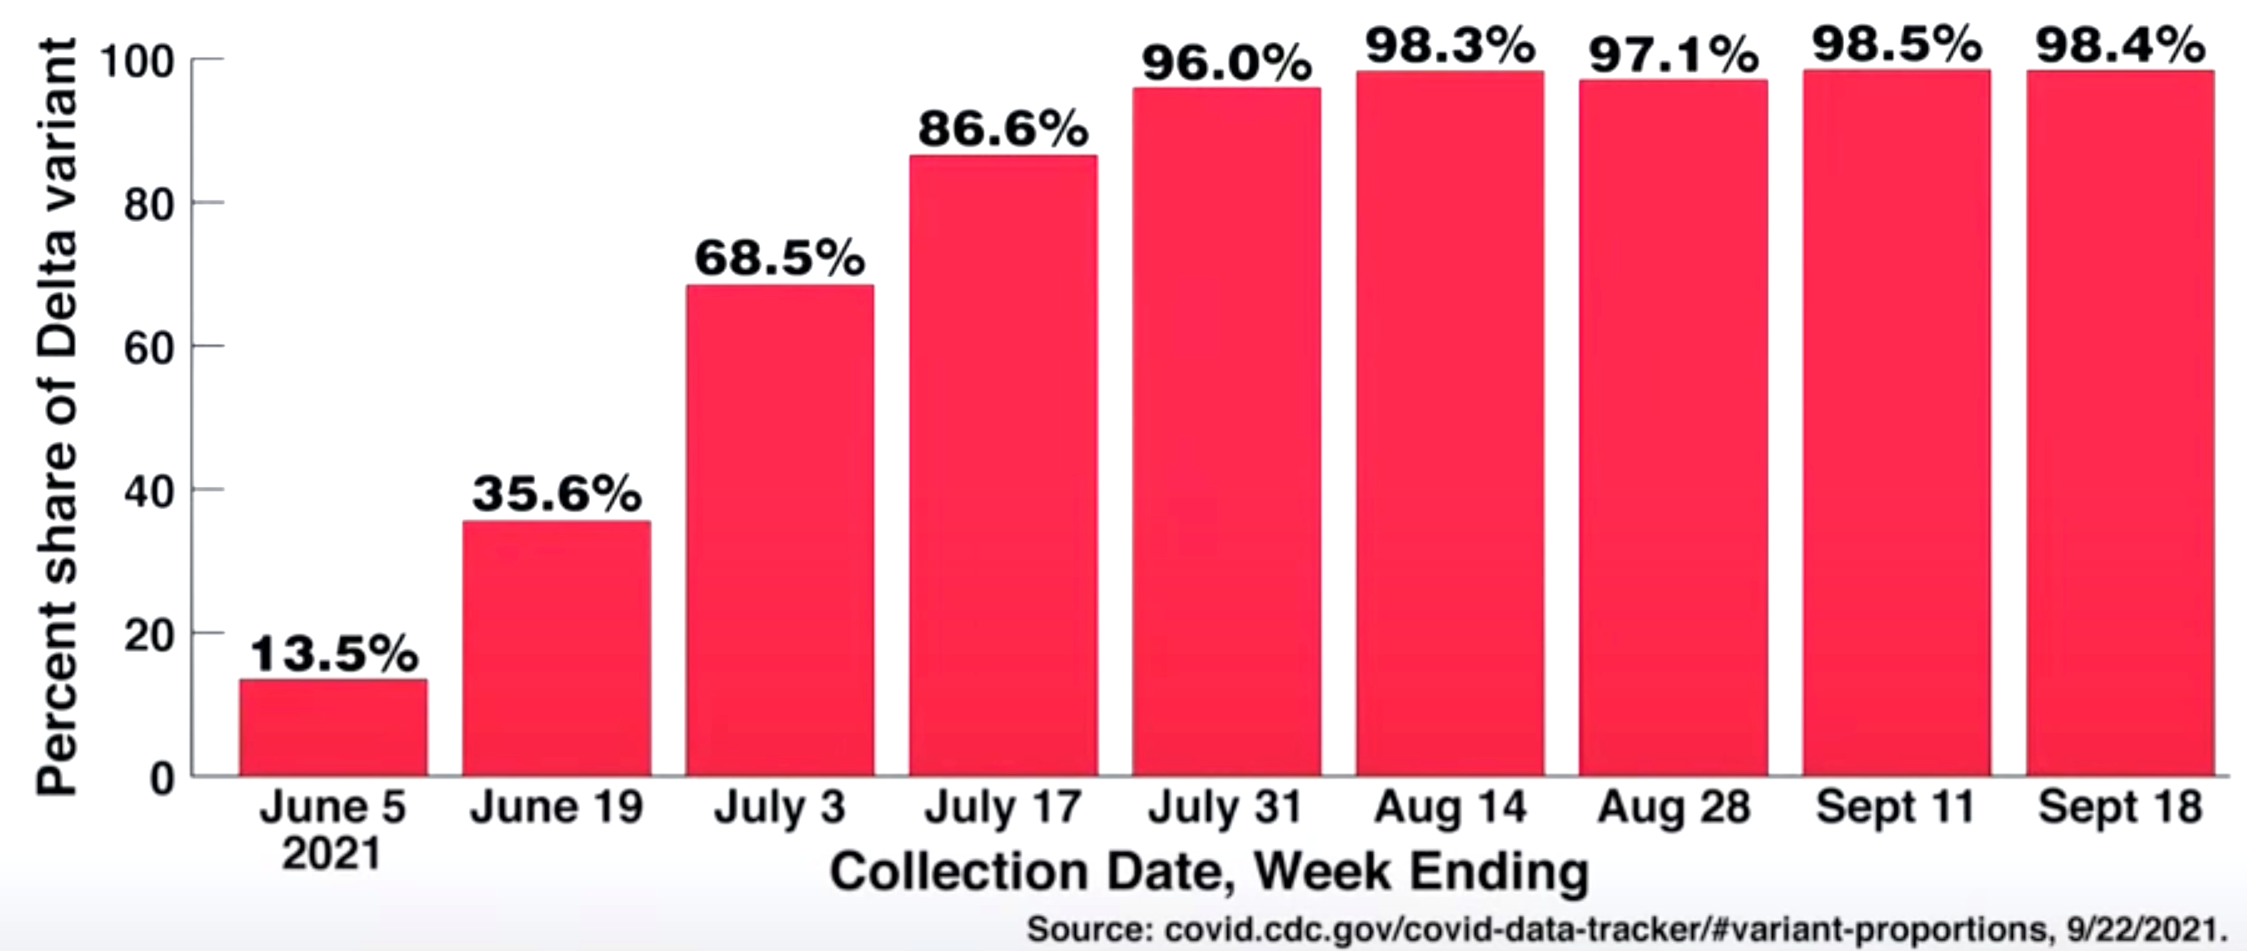
Estimated biweekly proportion of Delta variant among sequenced SARS-CoV-2 samples, USA

Slide 47
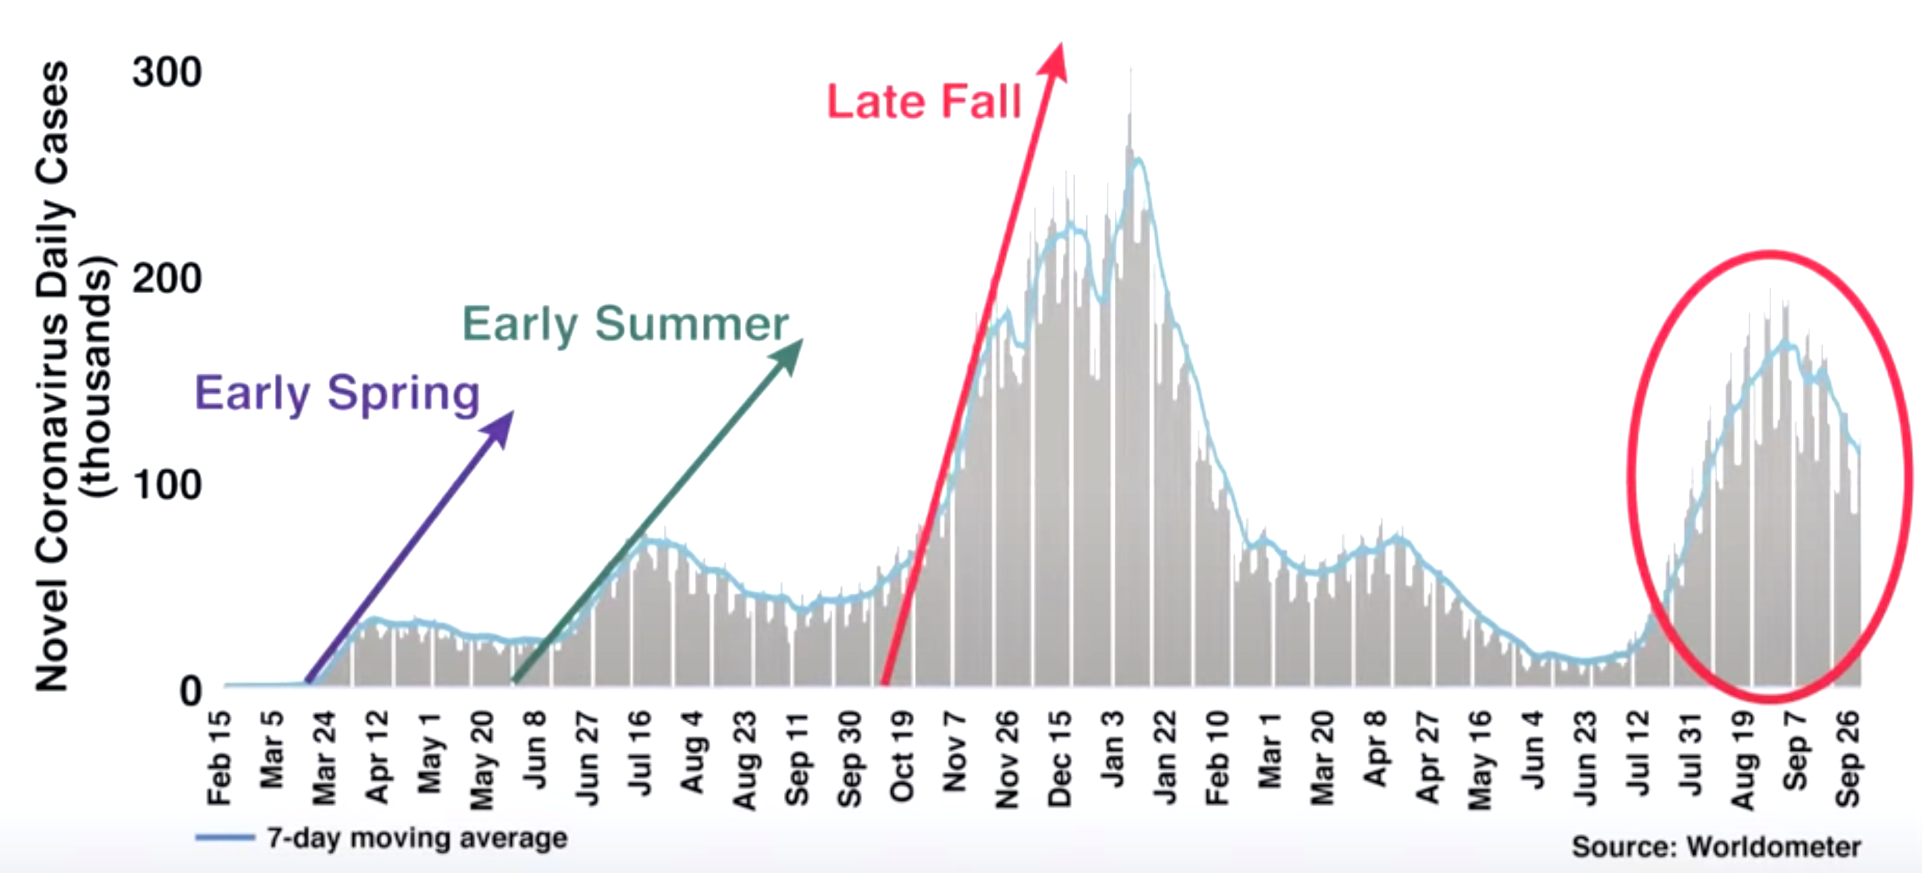
Daily new COVID-19 cases reported in the USA – slopes of the 4 waves
Source: Dr. Anthony Fauci - McGill University’s 67th Beatty lecturer. Date: Oct 1, 2021

Slide 48
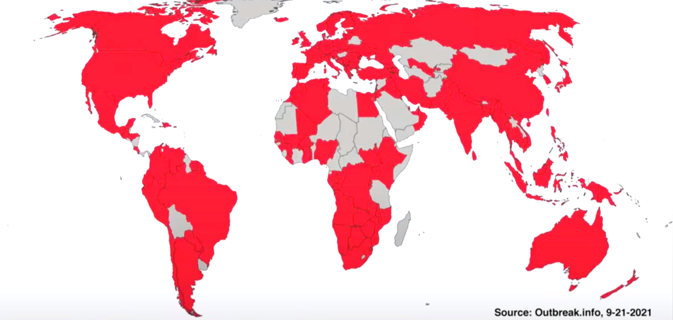
The SARS-CoV-2 B.1.617.2 (Delta) variant has been detected in at least 163 countries
Source: Dr. Anthony Fauci - McGill University’s 67th Beatty lecturer. Date: Oct 1, 2021.

Slide 49
Vaccine Effectiveness (VE)

Slide 50
Timing Between First & Second Doses
Extended in BC & Quebec Initially
We can get more people partially protected by using a single dose
We can protect more people by delaying the second dose
Not ideal, but was taken in times of vaccine shortages

Slide 51
Data suggests Canada's delay of second dose of COVID-19 vaccines paid off
Source: https://www.cbc.ca/news/health/canada-vaccine-effectiveness-data-delayed-doses-mixing-matching-covid-19-vaccines-1.6205993. Oct 9, 2021.

Slide 52
Pfizer 2-Dose Vaccine Effectiveness for
Alpha vs. Delta
Source: Meredith McMorrow, MD, MPH;
Colead Vaccine Effectiveness Team, CDC; July 29, 2021

Slide 53
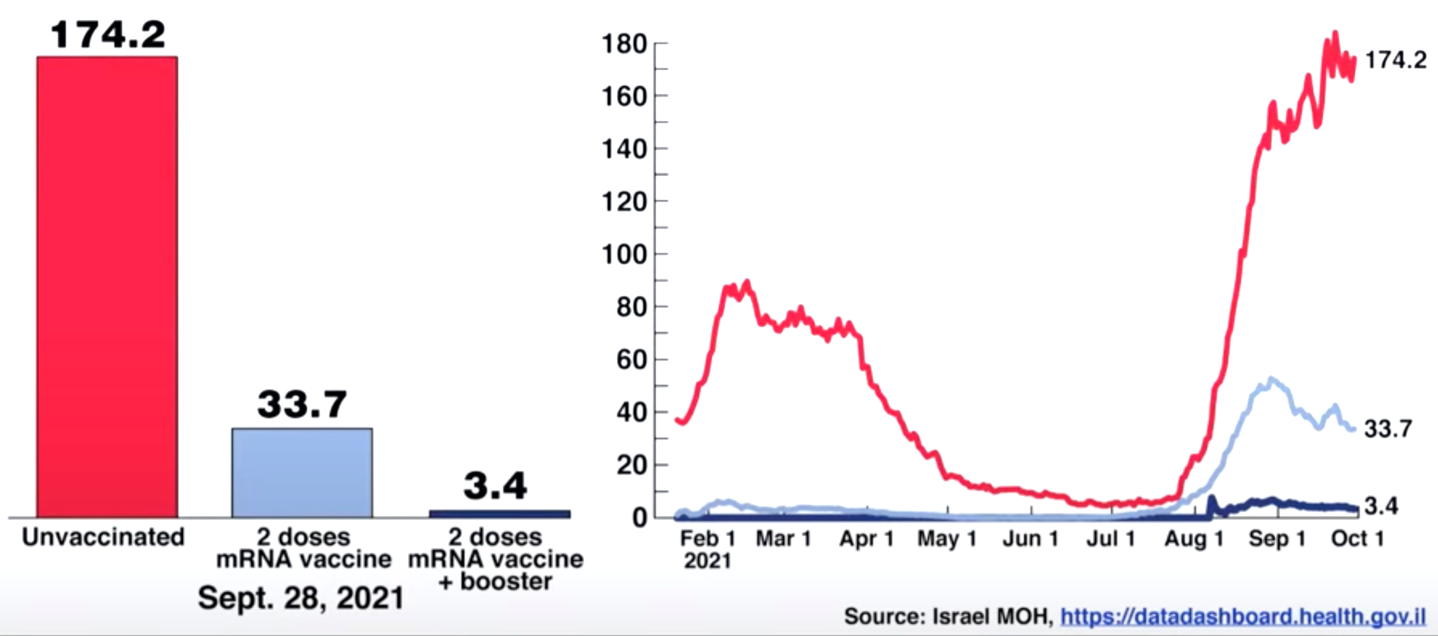
Active severe COVID-19 cases by vaccination status, age 60+ years, Israel (per 100K population)
Source: Dr. Anthony Fauci - McGill University’s 67th Beatty lecturer. Date: Oct 1, 2021.

Slide 54
Vaccine Hesitancy
Vaccine hesitancy is a serious & very significant issue worldwide
Delaying herd immunity and prolonging pandemic
Antivaxxers: small minority refuse all vaccines (<5%)
Hesitancy in Canada still remains significant → 15-20%
Contributes to polarization and conflict

Slide 55
Vaccine Hesitancy
Social media – huge source of misinformation
  This misinformation often carries the same weight as peer-reviewed scientific publications amongst hesitant and antivax individuals
  Misinformation often used by antivaxxers to drive their agenda
  Misinformation contributes to vaccine hesitancy

Slide 56
Vaccine Hesitancy
Most hesitancy is due to perception that COVID vaccine are new
  → Technology is NOT new; the application is new
Katalin Karikó - Hungarian biochemist
Karikó and Weissman mRNA technology was used within vaccines for COVID-19 that were produced by Pfizer (developed by BioNTech) and by Moderna
mRNA technology has been around over several decades looking at its incorporation into anticancer vaccines by many scientists and biotech
2022 Breakthrough Prize in Life Sciences

Slide 57
Vaccine Hesitancy Approaches
Communicate early and often
Listen and be responsive
Be honest, frank and transparent
Speak clearly and with compassion
Build trust in science

Slide 58
Conclusion
Very positive results particularly with COVID-19 mRNA vaccines - major triumph for science
Vaccines for COVID-19 will likely end the pandemic-generally very safe
Vaccine hesitancy-prolonging the pandemic
Vaccine certificates are here and booster requirement(s) likely to follow
COVID-19 will likely become endemic → long term annual boosters?

Slide 59
Thank you!

