Slide 1
Research Oriented Market Access for high cost therapies
Jeff Round, PHD
Director of Economics, IHE
Professor of Health Economics, University of Alberta
27 October, 2021
Canadian Association of Population Therapeutics 2021 Annual Conference

Slide 2
Overview
The Changing Regulatory/Reimbursement Landscape
The importance of uncertainty
Reducing uncertainty: Research Oriented Market Access
Principles
Overview
Methods and Outputs

Slide 3
The regulatory and reimbursement landscape is changing
Conditional approvals are now a common part of the regulatory and reimbursement landscape
Health Canada – NOC/c, R2D2
R2D2: “better use of real-world evidence to support regulatory decisions across a product's life cycle”
Notice of Intent to amend the Food and Drug Regulations and the Medical Device Regulations to support regulatory agility
NICE – managed access agreements in cancer and rare diseases
EMA – Conditional marketing authorization
P/T Working Group on EDRDs consultation on a supplemental process
CanReValue - the generation and use of Real World Evidence (RWE) for cancer drug funding decisions in Canada

Slide 4
The regulatory and reimbursement landscape is changing
Payers must answer difficult questions before listing a product
What is the value of the product?
Clinical and budget impact
Health impact
How confident are we about the evidence and our decision?
Quality of the evidence base
Data coverage and availability across jurisdictions
Can we increase confidence in our decisions?
Use existing RWD to improve knowledge base
Establishing new RWD collection if needed (eg establishment of registries)

Slide 5
The regulatory and reimbursement landscape is changing
Drug programs face increasing budgetary pressures
Increasing number of therapies
Increasing proportion of the covered population who are clinically indicated for one or more products
Increasing cost of therapies coming to market
Absence of mechanisms for reassessment and delisting therapies
Robust evidence and cost-effectiveness analysis (CEA) can support decision making
Available evidence often leaves decision makers highly uncertain, and
Additional, on-market, evidence is costly to generate.
Research-Oriented Market Access (ROMA)
Protocol to assess the value of generating real world evidence (RWE)
Consistent with a ‘life-cycle health technology assessment’ (LCHTA) framework
Notes:
HTA agencies must not only determine the new funding of drugs and technologies; they must also increasingly consider delisting products which are no longer justifiable from a value perspective.
In many cases, the evidence is not as strong or as clear as we would like it to be. There can be excess uncertainty due to many factors, such as complex populations, low generalizability, small effect sizes, or due to a gap in efficacy and effectiveness.
To address these challenges, we have developed a research-oriented market access, or ROMA protocol, which builds from life cycle HTA principles to assess the value of generating real world evidence (RWE) through ROMA.

Slide 6
ROMA
ROMA builds on existing HTA methods for assessing value of new technologies
Grounded in principles of current HTA methods
Evidence appraisal
Cost-effectiveness analysis / value assessment
Developed as an explicit response to increasing volume of promising but high cost and highly uncertain technologies
These technologies provide specific challenges to conventional health care reimbursement decision making processes and health system budgets
Focus is on addressing uncertainty and minimizing risk of making the wrong decisions

Slide 7
Sources of Uncertainty in HTA
Type of Uncertainty | Examples
Parameter Uncertainty | What is the effectiveness of the treatment? What resources do patients use?
Assumption Uncertainty | What is the relationship between progression free survival and overall survival?
Structural Uncertainty | What is the clinical treatment pathway? What are the relationships between parameters?
Methodological Uncertainty | What discount rate should be used? What is the most appropriate method for estimating survival curves?
Notes:
There are four distinct types of uncertainty which present challenges to HTA agencies.
I’ll discuss how ROMA addresses each type in the next slides, with the exception of methodological uncertainty, which ROMA doesn’t address.

Slide 8
The Importance of Uncertainty
Immature evidence base leads to higher uncertainty
eg small n, single-arm trials, case control studies, cohort studies
long follow-up times required may not be feasible
Small patient populations make small-n trials more common
More uncertainty means more payer risk
Uncertainty around product value means risky decisions
Products may have high up-front or life-time costs
Adoption and diffusion of technology
Whether a technology is good value depends on people both having access and being given treatment

Slide 9
The Importance of Uncertainty
Uncertainty has a value
In a research context uncertainty can be valued to determine whether further research is a good use of scarce resources
The value of the uncertainty can be used to identify an evidence based market access price
That is, the acceptable price when initially coming to market
On-market evidence may reduce uncertainty
Post-market data collection can change degree of uncertainty
If uncertainty in the evidence base then decision uncertainty will likely
Based on the collection of additional evidence:
a technology can be reappraised,
recommendations and listing decisions can be reconsidered, and
a long-term value based price identified

Slide 10
ROMA and Uncertainty
Challenge | ROMA advantage
Immature Evidence Base | Opportunities for collection of additional data in a real-world context
High cost products | Can make estimates of value and then assess whether value proposition is met and whether decision risk is reduced
Technology diffusion/adoption | Consider the technology over the course of a longer time frame and assess whether diffusion/adoption is happening, and impact on value proposition

Slide 11
ROMA Principles
Feasibility & Go-No-Go
Value Predictions and Monitoring Design
Decision Rules and Value Based Procurement Contracting

Slide 12
ROMA Overview
HTA
Decision
VBP
Pricing
Clinical Review
Economic evaluation & value of information
On-market evidence generation plan
Reimburse
Reimburse with conditions
Reimburse with ROMA (ie evidence generation)
Do not reimburse
Pharmacoeconomic assessment
Value Based Price informed by economic report
Plans for review informed by On-market evidence generation plan.
HTA recommendation
On-market evidence generation plan

Slide 13
ROMA Outputs
Cost-effectiveness
Cost-effectiveness statistics
Incremental cost-effective ratios
Net monetary benefit
Value of information
Value of on-market evidence generation given size of treated population
Can we generate post-approval evidence to inform reassessment?
Is the value of research greater than the cost?
What’s the maximum amount it’s efficient to pay to avoid risk of wrong decision?
On-market evidence generation plan
Decision information
Key information for decision making
Cost-effectiveness statistics
Cost of additional research
Value of additional research
Specify data collection and analysis plan
What data to collect?
From which patients?
For how long?
How to analyze it?
Notes:
Key differences between this model (ROMA) and other models of on-market evidence generation are the use of VOI to inform the acceptable price AND the evidence generation plan

Slide 14
ROMA Methods and Process
Methodological protocol built on standard CEA and value of information (VOI) methods
leveraging administrative data assets for data collection, synthesis and reanalysis
develop multiple research designs to allow alternative research-oriented market access agreements to be evaluated, and
facilitate RWE reanalysis for decision making, in three stages distinguished by continuation criteria.
Notes:
To develop the ROMA protocol, we looked to peer review and grey literature, and identified existing methods and processes.
Next, we synthesized our findings to develop a methodological toolkit and protocol to support ROMA.
The protocol is structured to minimize the analytic period for products that are unlikely to reach market access. We developed clear decision rules which are nested within established VOI methods and theory.
In particular
We designed the protocol to leverage existing data sources to reduce uncertainty.
We provide guidance for the development of multiple research designs, including modeling of technology diffusion and simulations for RWD generation.
The protocol is constructed in three distinct stages. Each stage contains a continuation criteria: which must be met in order for the candidate product to continue through to the next stage of the protocol. This ensures that only products which have potential to reach market access proceed– as any further analysis or decision deferral would be inefficient.

Slide 15
ROMA Methods and Process
Three key stages
Product assessment – clinical appraisal and early VoI
Develop multiple research designs to allow alternative research-oriented market access agreements to be evaluated
Facilitate RWE reanalysis for decision making, in three stages distinguished by continuation criteria
Notes:
To develop the ROMA protocol, we looked to peer review and grey literature, and identified existing methods and processes.
Next, we synthesized our findings to develop a methodological toolkit and protocol to support ROMA.
The protocol is structured to minimize the analytic period for products that are unlikely to reach market access. We developed clear decision rules which are nested within established VOI methods and theory.
In particular
We designed the protocol to leverage existing data sources to reduce uncertainty.
We provide guidance for the development of multiple research designs, including modeling of technology diffusion and simulations for RWD generation.
The protocol is constructed in three distinct stages. Each stage contains a continuation criteria: which must be met in order for the candidate product to continue through to the next stage of the protocol. This ensures that only products which have potential to reach market access proceed– as any further analysis or decision deferral would be inefficient.

Slide 16
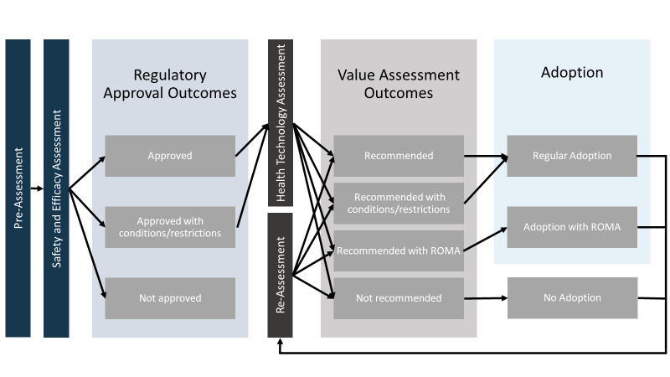
ROMA

Slide 17
ROMA Stage 1: Initial Assessment
The purpose of this stage is to provide guidance to develop models suitable for:
Expected Net Benefit (ENB) and PSA,
Iterative (Bayesian) updating of model parameters, and
Range of VOI outputs: EVPI, EVPPI, ENPVSI.
De novo model development to support:
Reduction of structural uncertainty, alignment to care pathway,
Efficiency of model structure for advanced methods implementation, and
Inclusive participation of all stakeholders.
Notes:
In stage 1, we provide guidance for the development of a model which produces ENB and a PSA, but also is structured to easily to implement Bayesian updating of model parameters, and to produce advanced VOI analytic outputs
We believe that it is important to construct a de novo model rather than recycle previously developed models:
First, because of the opportunity to reduce structural uncertainty through scoping and evidence review while also ensuring alignment to the care pathway in relevant jurisdiction
Ensure efficiency of model structure for advanced methodological components of the process
This approach will facilitate inclusive participation for all stakeholders in model development.

Slide 18
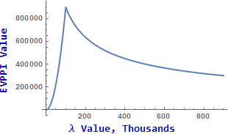
ROMA Stage 1: Initial Assessment
Objectives
Conduct scoping and evidence review, set model structure
Develop de novo model, produce ENB and PSA
Conduct rapid expected value of perfect parameter information (EVPPI) analysis
Continuation Criteria
For at least one parameter, the EVPPI is greater than the cost to generate RWE for that parameter
Notes:
by the end of stage 1, the protocol requires the completion of the scoping and evidence review,
the development and evaluation of the de novo model, with ENB, PSA, and EVPPI outputs
NEXT the continuation criteria requires that the EVPPI be compared to the expected cost of evidence generation for each parameter. If the value is greater than the cost for at least one parameter, the technology should continue through the ROMA protocol.
To illustrate, in this diagram, at a lambda value of 100 thousand $ per QALY, the maximum cost of evidence generation to meet the continuation criteria is approximately 900 thousand $.

Slide 19
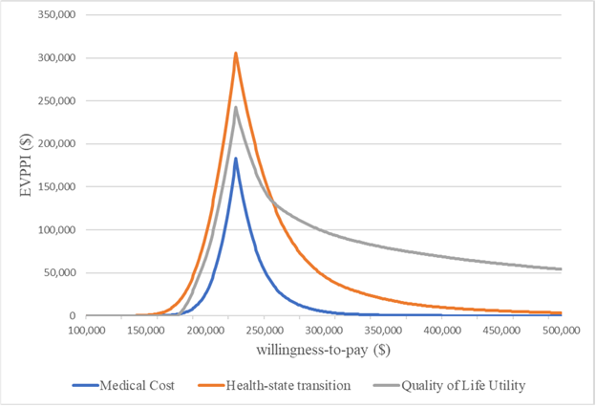
ROMA Outputs
The value of additional research depends on the willingness to pay per additional QALY

Slide 20
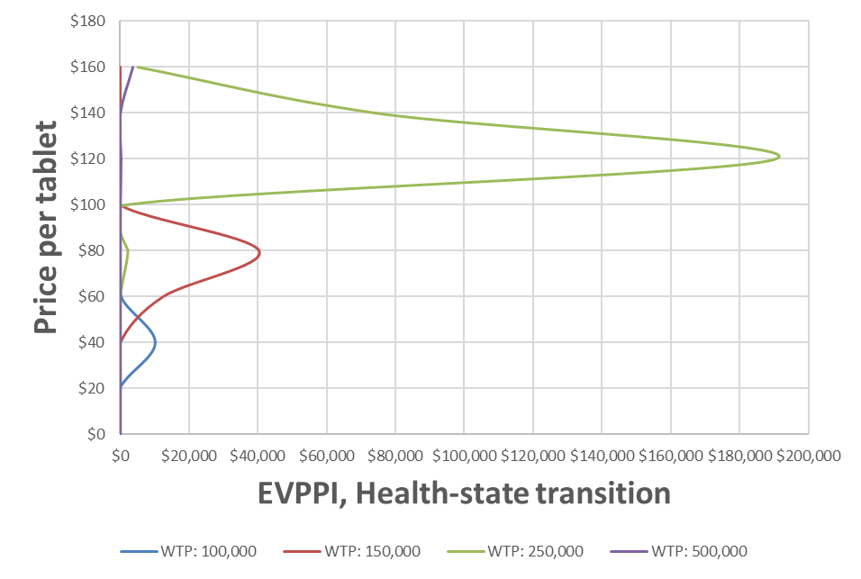
ROMA Outputs
The value of additional research for a given willingness to pay per QALY is dependent on the price of the product

Slide 21
ROMA Stage 2: RWE Research Design
Technology Diffusion
The purpose of this stage is to identify the optimal research design which maximizes expected net present value of sample information (ENPVSI).
Uptake Decision
Treatment Result
(+ or -)
RWE development is a function of interdependent processes which must be modelled
the diffusion of the technology
the subsequent generation of RWE
RWE Generation
Notes:
Now moving to stage 2. The purpose of this stage is to identify optimal research designs. The optimal design is the one which maximizes ENPVSI, and is characterized by the RWE generated, sample size, and the time required to reach that sample size.
To estimate the maximum ENPVSI for each design, the process under which evidence is generated must be modelled. This is a function of two interdependent processes: Tech diffusion and RWE generation.
The relationship is interdependent because clinicians counsel their patients based on their evolving perceptions of the treatment. [ONE] This is technology diffusion. [TWO]
If clinicians have positive perceptions, they are more likely to recommend the treatment to further patients and thus the rate of uptake will increase over time. [THREE]
Higher uptake will generate evidence more quickly, in a positive feedback loop which reduces the total time to report. Conversely, weaker evidence could lead to a negative feedback loop where evidence is generated more slowly. [FOUR]
Successful modelling of this dynamic requires integrated, stepwise modelling of technology diffusion and RWE generation.

Slide 22
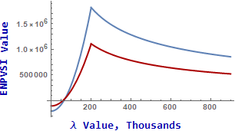
ROMA Stage 2: RWE Research Design
Stage 2 objectives:
Develop candidate research designs,
Simulate RWE generation through technology diffusion and data generation models
Estimate ENPVSI for each research design
Continuation Criteria
There must be a positive ENPVSI for at least one of the research designs
Notes:
There are three objectives in stage 2:
To develop the candidate research designs
to Simulate RWE generation under each research design through stepwise technology diffusion and data generation modelling
And to estimate ENPVSI for each research design
At the end of stage 2, the continuation criteria requires that the ENPVSI should be positive for at least one of the candidate research designs
To illustrate, in this diagram we’d need a lambda value of at least 50 thousand dollars per QALY, to meet this eligibility criteria for either research design, so that the ENPVSI is positive.

Slide 23
ROMA Stage 3: Implementation
The purpose of this stage is to implement one of the research designs with a positive ENPVSI
Stage 3 objectives
Implement research design through ROMA
Update ENB and ENPVSI with new information from RWE at each readout period, apply stopping condition
Complete analysis and final ENB estimate at end of ROMA period, or when completion condition is met
Notes:
In the final stage, one of the research designs is implemented.
There are three objectives
First, is to allow market access for a research design through ROMA
Second is at each readout period to update model outcomes with new information from the RWE, and to test stopping conditions
And then when the stopping condition is met, the analysis should be finalized and reported.

Slide 24
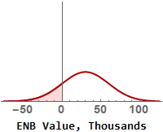
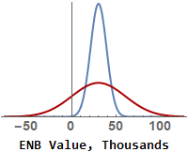
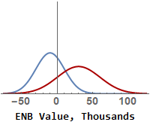
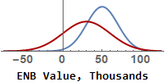
ROMA Stage 3: Implementation
Stopping Condition: ENPVSI is less than or equal to zero. This happens when the RWE produces:
1
1. a consistent mean ENB but with reduced uncertainty
2. a lower mean ENB such that it is more certain that the candidate technology is not cost effective
2
3. a higher mean ENB such that it is more certain that the candidate technology is cost effective
3
Notes:
In the ROMA implementation, the target is no longer to maximize ENPVSI, but rather to confirm that it is still positive.
There are three situations in which a negative ENPVSI could emerge in a ENB framework. Recall that the ENPVSI is the difference in EVPI (represented by the shaded red area in the top right plot) with and without the information from the research design, and accounting for research costs.
Now, consider the case that the RWE produces a consistent mean ENB, but with lower uncertainty. In this case, there is no value to further research.
Second, imagine the RWE produces a lower mean ENB, with somewhat reduced uncertainty. It is now more certain that the technology is not cost effective.
Third, imagine that the RWE produces a higher mean ENB such that it is more certain that the candidate technology is cost effective.

Slide 25


Comparing ROMA and traditional HTA
Traditional HTA
ROMA
Clinical and economic review
CDEC recommends that be listed for the treatment of in patients aged and with if the following clinical criteria and condition are met:
Clinical criteria
Confirmed diagnosis of with
Discontinuation criteria should be developed for in consultation with physicians and patients who have expertise in .
Condition
Substantial reduction in price
Stage 1: Clinical review and 1st VOI
Clinical effectiveness highly uncertain
For at least one parameter, EVPPI is > than the cost to generate RWE for that parameter.
Recommendation: Continue appraisal
Stage 2: VOI and Research Design
There are viable sampling designs to address methodological issues and reduce uncertainty
There is a positive ENPVSI for at least one of the research designs
Recommendation: Reimburse with ROMA
Stage 3: Implementation
Implement RWE strategy
Update outputs with new evidence
Complete appraisal and make final listing assessment
Notes:
To demonstrate what this might look like in practice, I’ll take the recent example of SEMAGLUTIDE, a drug for glucose control in type 2 diabetes patients. CADTH reviewed this drug and released its recommendation of reimbursement with initiation, administration, and pricing conditions in May 2019.
The decision committee noted methods limitations, which lead to a high degree of parameter uncertainty.
They also noted that the provided model was limited and lacked transparency. This caused structural and assumption uncertainty.
Due to these issues, the committee recommended price alignment with existing second line treatments.
Now, I’ll contrast how this could be improved through ROMA.
In stage 1, the analysis of the clinical pathway and de novo model development would resolve structural and assumption uncertainty.
In Stage 2, the development of less biased research designs would reduce parameter uncertainty.
In Stage 3, the generation of RWE will provide the data required to reduce parameter uncertainty, and also to evaluate structural and assumption uncertainty in the clinical pathway.

Slide 26
Conclusion
Traditionally, HTA agencies make one of three reimbursement decisions under uncertainty:
Recommend
Do not recommend
Recommend with conditions (eg managed access agreement, price reduction)
ROMA approach adds
Recommend with Research-Oriented Market Access
with specific research design and contractual arrangements
With ROMA:
HTA agencies gain an additional decision tool, and achieve the optimal price-uncertainty balance at the point of recommendation,
Patients have timely access to novel therapies,
Manufacturers are ensured fair compensation, and
Payers are supported to make efficient funding decisions
Notes:
In the example on the prior slide, the HTA agency had three possible decisions: to recommend, to recommend with conditions, or not to recommend.
Under ROMA, HTA agencies gain a new decision option: to grant research oriented market access under a specific research design and price.
With ROMA, HTA agencies achieve the optimal level of uncertainty at the point of recommendation.
In addition to this, patients gain timely access to novel therapies,
Manufacturers are ensured fair compensation for their products and innovation,
And Payers are supported to make efficient funding decisions.

