Slide 1
Closing the Gaps to Timely Patient Access
CAPT 2021 Conference
October 25, 2021

Slide 2
Welcome!

Slide 3
Objective
To discuss how stakeholders can work together to create a system that enables timelier patient access to medications.
Specifically, leveraging some variation of a conditional listing mechanism

Slide 4
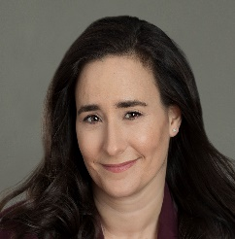

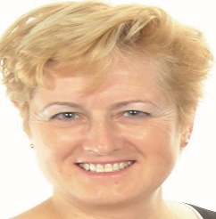
Speaker Introductions
Dr. Oonagh McGill, Market Access Director, AstraZeneca UK
Ms. Eva Villalba, Executive Director – Quebec Cancer Coalition (QCC)
Dr. Paul Wheatly-Price, The Ottawa Hospital Cancer Centre; University of Ottawa; and, Immediate Past President, Lung Cancer Canada
Dr. Judith Glennie, J.L. Glennie Consulting Inc. (moderator)

Slide 5
Housekeeping
Please feel free to enter questions into the chat room.
We will pull from these for the Q&A segment.
Presentations will be made available on the CAPT web site after the conference.
An evaluation survey will be sent out after the conference.
Feedback on this session and the whole event would be greatly appreciated.

Slide 6
Setting the Stage
Dr. Judith Glennie

Slide 7
Background – What is the issue?
Health Canada, CADTH, and INESSS have put significant effort into accelerating regulatory and HTA reviews for products where early clinical data are promising and there is high patient need.
Project Orbis
An international (regulatory) partnership designed to give cancer patients faster access to promising cancer treatments.
Aligned Reviews
Health Canada + HTA bodies;
CADTH + INESSS, etc.
Notes:
Project Orbis: https://www.canada.ca/en/health-canada/services/drugs-health-products/international-activities/project-orbis.html
https://www.smartbiggar.ca/insights/publication/first-year-of-project-orbis-leads-to-38-approvals-of-cancer-therapies-including-8-by-health-Canada
Parallel regulatory and HTA reviews: https://www.canada.ca/en/health-canada/corporate/transparency/regulatory-transparency-and-openness/improving-review-drugs-devices/notice-aligned-reviews-health-canada-health-technology-assessment-organizations.html

Slide 8
Background – What is the issue? (1)
These advances are undermined by later stages of the reimbursement process and, as a result, patients end up waiting for new medications due to barriers in other parts of the patient access system.
Delays due to the length of the negotiation process (average 160 days)
+
Delays due to files waiting to be picked up to start negotiations (50% ”under consideration”)

Slide 9
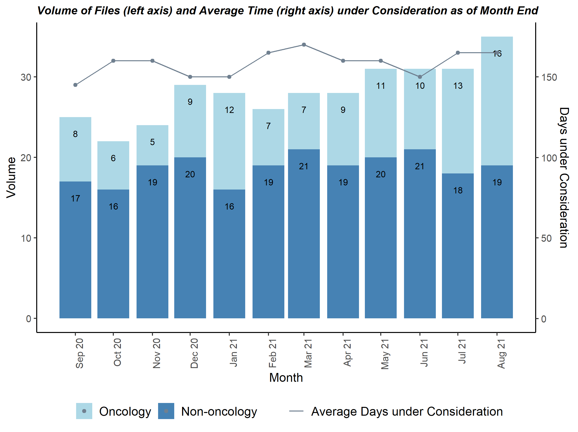
September 17, 2021 MORSEConsulting.ca
Notes:
Data on the current state (i.e., data from MORSE re: listing timelines for oncology products)
https://morseconsulting.ca/highly-productive-august-with-pcpa-completing-10-negotiations/
Signals Decoded:
Partly due to the high volume of CADTH recommendations finalized in August, pCPA’s under consideration count stands at its highest (35) over this past year. In addition, the number of oncology files under consideration follows the same trend, with a considerable rise and the highest we have seen over the last 12 months, sitting at 16.

Slide 10
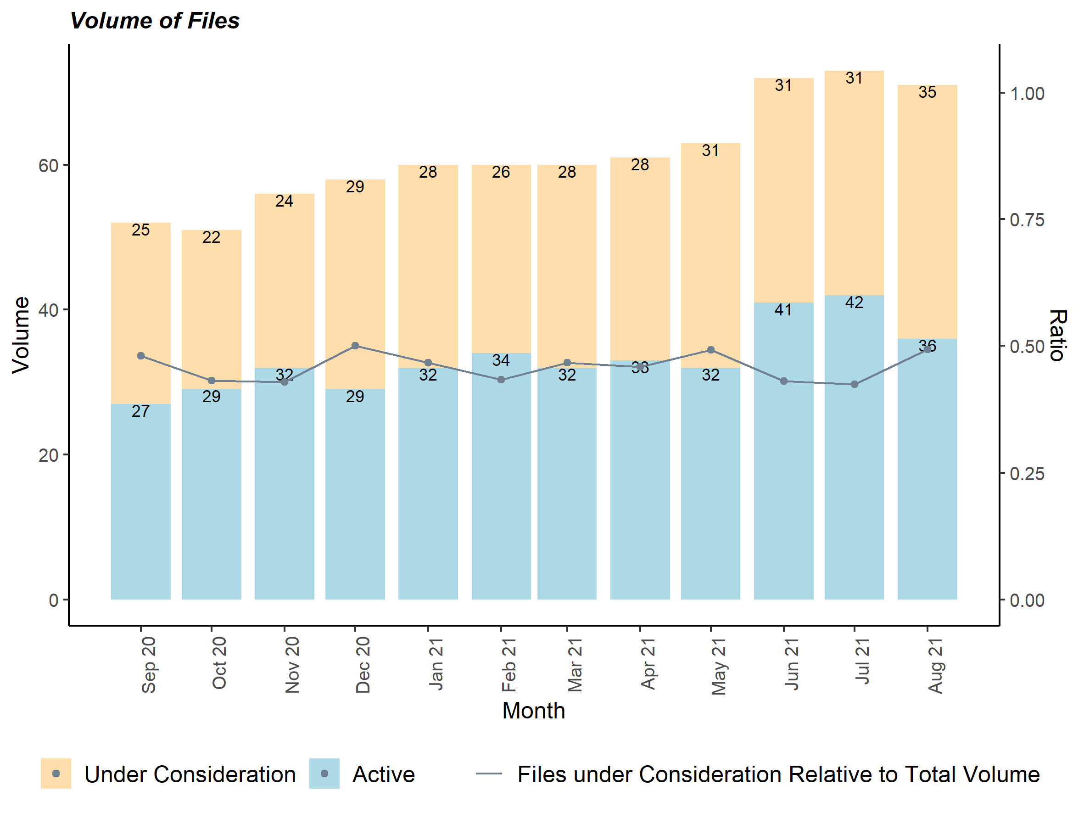
September 17, 2021 MORSEConsulting.ca
Notes:
Https://morseconsulting.ca/highly-productive-august-with-pcpa-completing-10-negotiations/
Signals Decoded: Four new files initiated negotiations, with 2 of the files being initiated relatively quickly (22, 33 days) while the other two files took 5-6 months to initiate (Entresto which already has a LOI in place and Kesimpta, for MS). The 2 files initiated quickly were:
Keytruda (for colorectal cancer) which opened and closed on the same day, the same as occurred with their last indication in head and neck squamous cell carcinoma in Feb 2021; and
Evrysdi, the third therapy for treatment of SMA, which will join Zolgensma which is currently under active negotiation as well.
The number of active files under negotiation dropped from the annual highs (over 40) seen over the last 2 months, mainly due to the high number of negotiations completed in August. The overall total volume of files under pCPA purview continues to be high with 71 files either under consideration or in active negotiations.

Slide 11
Background – What is the issue? (2)
Patient Support Programs (PSPs) have filled the gap for patients for many years.
PSPs are not sustainable in the face of ever-increasing delays in listing processes, and only serve to mask a broken system.
Need for all parties to demonstrate a willingness to bring creativity and change to develop options for accelerating access to medicines with high unmet need through some variation of a conditional funding mechanism.

Slide 12
What is Conditional Funding?
A conditional funding/listing is a:
An agreement that provides patient access to a new medication subsequent to the HTA review (or earlier?), while other aspects of the agreement are finalized (e.g., pricing negotiations, protocols for on-going data assessment, etc.).
Case study re: impact on patient access (Project Orbis product: Osimertinib)
Timeline from regulatory approval to patient access in UK = 0 days*
Timeline from NOC to first listing in Canada = ??? days*
* Calendar days
Notes:
Speak specifically to comparison of timelines for Tagrisso in UK vs. Canada, while both going through the Project Orbis process (ref UK press release; Erin to send)
UK
MRHA – May 7/21
NHS – May 7/21
NICE – Sept 21? (TBC – nothing on website as of Sept 30/21)
Canada
HC Jan 18/21
Submission Mar 24/21
CADTH draft reco Sept 2/21
pCPA – TBD
ON - TBD

Slide 13
Other Countries Acknowledging the Need for Change
September 2021:
France introducing new measures to accelerate market access in a manner similar to the German system (i.e., patient access after HTA but preceding price negotiations)
Linked to recognition of importance of maintaining a home-grown innovation ecosystem.
August 2021:
NHS England “smart deal” for sotorasib
Accelerated patient access to sotorasib (Project Orbis; breakthrough KRAS inhibitor for lung cancer).
Budget neutral agreement that allows a drug to be used within weeks of marketing authorisation in return for a substantial discount and a commitment to collect real-world evidence to support a future appraisal by NICE.
While systems are different, there is a lot that Canada can learn from other countries.
Notes:
France:
UK: https://www.linkedin.com/posts/neil-grubert_nhs-projectorbis-earlyaccess-activity-6842118355978092544-L6_8

Slide 14
So, our goal for today….
To advance discussions on the creation of a conditional funding framework and mechanism, as a tool in enabling timely access to innovative new medications in Canada.
To share ideas on what a conditional listing mechanism would look like.
How can we collaborate to create a conditional funding mechanism to accelerate patient access for important new medications with high unmet need?

Slide 15
Agenda:
Different examples and perspectives on accelerating patient access through innovative conditional funding mechanisms.
The UK experience
A patient perspective
A clinician perspective
Audience Q&A

Slide 16
The Challenge and a Potential Solution: The UK Experience
Dr. Oonagh McGill

Slide 17
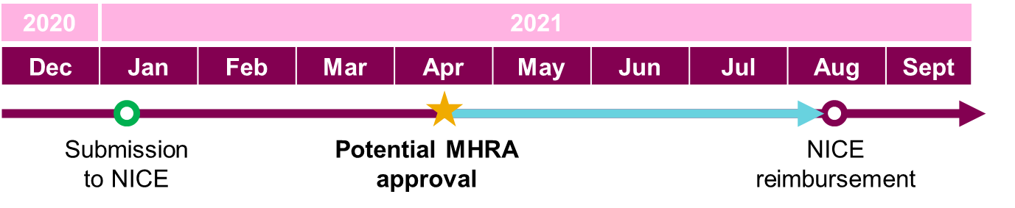



System willingness to co-create with AZUK new access solutions
Project Orbis & contingent approval for Tagrisso ADAURA
Accelerated marketing authorisation via MHRA for adjuvant treatment of adults with early-stage EGFR-mutated lung cancer
As Tagrisso recognised as an innovative therapy, the ADAURA indication was reviewed as part of Project Orbis
MHRA marketing authorisation successfully expedited creating a gap of 4 months between license & reimbursement
Notes:
Due to the truly innovative nature of osimertinib, regulatory timelines for the ADAURA indication have been significantly expedited creating a gap between marketing authorisation and reimbursement - Due to the unprecedented results from the ADAURA study, osimertinib was granted Breakthrough Therapy Designation in the USA for the adjuvant treatment of patients with stage IB–IIIA EGFRm NSCLC after complete tumour resection with curative intent
Project Orbis:
- Project Orbis is a FDA Oncology Centre of Excellence initiative with a focus on life-changing, highly innovative oncology drugs whose aim is to expedite regulatory approval.
- In 2020, the MHRA participated as part of Project Orbis as an observer and became a full participant as of 1st January 2021

Slide 18






System willingness to co-create with AZUK new uptake solutions
Project Orbis & contingent approval for Tagrisso ADAURA
Accelerated marketing authorisation via MHRA for adjuvant treatment of adults with early-stage EGFR-mutated lung cancer
AZUK partnered with NHS & NICE to create contingent approval process
Enabling access for UK patients from marketing authorisation to reimbursement
Patient access from accelerated regulatory approval
Ability to execute a full launch from the start of the programme, accelerating uptake at reimbursement
Unlike other EAPs, NHSE will take on all the administrative burden required to implement and track the programme from point of MA to reimbursement
NHSE issue a press release to notify all Trusts highlighting AZ partnership to enable early equitable access to such an innovative ground breaking medicine
The early access “bridging” program will have a mechanism in place to track indications, ensuring no spill over to other indications/off-label use
Upon reimbursement NHS to publish circular to all Trusts in England notifying them of the decision and supporting NICE’s decision driving uptake
Notes:
Due to the truly innovative nature of osimertinib, regulatory timelines for the ADAURA indication have been significantly expedited creating a gap between marketing authorisation and reimbursement - Due to the unprecedented results from the ADAURA study, osimertinib was granted Breakthrough Therapy Designation in the USA for the adjuvant treatment of patients with stage IB–IIIA EGFRm NSCLC after complete tumour resection with curative intent
Project Orbis:
- Project Orbis is a FDA Oncology Centre of Excellence initiative with a focus on life-changing, highly innovative oncology drugs whose aim is to expedite regulatory approval.
- In 2020, the MHRA participated as part of Project Orbis as an observer and became a full participant as of 1st January 2021

Slide 19
New NHSE “Contingent Approval” mechanism
Access Gap
Contingent Approval
Benefits & Implications
ILAP New accelerated reg. scheme
Involves MHRA and NICE, limited NHSE involvement – unknown entity at this time
Regulatory submission
NICE submission (Dependent on NICE capacity and timelines)
Regulatory approval
NICE approval
Specific qualifying criteria to be put in place, managing NHS concern about setting a precedent for access pre-NICE:
Medicine must hold an “Innovation Passport” or be submitted via other accelerated pathway
Unmet need confirmed (with NICE)
NICE dossier is ready for submission (feasibly cost-effective price ICER)
Negotiation on risk-share (NHSE)
Patient access from accelerated regulatory approval
Ability to launch fully at time of approval, accelerating uptake
Secures real action against the commitment for accelerated approvals to link to early access
Furthers pragmatism in approach between NICE and NHSE to ensure timely access
A positive build on the pre-approval option of EAMS
POTENTIAL GAP NICE aims to eliminate but capacity and speed of e.g. Orbis challenge

Slide 20

A Patient Advocate Perspective
Eva Villalba, MBA, MSc

Slide 21
Proposal to INESSS: Framework for rare conditions, conditional approvals, OBAs & RWE
Evaluation framework for the treatment of rare conditions which would recognize clinical rarity as a trigger, not tumour site or disease type.
Flexibility to address unmet patient needs.
Recognize the promise of therapeutic value and propose measures to confirm this and mitigate residual uncertainty ( RWE collection, risk-sharing agreements, etc.).
Patient-Reported Outcome Measures (PROMs) and Patient-Reported Experience Measures (PREMs) are already beginning to be used by patient groups in their submissions to INESSS and CADTH.
Outcomes-based agreements (OBAs) place the burden of proof and effectiveness on manufacturers in the context of limited data, while ensuring better access to the population.
OBAs provide important accountability for real-world evidence, while allowing greater flexibility for HTAs to produce more appropriate recommendations based on new evidence.
Notes:
June 2021. A single evaluation framework for rare conditions (including rare diseases) would serve to provide the flexibility to address unmet patient needs. This framework would allow the INESSS/MSSS to recognize the promise of therapeutic value and propose measures to confirm this and mitigate residual uncertainty (real-world evidence collection, risk-sharing agreements, etc.).

Slide 22
What is missing for improved patient access?
Weight given to patient group submissions in HTA evaluations
Measuring outcomes that matter to patients (PROMs & PREMs)
Tying outcomes to costs/reimbursement
PSPs are very helpful in bridging gaps, but not sustainable or equitably offered
Framework & infrastructure to collect RWE for HTA & clinical applications
Conditional approval mechanisms for re-evaluation
Patient group perspectives

Slide 23


Real people behind the access challenges
Notes:
Case of battling for access to precision medication in NSCLC
66 yr old retired elementary school teacher in the Laurentians, non smoker
Caregiver advocacy

Slide 24
Best case scenario for a conditional listing mechanism (patient perspective)
More weight given to patient group submissions by HTA
HTA evaluation summary in lay language
Quick access to innovative treatments
Reduced bureaucracy for access & reimbursement
Informed consent from patients
Simplified and systematic RWE collection
Explanation of how and why data will be used
IT infrastructure in public health care system
Educating and raising awareness among prescribers
Notes:
what "good" would look like re: a conditional listing mechanism from a patient perspective.
Give access now, evaluate later
Informed consent from patients for conditionally approved treatments
Reduced bureaucracy for
Educating and raising awareness among prescriptors of the reimbursement and access mechanisms

Slide 25
A Clinician Perspective
Dr. Paul Wheatly-Price

Slide 26


Closing the gaps to timely patient access
CAPT 2021, 25 October 2021
Paul Wheatley-Price
BSc, MBChB, FRCP (UK), MD
Associate Professor and Lung Cancer Lead, Division of Medical Oncology,
Department of Medicine, University of Ottawa
Immediate Past-President of Lung Cancer Canada (2016-2021)

Slide 27
A clinician perspective
Disclosures:
As a clinician I want access to the best drugs for my patients
As an advocate with Lung Cancer Canada we provide submissions to the HTA process for new drug approvals
I have directly contacted pCPA to request prioritization of some files
I attend Industry Advisory Boards where we discuss strategies for approval

Slide 28
Conflict of Interest
There can often be a real or perceived conflict of interest.
However, in general, all the stakeholders want effective drugs to be available
Patients
Clinicians
Payers
Unions
Industry

Slide 29
Current frustrations
During clinical trials stage of drug development we have some access to new treatments
Health Canada and CADTH are now fairly streamlined and smooth
Delays can include Industry not submitting their files early (other countries may go first)
The pCPA process is slow and lacks transparency

Slide 30
Current frustrations
Patient access programs can be very effective, but ease of use varies between companies
Patient access programs are variable in how long they remain open
Therefore there is a very real time gap where patients cannot access a treatment that someone would have received 3 months earlier or 6 months later (e.g. ROS1 NSCLC)
SAFETY – patients can die while waiting!

Slide 31
The role of pCODR / CADTH
Recently we have seen progressive adjudications
Crizotinib for ROS1¹ and Dabrafenib/Tremetinib for BRAF positive NSCLC² have received positive recommendations based on non-randomized phase 2 trials
Larotrectinib has been approved as a tumor agnostic treatment (NTRK fusion cancers) ³
However some decisions seem to put highly questionable constraints (osimertinib in early stage NSCLC asks for 82% reduction in price to $50,000 per QALY) ⁴
https://cadth.ca/xalkori-ros1-positive-advanced-non-small-cell-lung-cancer-details
https://cadth.ca/dabrafenib-and-trametinib-non-small-cell-lung-cancer-braf-v600-mutation-details
https://cadth.ca/larotrectinib
https://cadth.ca/osimertinib

Slide 32
What would we like?
Transparency and speed
Project Orbis has good principles, but seems to back up the system
The HTA process does not need to put specific funding requirements in their adjudication, that is the role of pCPA
pCPA could work to specific timelines and have more transparency
A mechanism for ‘bridging’ access during this process is needed
Mandatory patient access programs (particularly if pCPA has a deadline)?
Public payer conditional funding mechanism?
Would national pharmacare / cancer drug formulary provide inter-province/territory equity?

Slide 33
Conditional funding?
A moral distress exists for clinicians knowing an effective treatment is ‘available’ but ‘not available’
Real physical distress and threat to health and life exists for those patients
Conditional funding after a CADTH recommendation immediately closes the access gap that is the current concern
Would that risk the ultimate pricing negotiation, and how do we ensure the listing is not ultimately withdrawn?

Slide 34
Audience Q&A
Please enter your question into the chat room.
Leigh will select questions from the chat.

Slide 35
Wrap-up

Slide 36
Housekeeping - Reminders
Presentations will be made available on the CAPT web site after the conference.
An evaluation survey will be sent out after the conference.
Feedback on this session and the whole event would be greatly appreciated.

Slide 37
Thank You!
Thank you to our panelists!
Thank you to our audience!
Thank you to CAPT for this opportunity!

Slide 38
Thank You!

