Slide 1


Patient Support Programs (PSP) and Rare Disease: Utilization of RWE in Strategy
October 26 2021

Slide 2

Agenda
01 Introduction of Session
02 Sandra Anderson: Patient Support Programs
03 Ned Pojskic: Private Payer Perspective
04 Durhane Wong-Rieger: Patient Voice
05 Facilitated Panel Discuss

Slide 3
Patient Support Programs and Real-World Evidence
Sandra Anderson

Slide 4

Navigating a complex DRD ecosystem
Physio
Physician
EAP Counselor
Dietitian
Social worker
Private payers
EAP counselor
Patient
Social assistance worker
Mental heaalth
Advocacy groups
Public payers
Disability worker
Nurse
Pharmacist

Slide 5

Why rare disesase drugs are different
Difficult to diagnose (~7-10 years)
Wait times for Specialist (~18 months)
Population size (1 in 2,000 prevalence)
Unique patient and caregiver needs
Cost
Reimbursement challenges
Large number of stakeholders involved throughout treatment

Slide 6

Support service gaps in Canadian healthcare system
What forms do I need to fill out to get reimbursed?
Where do I go for my infusion?
What if I need help with my injections?
What if I experience side effects – can I speak to someone?
What if I have questions and can’t wait for my next doctor’s appointment in 3 months?
Where do I pick up my drug or do I need to?

Slide 7





Challenges in maintaining access to therapy
Understanding complex insurance policies and prior authorization requirements
High out-of-pocket expense associated with premiums or co-insurance (co-pay)
Changes in personal circumstances and/or site of care
(e.g. support between appts, geographic relocation, appt accessibility)
Clinical issues that threaten adherence to prescribed dosing intervals
(e.g. injection support, side effects, prescription access)

Slide 8


















The patient journey in rare disease
Enrolment in PSP
First Contact
INITIATING TREATMENT
Patient
Physician completes enrolment and fax/email into PSP
Nurse Case Manager contacts patient/caregiver
Obtains detailed patient history
Is an appeal required? Additional diagnostic or lab testing?
Additional clinical information required?
Employer escalation?
Financial assistance? High financial burden
Submission of Special Authorization-Public/Private
ACCESS TO THERAPY
Pharmacy Services
Co-pay, deductibles, lifetime maximums
Low percentage covered
Benefit not covered; Therapy not on formulary
Details of medical history
Details of applicable diagnostic testing results and lab testing
Nursing & Clinic Support
Compliance & Insights
Holistic Services
ONGOING CARE
Injection or infusion services
Assessment and education
Physiotherapy; Mental Health
Dietician

Slide 9










Integrated Patient Support Program (PSP) services
Facilitate HCP enrollment
Enrollment forms
Medical directives
Business Intelligence
Patient level data
Health outcomes metrics
Reimbursement
& Financial Assistance
Specialty Pharmacy & Distribution
Nursing and Clinics
AE Reporting & Medical Info
Education & Adherence
Patient Database and Web Portal
Notes:
Facilitate HCP enrollment
enrollment forms
Medical directive
Prescription
Clinic coordination
Financial Assistance
Reimbursement
Financial Assistance
Bridging doses
Adherence:
Education Scheduling, Product questions & Reminder calls

Slide 10
Real world data collection through PSP
Patient
enrolment
Treatment
update
Treatment
follow-ups
Treatment discontinuation
Program
RWE Connect/PSP Database
Data collection
Baseline information | Patient characteristics including age, weight (dose related), and treatment dose Baseline characteristics e.g., age at diagnosis, disease severity
Treatment patterns | Duration of therapy Reasons for discontinuation Medication adherence
Healthcare resource utilization | Healthcare utilization/burden e.g., physician visits, ER visits, hospitalizations, costs to system
Productivity and Societal outcomes | Work/school productivity Disability Caregiver burden questionnaires
Health outcomes (Secondary Measures) | Baseline and clinical response measures Laboratory reports QoL measures
Other Market Research and KOL Opportunities | PSP Satisfaction Surveys Abstract and Publications Conference Presentations
Notes:
Leverage our integrated model to capture from all points of patient and HCP contact to ensure comprehensive reporting and insight generation

Slide 11

PSP RWE: Opportunities and challenges
Opportunities
Truly Canadian evidence
Long duration of engagement with patients
Generalizability, potentially internationally
Characterize practice patterns, unmet medical needs and burden of illness
Prospective/retrospective analyses
Support HTA submissions
Guide pricing and listing negotiations
High incremental value
Challenges
Not comparative:
Confounders
Potential selection bias
Lack of parallel control cohort
Not a substitute for RCTs
Often relies on patient recall

Slide 12
RWE throughout the product life cycle
Legacy
Persistence
Optimal dosing
Prescription practices and treatment pattern
Adherence (if pharmacy data available)
Mortality
Additive or Complementary
Clinical outcomes/ PRO specified in reimbursement criteria
Detailed treatment pattern.
Switching of treatment routes
Progression of treatment location
Future
Demonstrate more robustly clinical value
Demonstrate economic value
Real-time data collection to minimize recall bias
Build on evidence lead against upcoming competitors
Retrospective
Retrospective + Prospective
Prospective

Slide 13




The PSP is one source of data to link to RWE
Patient Support Programs
Data Sources
Evidence Generation
Consent
Various mediums to communicate with patients
Centralized Validated CRM
Adverse Events reporting
Side effect management
Patient Registries
Pharmacy
Wholesale
Hospitals
EMR
Health case management
Chart Audits
Burden of illness
Drug utilization and treatment patterns
Meta-analyses
Budget Impact and Cost-effectiveness analyses
Retrospective and Prospective studies
Publications
Leverage insights across the product lifecycle
Data that is payer driven for PLAs, OBAs, Renewal Criteria, Publications

Slide 14
RWE - DRD Case study

Slide 15

Prospective data collection to supplement existing PSP data for DRD Opportunity
Following commercial launch, DRD manufacturer incorporates additional data collection through the PSP to achieve the following clinical and commercial objectives:
Capture further details of patient journey, including history of treatment location, patient-reported outcomes, additional patient characteristics, etc.
Broaden market access by capturing parameters relevant to payers
Future publication demonstrating the real-world effectiveness of product
Engagement with key KOLs across Canada

Slide 16
Approach
RWE Strategic workshop to review current patient journey and data collection, and gaps in current data collection
Assessed and determined the appropriate additional patient-reported outcome (PRO) tools and the time points during the patient journey for the collection of PROs
Developed RWE protocol
Additional programming of data fields in the PSP CRM to include the capability to collect additional patient-level data at pre-specified time-points
The CRM was also programmed to include scheduling or reminders for data collection follow-ups
KOL engagement to validate protocol
Demonstrate drug effectiveness in real-world setting in anticipation of future competition
Outcome
Broadened market access by capturing parameters relevant to payers
Established key relationships with KOLs and patient advocacy groups
Publication to be released in 2022

Slide 17
InnomarConsulting select RWE publications (1/2)
Linkage of PSP to Patient Registry
Robert Sandhaus, Kristen Holm, Belinda Yap. Exacerbation Frequency and Quality of Life in Canadians with Alpha-1 Antitrypsin Deficiency: Effect of Augmentation Therapy. (Poster presented at Canadian Respiratory Conference, April 8 – 10, 2021, Virtual Conference).
Linkage of PSP to Rx Claims Data
Michael Hanna, Belinda Yap, Michael Crooks, Ned Pojskic, Leila Mandlsohn, Marilyn Jung Andrea MacDonnell, Diane Hink, Alison Drinkwater, Sandra Anderson, Phil Peters, Kevin West. Enhancing Medication Adherence Through An Adherence Support Program. (Poster presented at ISPOR Europe, Nov 10-14, 2018, Barcelona). Value in Health, Vol 21, Supplement 3, October 2018, pS321.
Private Payer Data
Belinda Yap, Yulia Krupitsky, Tara Liu, Phil Peters, Alison Drinkwater, Sandra Anderson, Kevin West. Improved Health Outcomes in Patients Receiving Health Case Management (HCM). Poster presented at the CADTH Symposium, April 23-25, 2017, Ottawa.
Chart audit
Eric M. Yoshida, Robert James Bailey, Magdy Elkhashab, Dusanka Grbic, Nir Hilzenrat, Euiseok Kim, Gerald Y. Minuk, Meaghan B. O’Brien, Kevork M. Peltekian, Marco A. Puglia, Alnoor Ramji, Mark Gordon Swain, Edward V. Tam, Cynthia Tsien, Catherine Vincent, Vlad Popovic, Jamie Twiselton, and Belinda Yap. Characterization of Primary Biliary Cholangitis (PBC) in Canadian Patients. (Poster presented at The Liver Meeting®, Nov 9-13, 2018, San Francisco). Hepatology. 2018, Vol 68, Issue S1, pp.906-907 (Abstract #1916).

Slide 18
InnomarConsulting select RWE publications (2/2)
Retrospective analysis of PSP data
Simron Singh, Henriette Gourdeau, Belinda Yap, Germain Rioux, Winson Y. Cheung. The Use of Octreotide Long-acting Release (LAR) in Routine Canadian Practice: Dosing Considerations and Persistence Rates. (Poster presented at North American Neuroendocrine Tumor Society, Oct 1 – 3, 2020, Virtual Symposium).
Aliya Gulamhusein, Belinda Yap, Erin Lister, Femi Adekunle, Gideon Hirschfield. Real-World Experience with Obeticholic Acid (OCA) in Canada: A Retrospective Analysis Of Primary Biliary Cholangitis (PBC) Patient Characteristics And Treatment Patterns From The Canadian Patient Support Program. (Poster presented at Canadian Liver Meeting, Feb 28 – March 1, 2020, Montréal).
Janet Pope, Louis Bessette, Niall Jones, Lara Fallon, John Woolcott, David Gruben, Michael Crooks, David Gold, and Boulos Haraoui. Experience with tofacitinib in Canada: patient characteristics and treatment patterns in rheumatoid arthritis over 3 years. Rheumatology. 2020, Vol 59, Issue 3, pp.568-574.
Batist G, Ghedira S, Khan A, Nijjar P, Sethi SV, Wehbi H, Chiasson C, Drinkwater A, Anderson S, Pabla A, Hopkins J, Yap B. Time-to-Treatment Initiation (TTI) in Community Infusion Clinics: Decreasing Wait Times for Canadian Oncology Patients. (Poster presented at ISPOR, Nov 10-14, 2020, Orlando).
S.J. Hotte, E. Winquist, B. Lemieux, S.A. Laurie, N. Bouganim, N. Chua, M. Brassard, J.D. Ruether, N. Lamond, S. Ezzat, P. Klimo, H. Lim, M-H. Massicotte, R. Wong, P. Lam, B. Yap, M.K. Krzyzanowska. Prescription And Treatment Patterns Of Lenvatinib (L) In Patients With Radioactive Iodine-Refractory Differentiated Thyroid Cancer (rDTC): A Retrospective Analysis Of The Canadian Patient Support Program (PSP). (Poster discussion presented at the ESMO 2019 Congress, Sept 27-Oct 1, 2019, Barcelona).

Slide 20
Patient Support Programs (PSP) and Rare Disease: Utilization of RWE in Strategy
Ned Pojskic, PhD
Vice President, Pharmacy Benefits Management

Slide 21
Agenda
About GSC and HBM+
Drug Trends
Real World Evidence – Role at GSC / HBM+
RWE and Product Listing Agreements
RWE – Path Forward

Slide 22


Slide 23
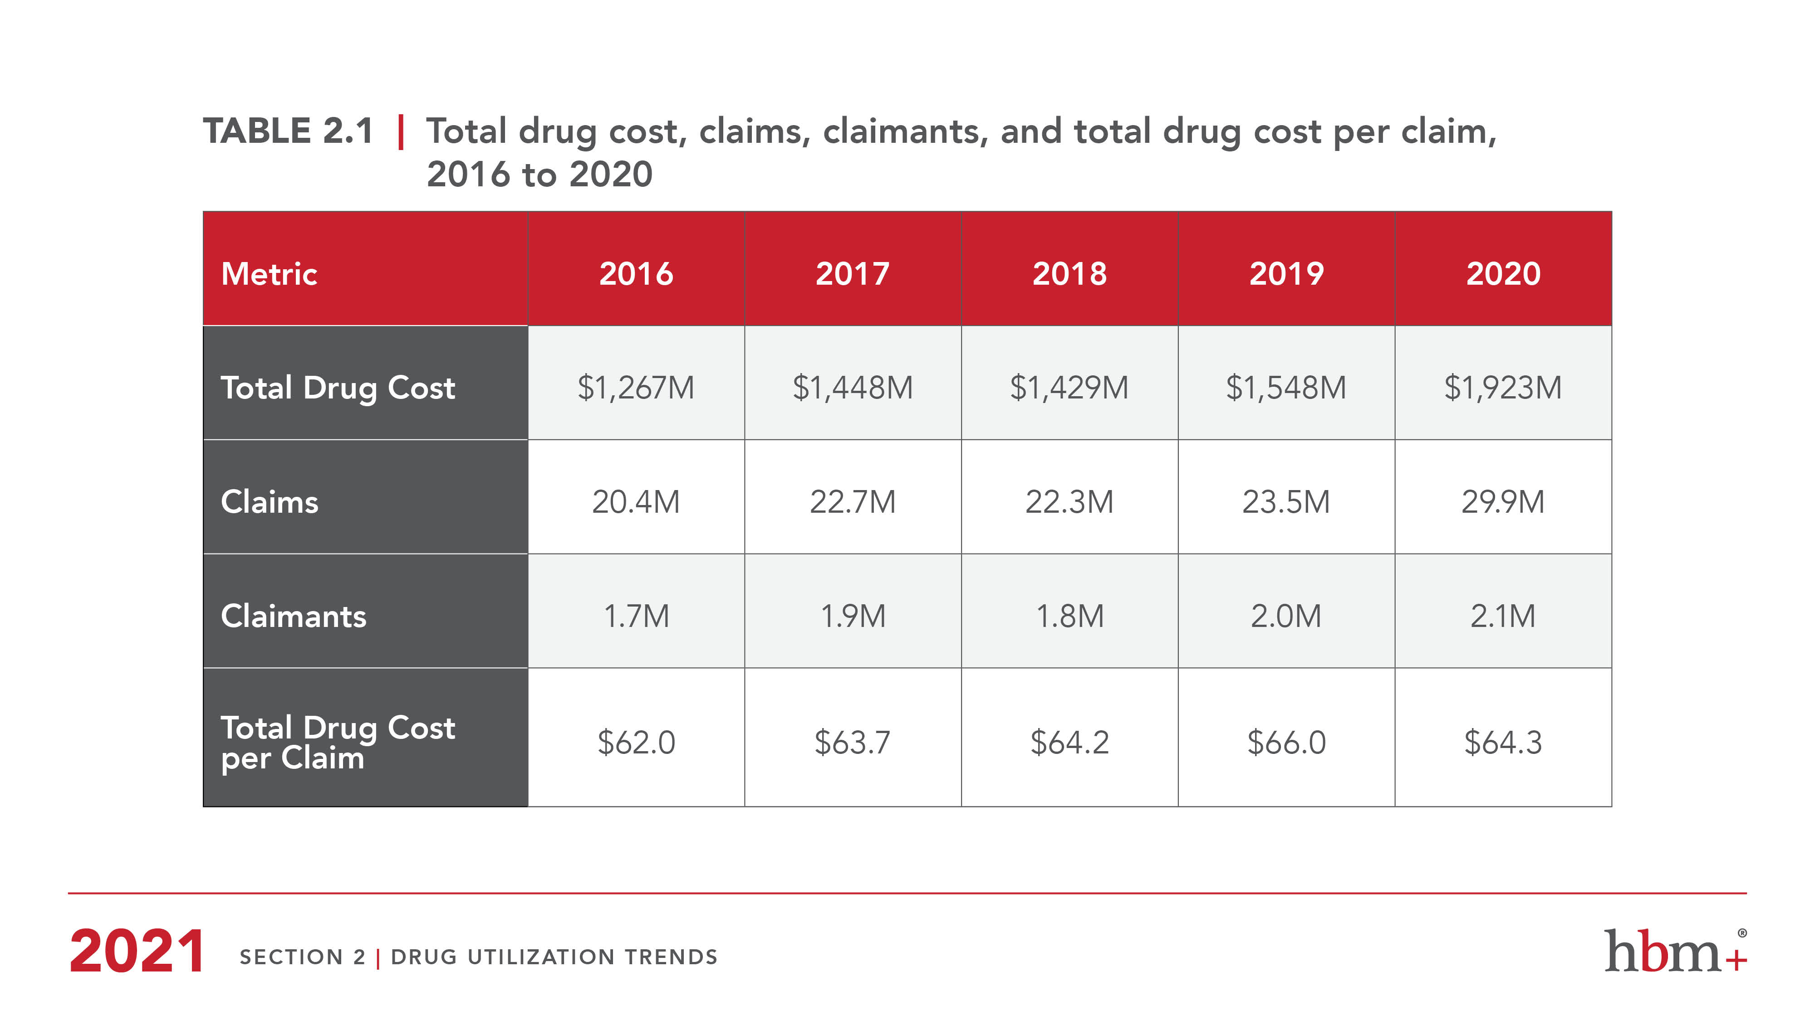

Slide 24
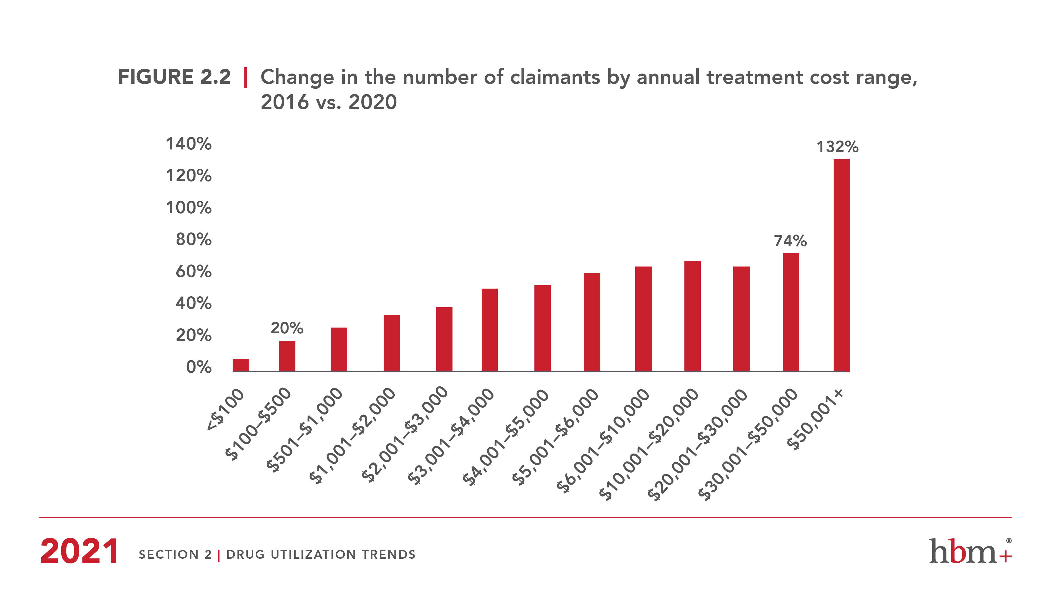

Slide 25
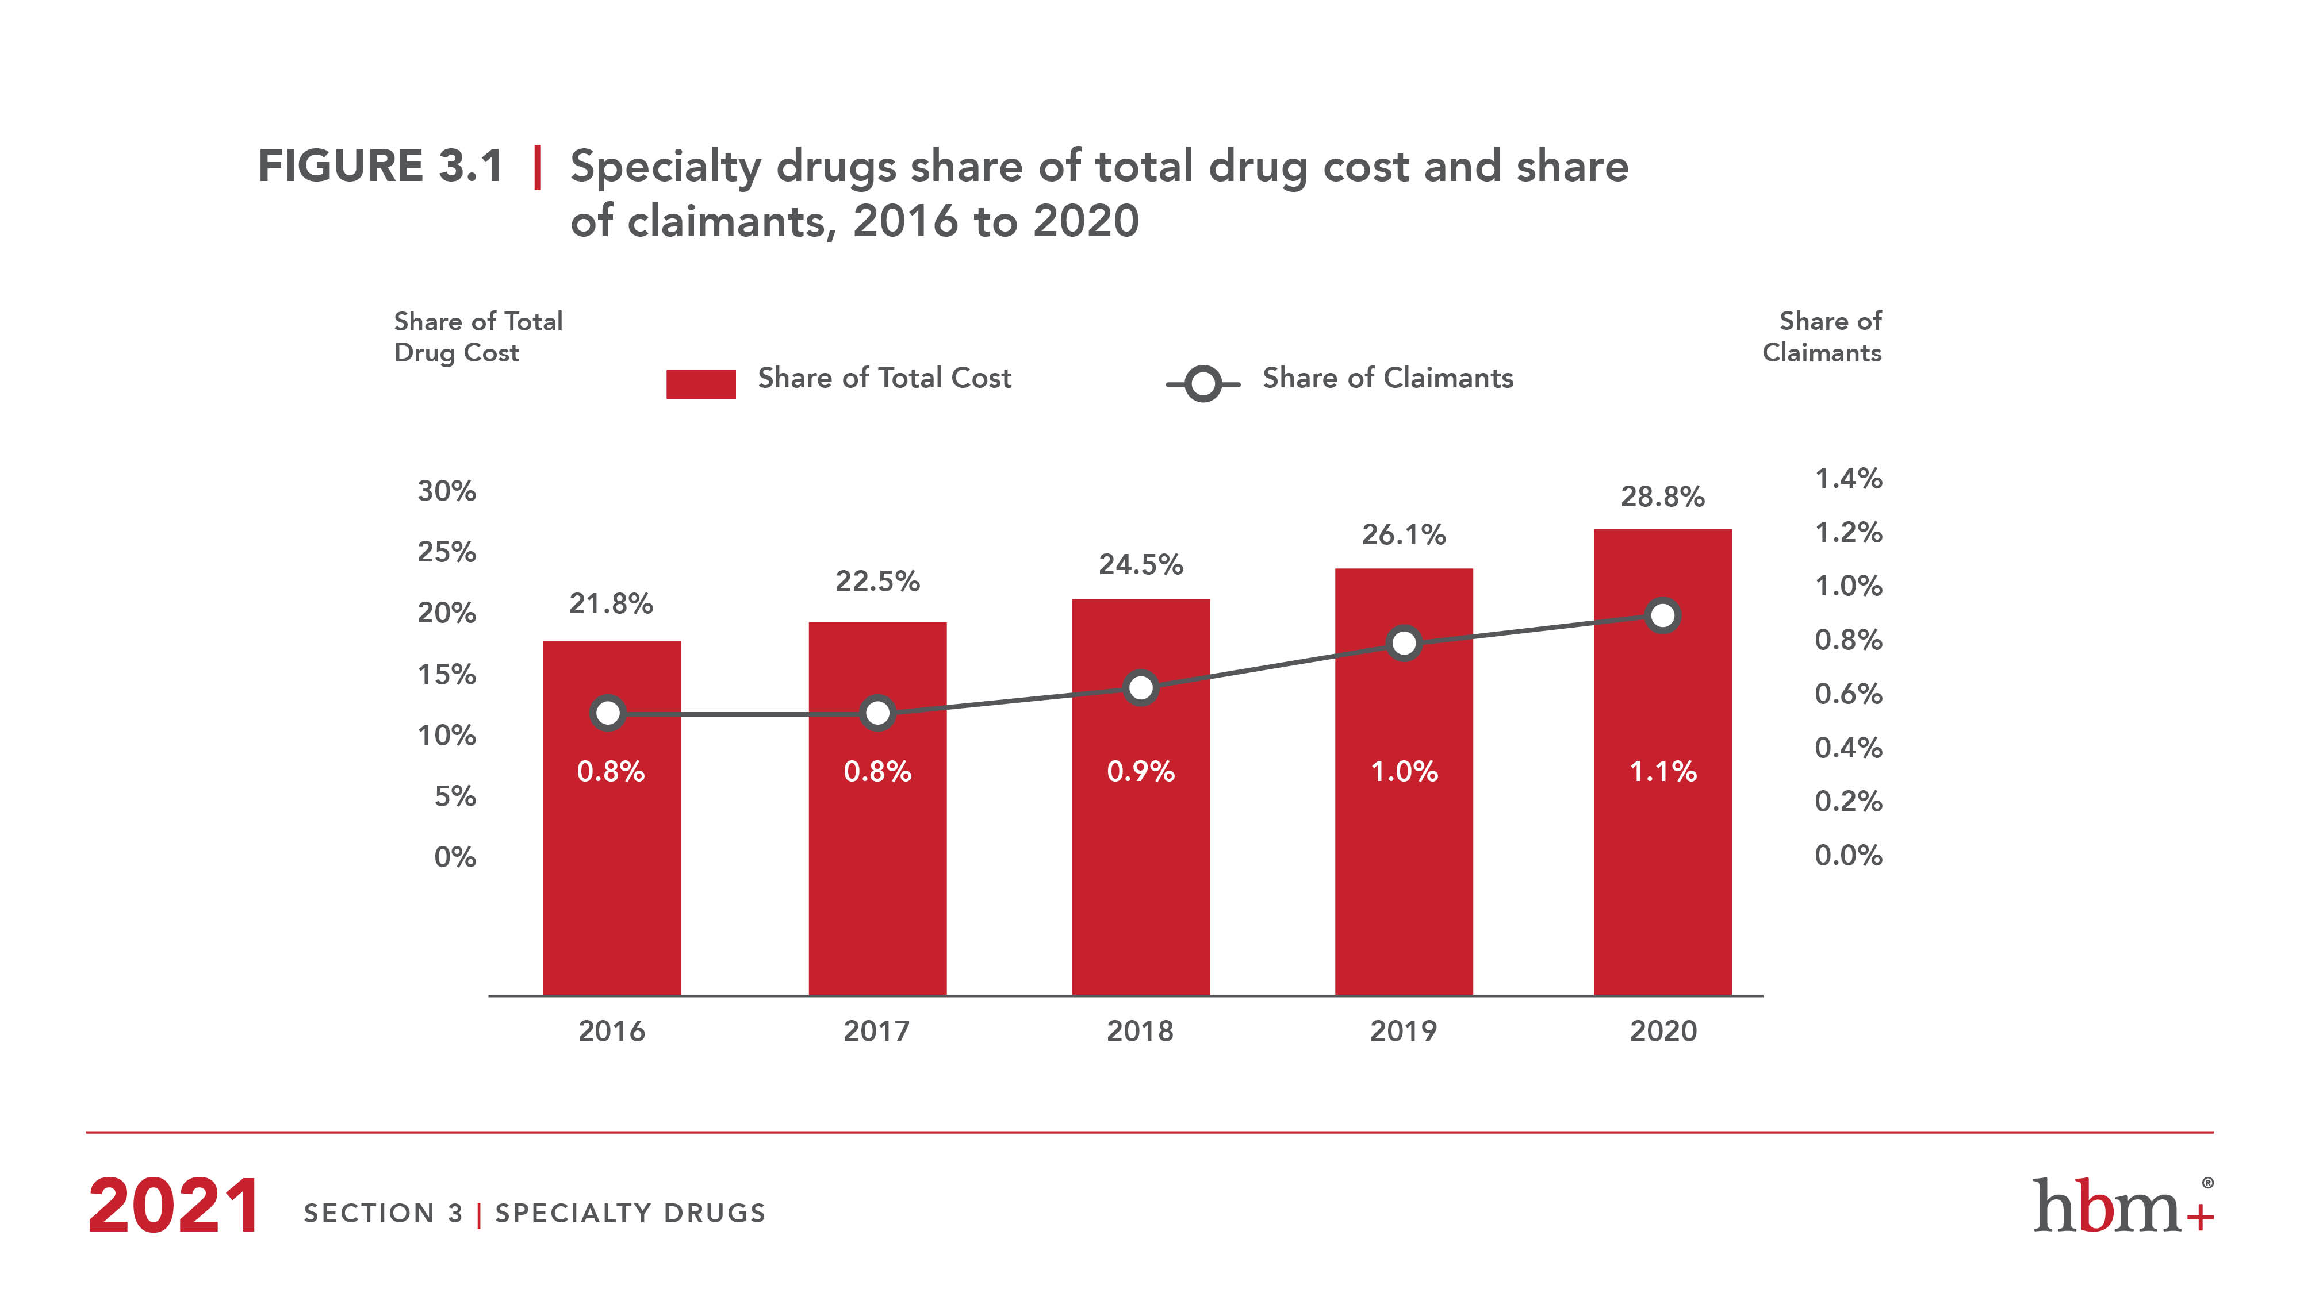

Slide 26
The Role of RWE at GSC/HBM+
Drug review and listing process
Safety data
Efficacy data (including comparison to existing therapies)
Cost
Real world evidence (safety, efficacy and cost)
Ongoing formulary management
Actual cost and utilization relative to projection
Issues with adherence or overutilization
Off-label usage
Expansion of coverage criteria

Slide 27
RWE and Product Listing Agreements
Growing momentum in the United States (US) and other jurisdictions towards outcome-based agreements as health care systems move to a pay-for-performance model
Perceived as a mechanism to ensure greater accountability and risk sharing between health plans and manufacturers
Manufacturers often tend to enter into agreements post other unsuccessful listing strategies
Sixteen risk-sharing contracts announced publicly in the US between 2015 and 2017
Examples:
Gilead and Cigna for Harvoni
Amgen and Harvard Pilgrim for Repatha
Novartis and Aetna for Entresto
Novartis and Cigna for Entresto

Slide 28
Outcome-Based PLAs – Repatha Example
Agreement based on Repatha, a PCSK9 inhibitor that significantly lowers LDL cholesterol
Amgen will refund the full cost of treatment for all eligible patients who suffer a heart attack or a stroke when taking Repatha
Patients should adhere to Repatha regimen for at least 6 months before a cardiac event occurs in order to be eligible in outcomes calculations
Amgen refund includes any out-of-pocket costs a member has paid for Repatha
Harvard Pilgrim to “refine their utilization management criteria to accelerate access for their high-risk patients”

Slide 29
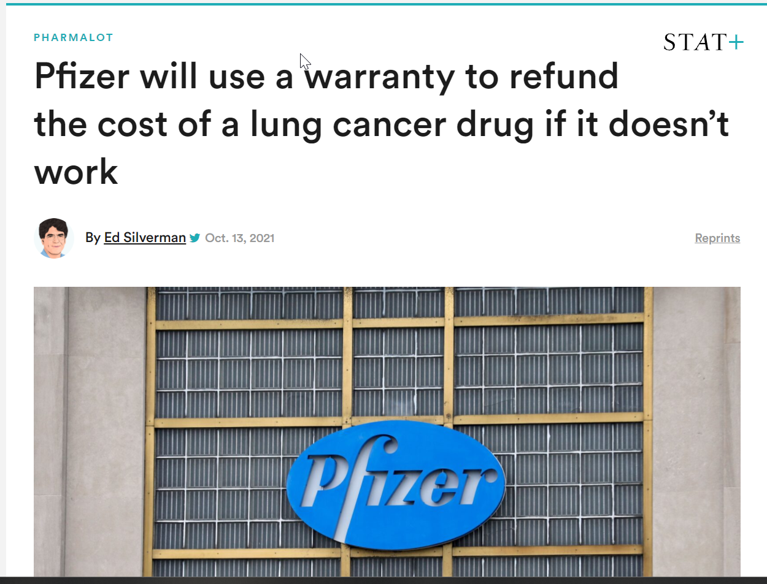

Slide 30

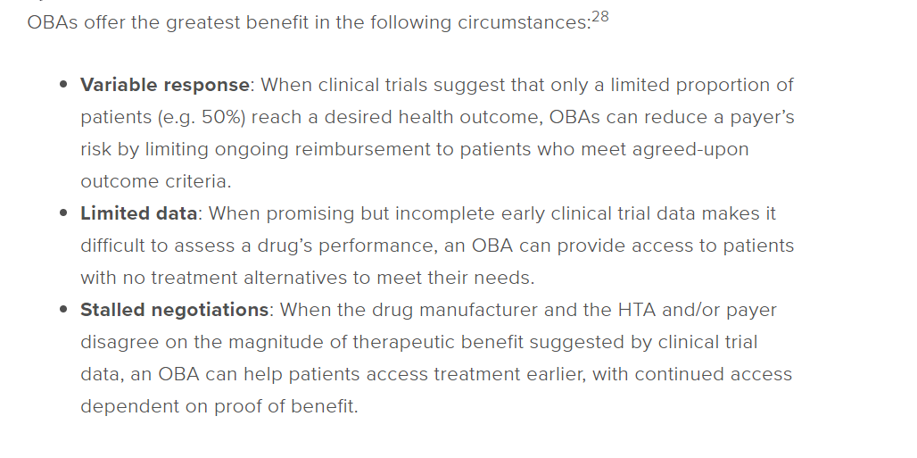
Outcome-Based Agreements

Slide 31
RWE and PLAs - Challenges
Availability/accessibility of data for outcome measurement
Agreement as to relevant clinical outcomes and associated contractual challenges
Cost of administration of agreement and collection of data relative to potential savings
Both parties challenged to assess risk in absence of existing real world data
Lack of control over product prescribing/use
Plan member shifting between insurers

Slide 32
PLAs and RWE - Opportunities
Preferred pharmacy networks and associated case management / health management infrastructure well positioned for data collection and generation of RWE
Significant patient assistance program infrastructure; data collected needs standardization
Physicians already accustomed to prior authorization processes and subsequent re-approvals for high cost drugs
Potential for closer collaboration with public sector including data available through provincial repositories (e.g. ICES in Ontario)
Rare diseases and new emerging gene therapies present excellent opportunity for testing of concept – growing startup involvement in this space

Slide 33
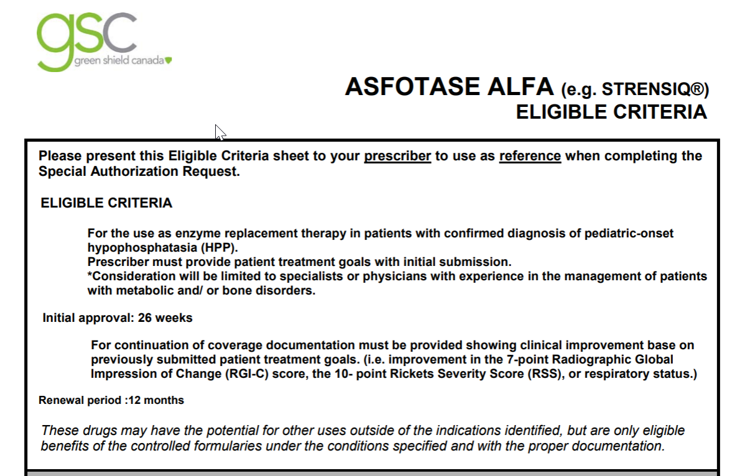
Rare Diseases and RWE

Slide 34


Slide 35
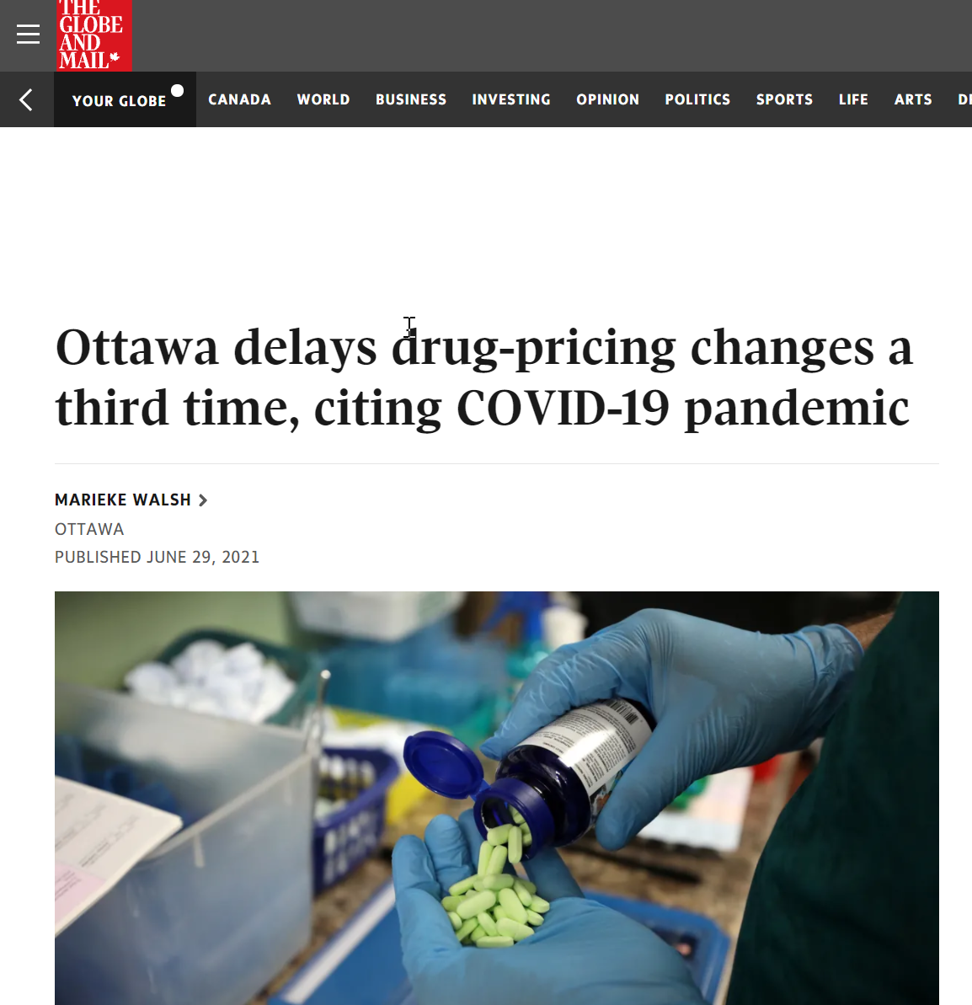

Slide 36
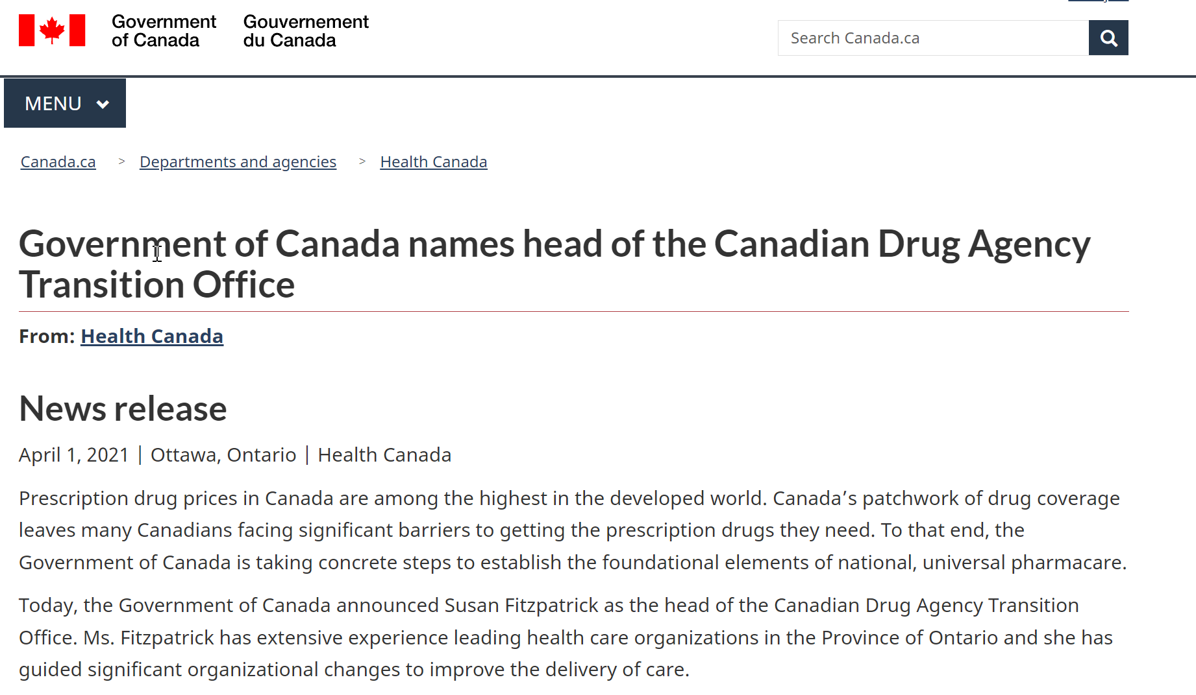

Slide 37
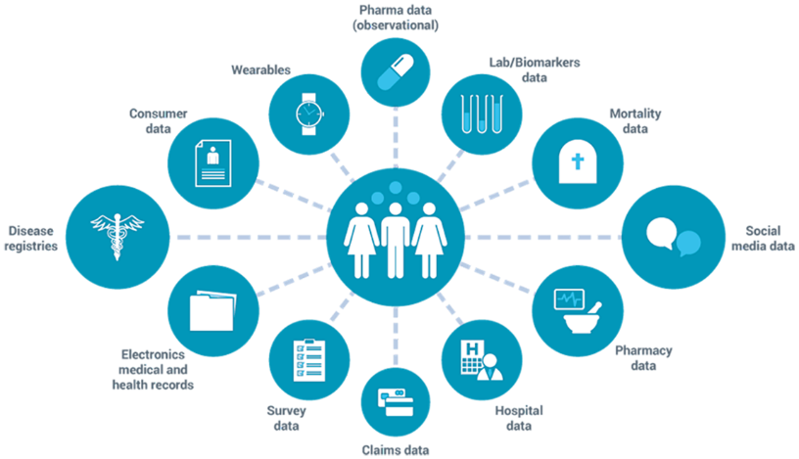
Real-world data (RWD) / real-world evidence (RWE) for Rare Disease Drugs
CAPT
Durhane Wong-Rieger
Canadian Organization for Rare Disorders
October 26, 2021

Slide 38
Rare Disease Strategy - Five-point Action Plan
Improving early detection and prevention,
Providing timely, equitable and evidence-informed care,
Enhancing community support,
Providing sustainable access to promising therapies and
Promoting innovative research

Slide 39
12-Steps to a National Rare Disease Framework
Patient empowerment: Empower patient organizations and patient advocates as active full partners
Creation of a Canadian Rare Drug Agency: independent, transparent, publicly accountable agency with responsibility for all aspects of the review of drugs for rare diseases, in coordination with Health Canada
Create R&D incentives: Invest in Research and Development to support therapeutic product accessibility, monitoring, and evaluation. Build capacity for drug discovery, technological innovation, manufacturing and production, and (global) distribution.
Speed up access to treatment: Ensure timely availability of new treatments by establishing a competitive and viable environment, including supportive mechanisms for clinical trials, early access programs, clinical site development, patient registries, and patient support programs

Slide 40
12-Steps to a National Rare Disease Framework
Address regulatory barriers: Ensure PMPRB guidelines do not exceed a “reasonable” threshold of fairness compared to comparable countries; roll back 2019 PMPRB regulatory changes by removing use of economic factors
Improve regulatory approvals process: Ensure Health Canada continues to update its regulatory process to encourage clinical trial and new drug submissions for rare disease drugs
Ensure pathways for special cases: For urgent need, timely access provided through Special Access Program (SAP) prior to Health Canada approval; create pathway through Early Access Programs.
Need for multiple funding options: Multiple separate pathways based on population size, disease severity, unmet need, evidence uncertainty, potential therapeutic value, budget impact, annual unit price, and industry

Slide 41
12-Steps to a National Rare Disease Framework
Leverage Managed Access Programs (MAPs): For drugs receiving an NOC-C where there is uncertainty about the evidence at the time of approval but where the unmet needs and benefits outweigh the risks.
Facilitate concurrent Health Canada and HTA reviews: Joint Health Canada and HTA application (where appropriate)
Support real-world evidence generation: Be responsible for real-world monitoring, data collection, evaluating benefits, risks, and uncertainty
Enhance centres of clinical expertise: Partner in developing Networked Centres of Expertise for specific rare diseases related to management of a therapy.

Slide 42
What are Real-World Data
Where Do Real-World Data Come From?
FDA: Real-world data are the data relating to patient health status and/or the delivery of health care routinely collected from a variety of sources, for example:
Electronic health records (EHRs)
Community care, social, and occupational care records
Product and disease registries
Patient-generated data including in home-use settings
Data gathered from other sources that can inform on health status, such as mobile devices
Examples of RWD
Electronic medical records
Patient registries
Wearables
Billing/claims data
Surveys
Social media

Slide 43
What is Real-World Evidence?
Definition:
“Real-world evidence is the clinical evidence regarding the usage and potential benefits or risks of a medical product derived from analysis of RWD.” ¹
1https://www.fda.gov/science-research/science-and-research-special-topics/real-world-evidence
RWD
RWD combined into a research database
Analyzed according to a research protocol
RWE

Slide 44
RWE and Managed Access to Therapy
RWE provides answers to questions about impact of therapy in controlled and real world settings:
Disease Status Pre-Clinical
Regulatory, RW Access & Usage
Natural History Treatment Needs
Clinical and Expanded Studies
RW Monitoring
RTCs, Non-controlled, Managed Access
Value-Based Assessment
Controlled population
Real-world population
RWE
RWE
RWE
Burden of Disease
Unmet need
Quality of life
Treatment landscape
Regulatory Approval & HTA strategy
Relative efficacy
Cost-effectiveness
Budget impact
Value proposition
Place in therapy
HTA/scientific advice
Real-world safety and effectiveness
Treatment patterns
Resource use and costs
Quality of life
Patient and physician preferences

Slide 45
Panel Session

